Slide 1


Fall Business Meeting
September 18, 2025
Steve Lommel
agInnovation Chair
Notes:
Thank you all for joining us today for the fall agInnovation business meeting.

Slide 2
Time | Item # | Topic | Presenter | Action Requested
8:30 am | 1.0 | Chair’s Welcome Approval of the agenda Approval of 7/15/25 meeting minutes NRSP vote outcome Honoring agInnovation Colleagues | Steve Lommel | None Approval by Acclamation Approval by Acclamation For information For information
8:40 am | 2.0 | FANR Update | Doug Steele | For information
8:50 am | 3.0 | MAHA – Research Opportunities? | Elizabeth Stulberg | For information
9:00 am | 4.0 | STC Awards Proposal | Nathan Slaton | Straw vote
9:10 am | 5.0 | TD Wealth Investment Account | Rick Rhodes | For information
9:20 am | 6.0 | CY2026 Budget Recommendations | George Smith | For information
9:40 am | 7.0 | Pursue Effective Collaborations: 1862 and 1890 Research Insights | John Green | For information
10:00 am – Break
10:15 am | 8.0 | Chair Reflections | Steve Lommel | For information
10:30 am | 9.0 | Incoming Chair’s Initiatives | Chandra Reddy | Discussion
10:45 am | 10.0 | agInnovation Chair-elect vote and 2026 meeting announcement | Steve Lommel | Vote
10:50 am | 11.0 | Welcoming New agInnovation Leadership: Chandra Reddy, agInnovation Chair | Steve Lommel | For information
11:00 am - Adjourn
Notes:
We have full agenda today with the first half focusing on updates and committee issues and the second half on the transition of the agInnovation chair. The agenda and minutes from the July 15 summer business meeting were sent on September 8.
Housekeeping business items (agenda and minutes approval)
Review/Approve Agenda
Briefly review the agenda
Any additions or discussion of the agenda?
Any objections to the approval to the agenda? If none, approve by acclamation (unanimous consent)
Review/Approve Minutes from July 15, 2025 agInnovation Summer Business Meeting
Any additions or edits to the minutes?
Any objections to the approval of the minutes? If none, approve by acclamation

Slide 3

NRSP Vote Recap
NRSP4 Facilitating Registration of Pest Management Technology for Specialty Crops and Specialty Uses
Recommendation: renew with a budget of $409,005 per year
agInnovation Vote: approved the recommendation (36 approve, 4 do not approve)
NRSP9 National Animal Nutrition Program
Recommendation: renew with the proposed budget
agInnovation vote: approved the recommendation (39 approve, 1 do not approve)
NRSP_temp13 Artificial Intelligence for Agricultural Autonomy
Recommendation: fund NRSP_tem13 with the proposed budget
agInnovation vote: approved the recommendation (38 approve, 2 do not approve)
Notes:
Recall at the summer meeting, I presented a summary of the discussion and recommendations made by the NRSP RC in Kansas City May 19-20.
A vote on the three NRSP RC recommendations conducted by email was completed on July 31 (40 voting members voted)
All three of the NRSP projects were approved by the membership.
NRSP approvals were completed in August and OTT submitted to NIFA on September 3
An agenda brief has more detailed information about the NRSP RC recommendations

Slide 4


Honoring Those Who Served
Retirements, New Positions, New Directors
Notes:
I’d like to take a few minutes to recognize folks who have served agInnovation and have either retired or taken different positions within our system.
Please refer to the agenda brief for the complete listing, including the names and institutions of 44 new directors

Slide 5
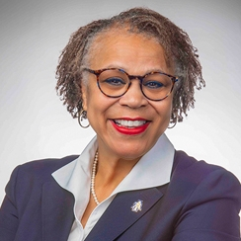
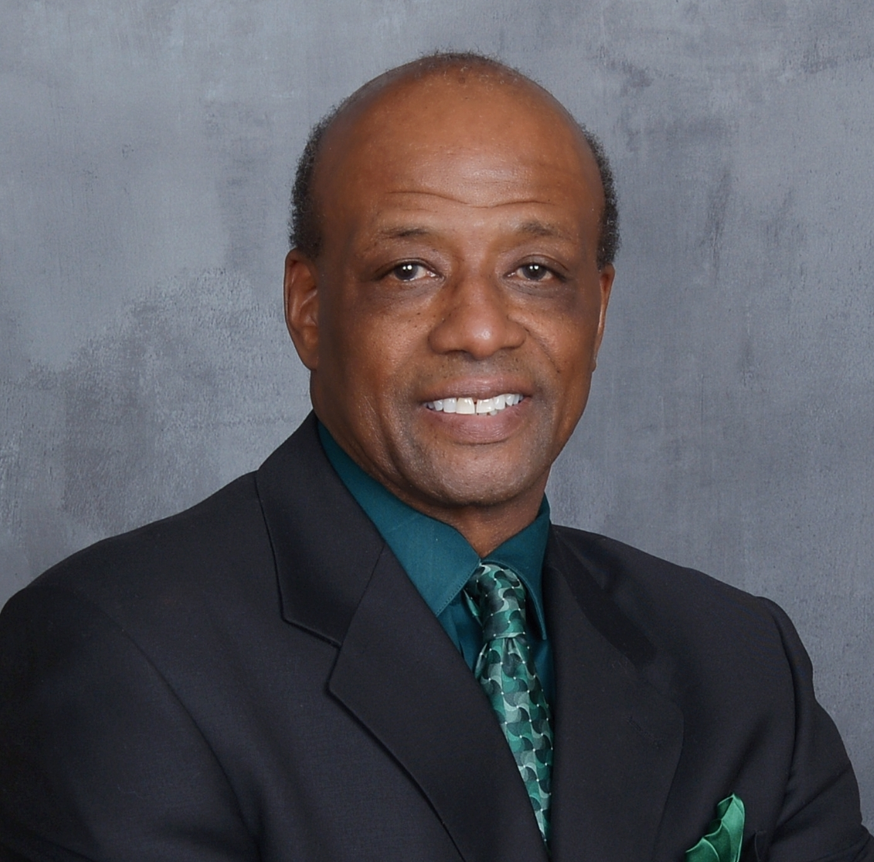
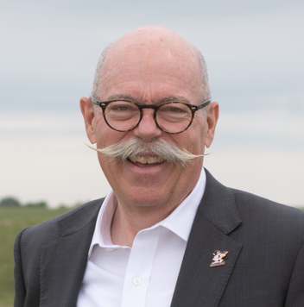
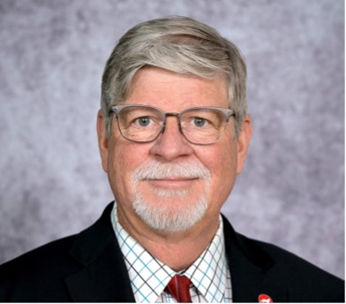
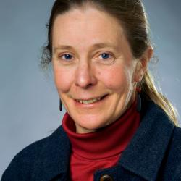
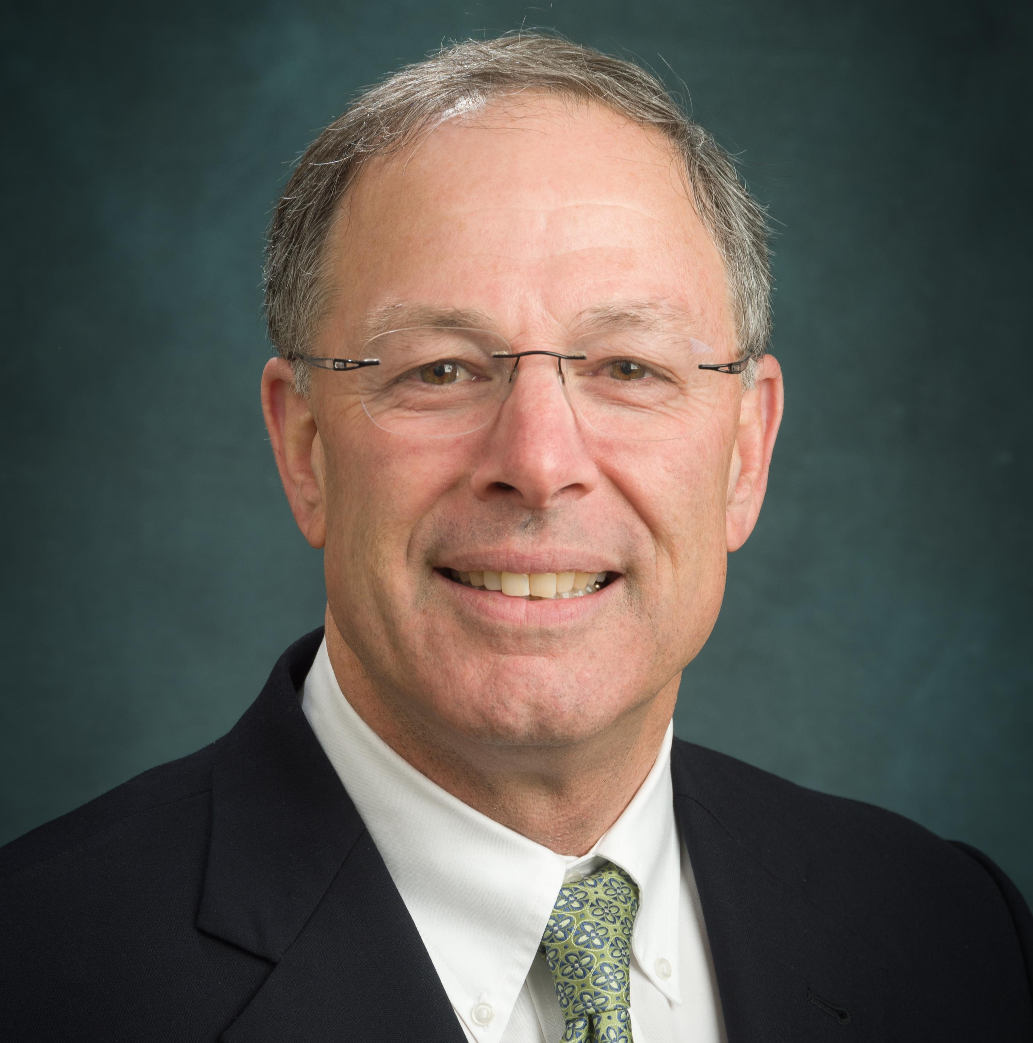
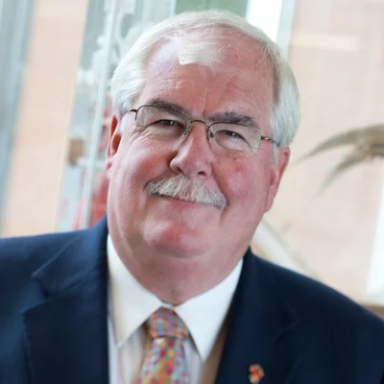
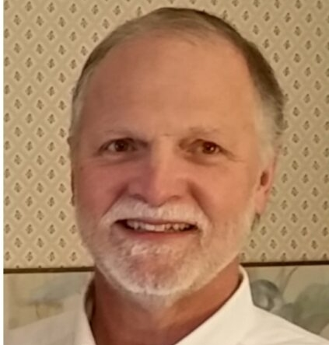
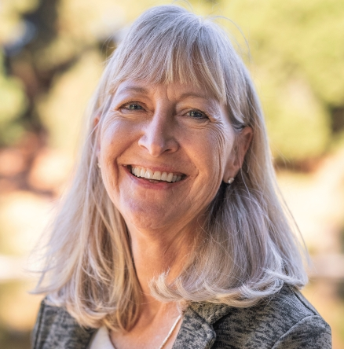
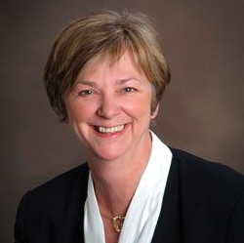
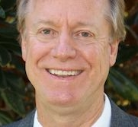
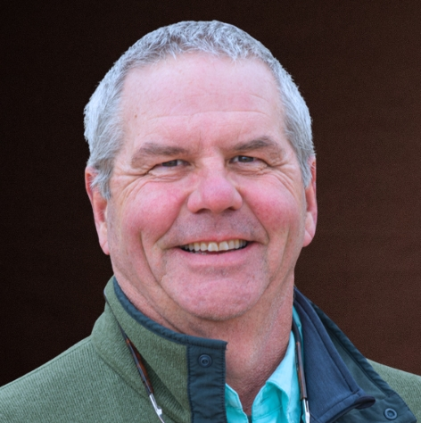
Shirley Hymon-Parker
NC A&T State University
Vernon Jones
Langston University
Ernie Minton
Kansas State University
Steve Lommel
NC State University
Margaret Smith
Cornell University
Craig Beyrouty
University of Maryland
John Kirby
University of Rhode Island
George Criner
University of Maine
Anita Oberbauer
UC-Davis
Jan Leach
Colorado State University
Walter Bowen
University of Hawai’i
Eric Webster
University of Wyoming
Notes:
This slide is in recognition of the 12 retirees who have made significant contributions to agricultural research and the Experiment Station System

Slide 6

Accepted New Positions
Douglas D. LaVergne Associate Vice President for Academic Affairs, Alabama A&M University
Robert Corley III Senior Advisor to the President, Virginia State University
Derrick C. Scott Provost and Vice President for Academic Affairs, Fort Valley University
Johnnie Westbrook Dean, College of Agriculture, Environmental and Human Sciences, Lincoln University
Kang Xia Associate Director of MSU AgBioResearch, Michigan State University
Michael Toews Associate Dean for Extension, University of Georgia
David Monks Associate Dean & Director of Extension/Vice Provost for Outreach and Engagement, NC State
Indrajeet Chaubey Provost, University of Arkansas
Wendie Cohick Vice Provost for Research, Rutgers University
Blair Siegfried Professor of Entomology, Penn State University
Shane Burgess Professor, College of Agriculture and Life Sciences, University of Arizona
Greg Cuomo Director, Ag and Biotech Initiatives, Research & Innovation Office, University of Minnesota
Leslie Edgar Dean, College of Agricultural and Life Sciences, University of Idaho
Wendy Powers Dean and Director, College of Agriculture and Natural Resources, University of Maryland
Ken White Professor, Animal, Dairy and Veterinary Sciences, Utah State University
Notes:
In addition, 15 directors have accepted new positions outside of the Experiment Station System or moved to a new university (current positions are listed)

Slide 7



THANK YOU
Notes:
Let’s give a round of applause in recognition of the contributions by all who have served agInnovation

Slide 8
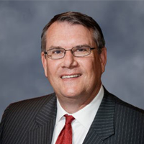
FANR Update
Doug Steele
Vice President, Food Agriculture, & Natural Resources, APLU
Notes:
Introduce Doug Steele, VP FANR for the FANR update

Slide 9

Office of Food, Agriculture and Natural Resources (FANR)
Douglas L Steele, PhD.
Vice President, Food, Agriculture and Natural Resources
Association of Public and Land-grant Universities
Suzette Robinson, Special Assistant

Slide 10
Academic Programs Section
Wendy Fink, Executive Director APS and Associate VP FANR
Sophia Baker, Associate

Slide 11
AgNGINE - Agriculture National Graduate Institutional Name Exchange
Purpose: Enhance graduate student recruitment through shared data
Sponsors: agInnovation and Academic Programs Section
Status: Year 3 of 3-year proposal
Notes:
On participating campuses, domestic U.S. students (juniors, seniors, and masters) can input their information (demographic and desired degree/discipline) from April through early September. In October, participating campuses can download the information to use for their graduate school recruitment efforts.
As of May 28, we have 51 institutions participating this year, so it is likely we will see increased numbers of student participation for 2025.
Wendy Fink and Dr. Elaine Turner of UFL are pursuing grants to fund this for another year or more beginning in 2026. If they are unsuccessful, this will likely move to a membership based initiative.

Slide 12
Recruitment Initiative
Science Societies, Universities, Industry, Government, and Agricultural NGOs pulling together to create a national recruitment effort for the food, agricultural, and natural resources sciences.
Three-part initiative
Form an organization that can champion this effort
Conduct a landscape analysis of: the actual needs in various disciplines (how many needed and at what level of education); understanding what attracts students into these fields and what barriers exist for students to pursue education in these areas.
Recruitment campaign that would attract student, parent, and advisor attention to these general fields and then direct them to campaigns specific to institutions or disciplines.
Timeline – starting launch of organization formation and landscape analysis now. Hope to have this up and running in a year or year and a half.
Notes:
Agriculture, Natural Resources, and Food-related disciplines make up a small amount of the overall disciplines studied in the US, and we compete with other STEM fields that are far better funded. No single discipline has the resources to carry out a large campaign on its own to try to reach an extra 20k or 50k students a year to attract them into our sciences. This effort would hopefully create a much visible message than any one group working alone. In the end, it will still point students back to all the individual disciplines and institutions’ recruitment campaigns. Think of social media posts that might read “Your Planet is on the Line…Answer the Call?” or “Human Hunger is on the Line…Answer the Call?” or “Human Existence is on the Line…Answer the Call?” Those are fake examples of a potential recruitment campaign that could be developed to capture student, parent, or advisor attention.

Slide 13

Board on Health and Human Sciences Kelly Dalton, Executive Director BHHS Susan Thomas, Senior Associate

Slide 14
Board on Health and Human Sciences
BHHS Vision: Holistically advance human development, health, and economic vitality to achieve a healthy, resilient, equitable, and sustainable world.
BHHS is reimagining the role of health and human sciences within the broader public and land-grant mission. Our work intersects directly with agriculture through nutrition, family and community wellbeing, and workforce development.
Regional Strategy launched in 2024 to better position our institutions as responsive, community-embedded, and policy-relevant.
Notes:
BHHS is one of five boards under the APLU Commission on Food, Environment, and Renewable Resources
We have 41 member institutions from public and land-grant universities across the United States
BHHS is reimagining the role of health and human sciences within the broader public and land-grant mission. Our work intersects directly with agriculture through nutrition, family and community wellbeing, and workforce development.
Our Regional Strategy, launched in 2024, is not just about engagement—it’s a strategic move to better position our institutions as responsive, community-embedded, and policy-relevant. We launched our first virtual regional meetings this year and have so far engaged with 27 institutions, including public, land-grant, and 1890s.
This is particularly important now – given the evolving political landscape, which we believe presents many opportunities to connect agriculture, health, and human sciences together to address the most pressing issues our nation is facing.

Slide 15
MAHA Report
The recently released Making Our Children Healthy Again (Assessment) outlines the Administration’s perspective on rising rates of chronic disease in American children and proposes a shift in national priorities toward prevention, food systems, and environmental health.
The MAHA report outlines four primary root causes:
Poor Diet: Widespread consumption of ultra-processed foods and limited access to whole, nutrient-rich options.
Environmental Chemicals: Exposure to substances such as pesticides, microplastics, and industrial chemicals.
Physical Inactivity and Chronic Stress: Trends in sedentary behavior and increasing psychosocial stress among children and adolescents.
Overmedication: Rising use of pharmaceuticals to address chronic and behavioral health conditions in children.
Notes:
For example, the BHHS and BAA are uniquely positioned to lead in defining what a healthier future for America’s children looks like, and how our institutions will get us there.
The recently released Making Our Children Healthy Again (Assessment) outlines the Administration’s perspective on rising rates of chronic disease in American children and proposes a shift in national priorities toward prevention, food systems, and environmental health.
The MAHA report reinforces the values that already define our institutions: prevention, systems thinking, interdisciplinary collaboration, and community-rooted solutions. We are well-positioned to lead this national pivot, but we must do so together strategically.

Slide 16
Cooperative Extension & ECOP Bill Hoffman, Executive Director, Assistant VP FANR Maria Marzullo, Senior Associate

Slide 17
Cooperative Extension & ECOP
SNAP-Education Reconciliation Process
Keeping Extension Section Informed on DC Happenings
Working Together to Increase the Prominence of AI (Youth & Adult)
Opportunities Ahead to “Make America Healthy Again”
Continuing Work with Centers for Disease Control (Small Flock Survey)
2025-2035 Roadmap with agInnovation
Defend and Grow Capacity Funding

Slide 18
Council for Agricultural Research, Extension, and Teaching Marcus Glassman, Executive Director and Director Government Affairs, Agriculture and International Development Flannery Bethel, Manager CARET

Slide 19

CARET
CARET’s annual meeting hosted more than 300 attendees in Washington, DC in February, with delegates attending from coast-to-cost and U.S. territories; House and Senate leadership as well as representatives from the new Trump administration joined as well
CARET delegates received warm welcomes from their Congressional delegations, and canvassed Capitol Hill sharing the value of capacity funding and the BAA’s unified FY26 appropriations asks
House Majority Chairman G.T. Thompson was among those who welcomed CARET to Capitol Hill
In May, the Southern CARET Region elected Rodd Mosel to serve as national secretary
Planning is underway for the 2026 Washington DC conference and Save the Date notices have been sent out across the system.

Slide 20
CGA Agriculture Teams
APLU’s Council on Governmental Affairs, or CGA, is a coordinated working group comprised of the government relations professionals and lobbyists representing APLU’s member institutions
On Agriculture, the CGA has two teams: one focused on agricultural appropriations, and another focused on agricultural authorizations.
The CGA Agriculture Teams are among our frontline outreach teams in promoting the BAA unified appropriations ask on Capitol Hill
The Teams have additionally worked in tandem with the BAA on reconciliation, the Farm Bill, and FY26 appropriations
Marker bills were introduced this week in the House and Senate calling for $2.5 billion and $5 billion, respectively for the Research Facilities Act
House reconciliation bill language provides $1.25 billion for Research Facilities Act

Slide 21
Communications & Marketing Committee
Andrea Putman, Assistant VP FANR
Kim Scotto, Manager

Slide 22
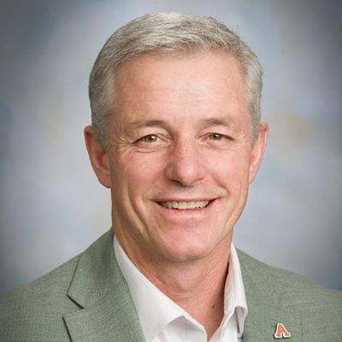
Communications & Marketing Committee - Voting Members
Incoming Chair: James Pritchett, Colorado State University
Regional Communications Representatives Jennifer Alexander, Oregon State University Latasha Ford, Fort Valley State University Michelle Enger, University of Missouri Frankie Gould, Louisiana State University Stacey Stearns, University of Connecticut
Academic Programs Section: Dan Moser, Kansas State University
Council on Governmental Affairs: Anne Megaro, University of California
Association for Communication Excellence: John Hawley, Montana State University
Notes:
Incoming Chair:
James Pritchett
Vice President for Engagement and Extension
Colorado State University
The CMC, a standing committee of APLU’s Board on Agriculture Assembly (BAA) Policy Board of Directors, oversees and guides the educational effort to increase awareness of the land-grant universities’ research, Education, and Cooperative Extension.

Slide 23

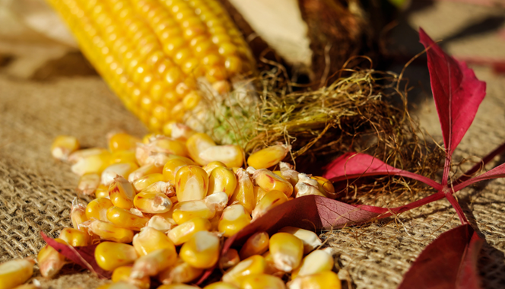
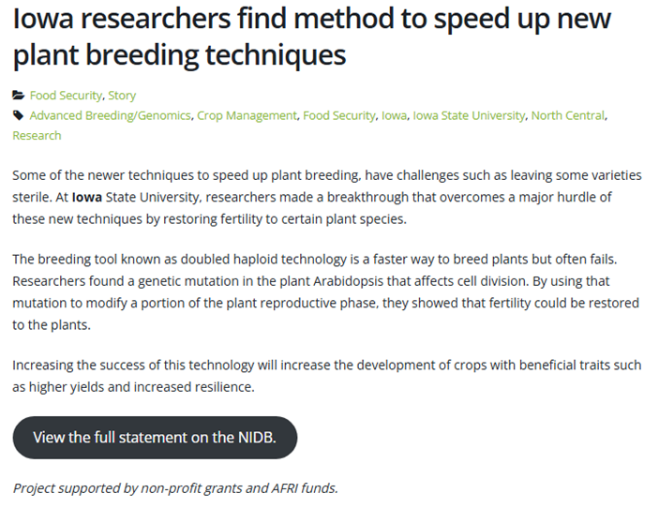
National Land-Grant Impacts Database (NIDB)
Notes:
In October 2023, the APLU Board on Agriculture Assembly began administering National Land Grant Impacts Database (NIDB), the nation’s most extensive repository of the land-grant system’s collective impacts statements in research, education, and Extension. It serves as a comprehensive and important resource for the land-grant system to tell their stories.
Kim Scotto manages and oversees the NIDB. Due to Kim as well as NIDB Co-Chairs (Frankie Gould and Sara Delheimer) and NIDB Communication Team’s efforts:
Major upgrades that improve site functionality, accessibility, and visual appeal.
NIDB comms team expanded to include 24 total members with equal representation from each region.
Team produced 121 impact stories and summaries in preparation for 2025 CARET BAA Washington conference.
Traffic to the WordPress site has increased 186% from Jan 1-May 19 2024 vs. 2025.
45% increase in total number of impact statements submitted in 2024 vs. 2023 (623 à 903)
33% increase in the number of units submitting impacts (72 vs. 96) from last year.

Slide 24
Positioning LGU’s For Long-Term Advocacy Success
Much of our work spans a huge breadth of significant subjects that do not change drastically year to year;
Our top-level federal funding priorities, i.e., advocacy asks, do need to be annually revised to address new funding opportunities and address research and programmatic priorities;
Creation of an advocacy message that remains true to our work but that is also flexible enough to support changing BAA advocacy goals and compelling enough to justify the significance of our impacts and goals;
Develop a unified document that no matter what our new goals or asks may be, our *message* stays consistent;
Identify and support the development of long-term federal funding priorities that can not be addressed in a single year's appropriation.

Slide 25

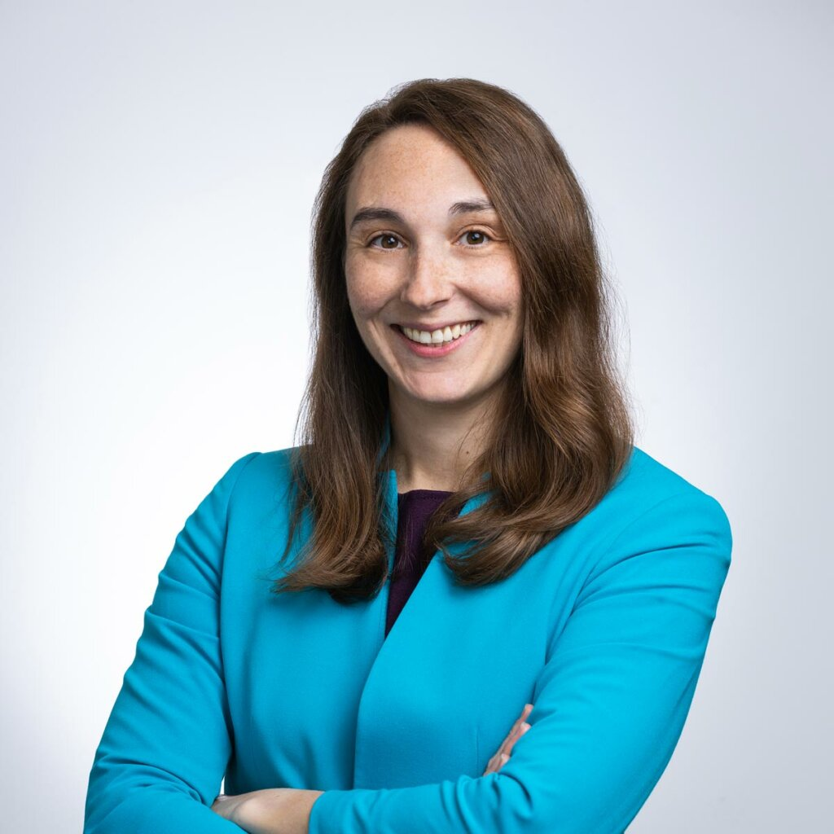
MAHA
Research Opportunities?
Elizabeth Stulberg
Principle, Lewis-Burke Associates
Notes:
Introduce Elizabeth Stulberg, LBA who will share her thoughts on potential research opportunities that align with MAHA

Slide 26

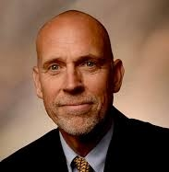
STC 2025 REPORT
2025 AGINNOVATION BUSINESS MEETING
Nathan Slaton

Slide 27


PROPOSED CHANGES TO AWARDS
Two New Categories for Excellence in Agricultural Research Innovation
Early Career Scientists
Mid-career Scientists
Assistant Professional Rank <5-6 years
Associate Professional Rank up to 10 years post-promotion

Slide 28
PROPOSED CHANGES TO AWARDS BUDGET
Current Award Expenses | Current Budget | New Award Expenses | Proposed Budget | Change in Budget
Regional winners cash | $2,500 | Regional winners cash | $7,500 | $5,000
National winner cash | $500 | National winners cash | $1,500 | $1,000
Silver-level AAAS Membership | $1,680 | Silver-level AAAS Memberships | $5,040 | $3,360
National winner plaque | $100 | National winners' plaques | $300 | $200
All winners travel | $12,500 | National winners' travel | $7,500 | ($5,000)
Totals | $17,280 |  | $21,840 | $4,560

Slide 29
PROPOSED CHANGES TO AWARDS SCORING METRICS
Rating Category/Subcategory |  | Original Weighting | Proposed Weighting
Demonstrated high impact of research, … |  | 50% | 60%
 | Relevance to one or more of the Grand Challenges | 20% | --*
 | Explain the translation, adoption, and/or impact (or potential impact on policy, environment, economic benefits, productivity and/or efficiency) … | 20% | 30%
 | Effective collaborations | 10% | 20%
 | Mentoring & development of students and other scientists |  | 10%
Recognized excellence in one’s field of expertise |  | 40% | 40%
 | Grant funding history including the nominee's specific role in each project (e.g., principal investigator, co-PI, collaborator) | -- | 15%
 | Publication record and invitations to publish | -- | 10%
 | Contributions as a scientific expert on panels or committees and invitations to present research at national and international conferences | -- | 10%
 | Recognition through professional awards and notable achievements | -- | 5%
Demonstration of cultural sensitivity and … inclusivity |  | 10% | --*

Slide 30


W525: Evaluation of Outcomes-Driven, Aspirational Goals to Achieve National Food Security
“Achieve national and local food security by producing 95% of our food domestically, increasing local and regional farm net incomes by 20%, and reducing food waste by 50%. “
Call to Action: Enlist experts to
validate the outcome goal
evaluate research strategies
demonstrate public value and ROI

Slide 31

THANK YOU
HTTPS://WWW.AGINNOVATION.INFO/

Slide 32

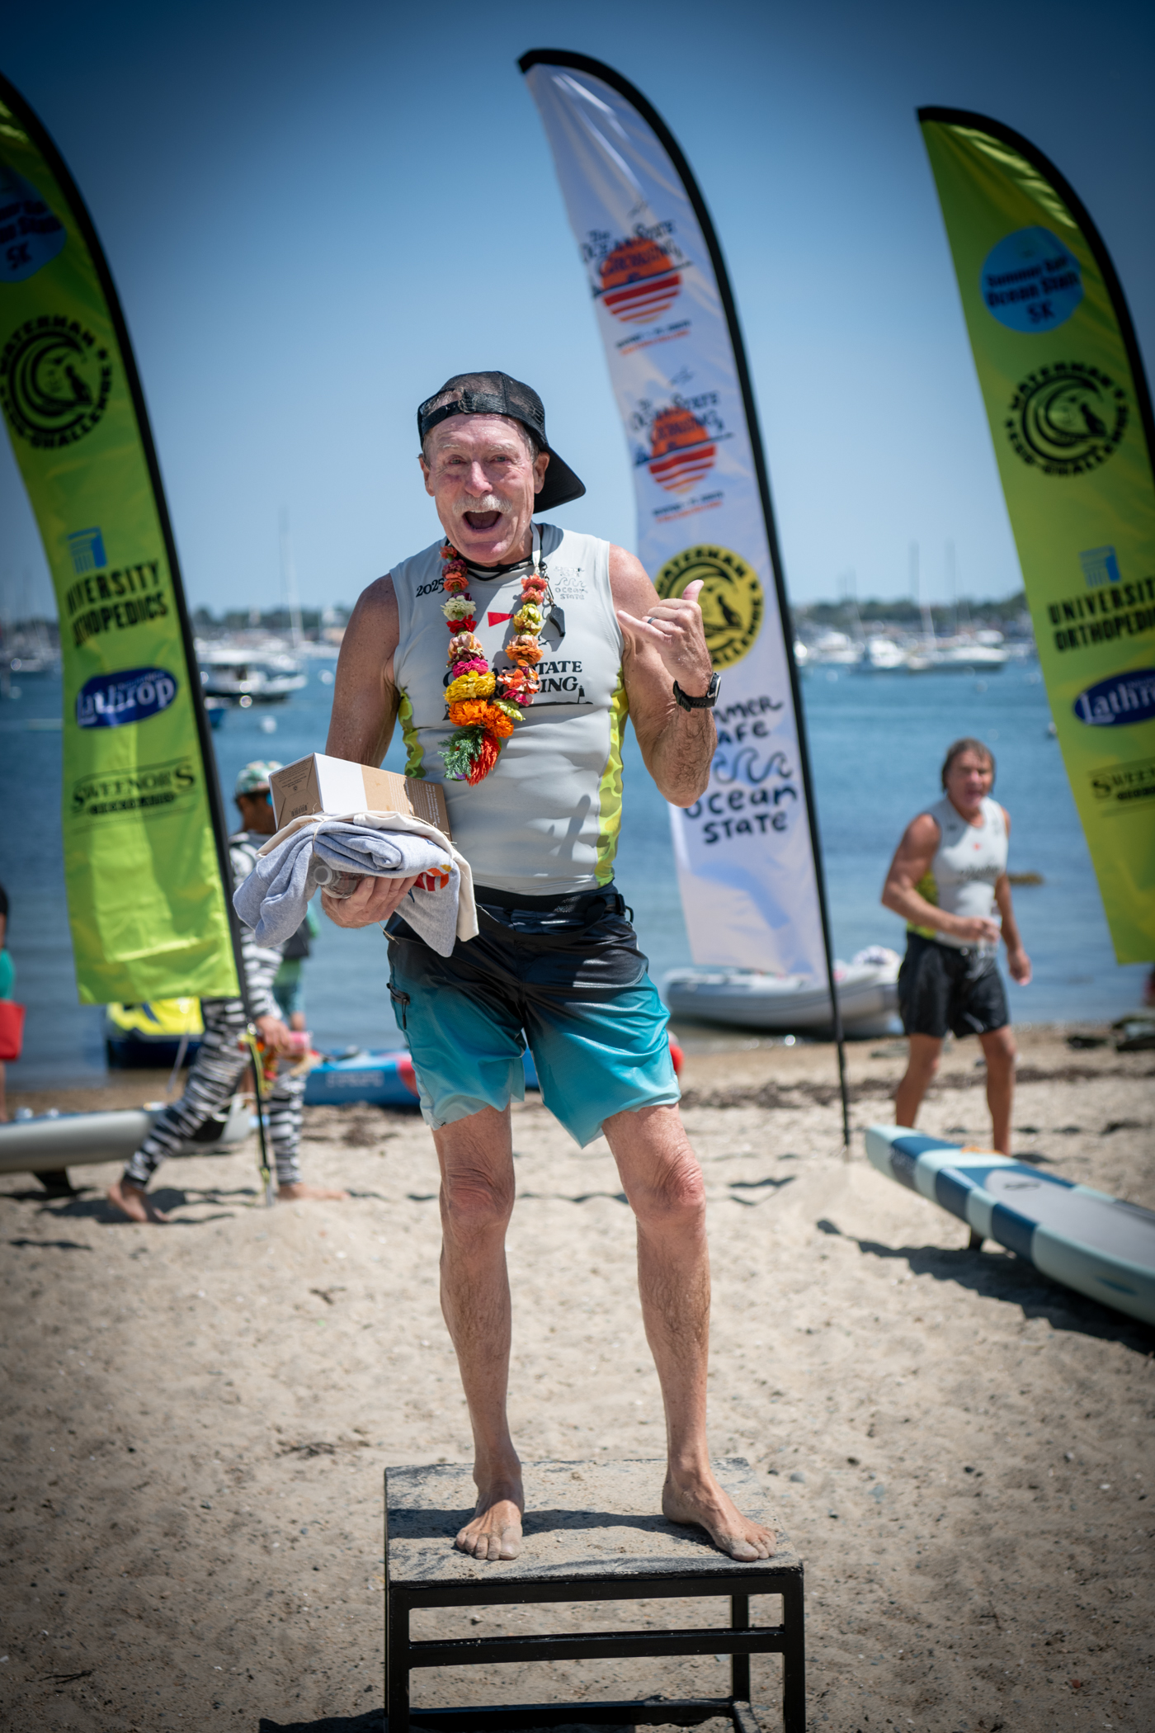
TD Wealth
Investment Account
Rick Rhodes

Slide 33

agInnovation Financial Primer
Finance Committee and agInnovation 501(c)(3) “manage” three accounts
5800 Account – held by the APLU
Chase for Business – held by 501(c)(3)
TD Wealth Account – held by the APLU
Funding sources (intent)
5800 Account – assessment (operating)
Chase for Business – transfers from 5800 (operating)
TD Wealth Account – carry forward from pre-2019 (endowment)

Slide 34
Endowment goals
agInnovation investment goals:
Seek 6% return
4% annual drawdown
Preserve corpus
Access to account assets

Slide 35
Current Challenges with TD Wealth
agInnovation is not a signatory of the TD Account
Cash liquidity and access to assets (turn around on withdrawal, up to a month)
Banking laws don’t allow transfer of funds from TD Wealth to Chase for Business
agInnovation management of account is limited
TD manages fund passively (moderately conservative)

Slide 36
What We’ve Done
Initiated conversations with Chase (the bank of the non-profit)
Chase (consumer and commercial banking subsid of JP Morgan Chase & Co) introduced us to JP Morgan (investment banking, corporate banking, asset management, and private banking services)
Non-profit engaged in several conversations with a JP Morgan advisor

Slide 37
Case for transferring assets: TD to JP Morgan
Key takeaways
Similar:
Fees: ~1.0%
Neither guarantees returns (Our goal: 6% with 4% annual drawdown)
Different:
Investment strategy
JP Morgan
Robust platform
Dynamic, active: guided by real time global research
Access to a wide range of asset classes
Dedicated trust and philanthropy services

Slide 38
Case for transferring assets: TD to JP Morgan
Different:
High touch relationship
JP Morgan
Dedicated relationship manager
Periodic strategy reviews and rebalancing
Ease of access
JP Morgan
agInnovation owns the account
3-day liquidity, single institution (JP Morgan Chase & Co)
Local support

Slide 39
Action Plan
Socialize idea
Internal with agInnovation 501(c)(3)
agInnovation Finance Committee
agInnovation Executive Committee/agInnovation standing committee chairs (BAA Summer Leadership Meeting)
APLU
agInnovation (2025 agInnovation/CES-NEDA Meeting)
agInnovation vote for approval
30-day notice
electronic referendum
Passes with 2/3 majority

Slide 40
CY2026 Budget Recommendations
Chandra Reddy

Slide 41
Governance and Approval Process
Gather input on budget and budget narrative
Send edited budget and budget narrative followed by a 30-day evaluation period
Electronic ballot
Assessment ($100,000) – needs 2/3 majority
Budget – simple majority

Slide 42
Income and Expenses
Income ($224,000)
Assessment: $100,000 (same as CY 2025)
Cash Carryover: ~$100,000 from CY 2025
TD Wealth Draw: $24,000 (4% annual draw)
Expenses ($192,000)
Projected balance ($32,000)

Slide 44
Summary
The CY 2026 budget
Maintains the assessment at $100,000
Introduces new and expanded lines to strengthen communications, professional development, promotion, and digital outreach
Eliminates completed initiatives
Leaves a modest $32,000 carryover balance

Slide 45
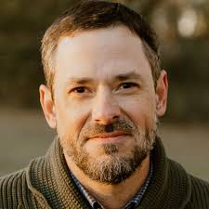
Pursue Effective Collaborations:
1862 and 1890 Research Insights
John Green
Director, Southern Rural Development Center

Slide 46




Pursue Effective Collaborations: 1862 and 1890 Research Insights
John J. Green and Grace Langford
Southern Rural Development Center, Mississippi State University
Conducted in collaboration with
Alton Thompson, Association of 1890 Research Directors
Gary Thompson, agInnovation South
Presented at the Fall 2025 agInnovation Business Meeting, St. Louis, Missouri

Slide 47

Focus and Purpose
Assess and pursue improvement of research collaborations between 1890 and 1862 Land-Grant Universities
Understand how researchers interact, communicate, and work together
Identify what is working well and what needs improvement
Identify the barriers to effective collaboration, enabling targeted actions to enhance overall collaboration
Inform action

Slide 48
Partnerships in Pursuit of Collaboration
There are different kinds of interorganizational relationships, including (Castañer & Oliveira, 2020):
Coordination – jointly determining goals
Cooperation – making efforts in support of goals
Collaboration – helping each other in implementing goals
Exploring collaboration through complexity and systems thinking, it is helpful to conceptualize “partnership” as the action to achieve a particular relationship (Fransman et al., 2021).
Collaborative partnerships (i.e., collaboratives) have life stages that include birth, growth, maintenance, decline, adaptation, and even death. Adaptive capacity is thus important for the long run (Getha-Taylor, 2019).

Slide 49
Organizational Ecology of Collaboration
Institutional Structures and Processes
Organizational Culture
Personal/ Interpersonal Interaction

Slide 50

Methods
Applied research project informed by previous studies of multidisciplinary/interdisciplinary research initiatives (Arnold et al., 2021) and interorganizational Extension collaborations (Green, Welborn, & Eley, 2024)
Current study involved multiple methods
Survey of research administrative leaders
Open ended (write-in response) and closed (set response) questions
1890 and 1862 institutions (13 states in the Southern region and 3 states in the Northeast and 2 in the North Central regions, and 1 university each in the territories Puerto Rico and the U.S. Virgin Islands)
N=39: 1890 respondents=19, 1862 respondents=20
*Note: Conducted with assistance from Camica Sanderson (doctoral student) and Camille Taylor (undergraduate student) at Mississippi State University.

Slide 51

Methods (continued)
Interviews with researchers
Open ended, discussion-oriented questions
Conducted over Zoom and audio-recorded
Working from transcripts, the team developed thematic lists with a focus on achieving a balance between saturation and meaningful categorization of content
N=19: 1890 participants=9, 1862 participants=10
14 interviewees were connected to 1 other interviewee through collaborative projects
8 states represented
Numerous fields and disciplines were represented, such as agricultural leadership, biosystems, demography, engineering, entomology, and food science
*Note: Conducted with assistance from Camica Sanderson (doctoral student) and Camille Taylor (undergraduate student) at Mississippi State University.

Slide 52

Findings

Slide 53

Indicators of Successful Collaboration – Administrative Leaders
Joint publications, presentations, and popular press articles
Funding/funded collaborations
Equitable funding distribution and output expectations
Successful and timely project execution
Student engagement and matriculation
Sharing labs and farm facilities
Attendance at collaborative meetings
Institutional administrative support and encouragement
Demonstrate diversity in types of collaborations

Slide 54

Indicators of Successful Collaboration – Researchers
Completion of goals and objectives
Effective teamwork and mutual support across institutions
Strong leadership and clear communication
Collaborative structures that enable outcomes otherwise unattainable
Opportunities for student and staff exchanges
Audience/stakeholder engagement
University–community partnerships
New programs, knowledge, and technologies to inform stakeholders, extension, and policy leaders
Dissemination through publications, trainings, and other avenues
“No one in the world can solve all issues by himself or herself. No institution can solve all issues by itself. So, this is why we have to put our hands together and work in collaboration…”
--Interviewee

Slide 55

Challenges to Collaboration – Administrative Leaders
Not enough time spent thinking about and maximizing collaboration
Teaching responsibilities
Organizational and cultural misalignments
Limited organizational mechanisms for interaction and collaboration
Limited resources and capacities (e.g., office/lab space and grant offices)
Administrative (OSP) barriers are beyond research and academic administrators’ control
Physical distance between institutions
Lack of funding

Slide 56

Challenges to Collaboration – Researchers
Limits of self-confidence
Scheduling and time demands
Capacity and operational differences between types of universities
Differences based on location and commodity focus
Differences in how academia and private sector work
Inadequate infrastructure
Limited funds for travel to multistate project meetings
Termination/fear of termination of grants
Impact on researchers and universities
Impact on producers
Key partners taking other positions or retiring
“We are building the plane as we fly it.”
--Interviewee

Slide 57

Ways to Pursue Collaboration – Administrative Leaders
Act as a joint system
Hold regular meetings with administrators and researchers
Develop administrative programs for collaboration

Slide 58
Ways to Pursue Collaboration – Administrative Leaders (cont'd)
Personal/Interpersonal Interaction
Be open-minded
Take advantage of exchange opportunities
Involve each other early on in project development and grant applications
Organizational Culture
Acknowledge and incentivize collaborative activities (tenure and promotion guidelines)
Cultivate interest in and leadership for collaboration
Unify vision and leadership team
Provide mentoring and training for grant writing and administration
Organizational Culture (cont’d)
Strengthen offices of sponsored programs, including compliance
Recruit faculty interested in collaboration
Advertise collaborative capacity

Slide 59
Ways to Pursue Collaboration – Administrative Leaders (cont'd)
Institutional Structures and Processes
Change position appointments (include joint appointments)
Reduce three-way appointments and teaching loads
Expand plans of work to incorporate collaboration
Establish MOUs for collaboration
Provide more administrative support
Identify and expand resources to support collaborative research
Pursue state funding together
Push for equitable funding
Advance collaborative multistate research projects/programs

Slide 60

Ways to Pursue Collaboration – Researchers
Personal/Interpersonal Interaction
Develop soft skills
Build relationships
Don't take problems personally
Be patient
Don’t be too pushy
Be proactive in reaching out to researchers from other institutions
Seek partners committed to team approach
Make time
Organizational Culture
Open communication
Value the group that’s already operating
Bring together people with diverse expertise
Appreciate differences between organizations (resources, operations, expectations)
Take an organic developmental approach
Pivot as the situation changes
Focus collaborations on common interests and pressing issues
“Know your history and know how it lives every day in your work.”
--Interviewee

Slide 61
Ways to Pursue Collaboration – Researchers
Institutional Structures and Processes
Pursue bottom up over top-down efforts
Offer workshops and networking opportunities that bring people together around common topics
Provide training for how researchers can partner on grants and contracts
Commit to student development
Provide more support for 1890 capacity

Slide 62

Takeaways and Next Steps

Slide 63
Takeaways and Next Steps
Administrative leaders and researchers provided numerous insights on their perspectives of partnerships for 1890 and 1862 collaboration, ranging from indicators of success to challenges and recommendations
Recommendations for strengthening collaboration may be categorized using three major dimensions
Personal/interpersonal interaction
Organizational cultures
Institutional structures and processes
Next steps for advancing collaboration should include discussion of what can be done...
Within and between universities
Across universities through the regional associations and funders (acknowledging other actors in these complex systems)
To create places and times for 1890 and 1862 researchers and research leaders to come together to build relationships
To build adaptive capacity for the relationships to advance over the long run

Slide 64
References
Arnold, A., Cafer, A., Green, J., Haines, S., Mann, G., & Rosenthal, M. (2021). Perspectives promoting and fostering multidisciplinary research in universities. Research Policy, 50, 104334. https://doi.org/10.1016/j.respol.2021.104334
Castañer, X., & Oliveira, N. (2020). Collaboration, coordination, and cooperation among organizations: Establishing the distinctive meanings of these terms through a systematic literature review. Journal of Management, 46(6), 965-1001. https://journals.sagepub.com/doi/10.1177/0149206320901565
Fransman, J., Hall, B., Haymanc, R., Narayanand, P., Newmane, K., & Tandon, R. (2021). Beyond partnerships: Embracing complexity to understand and improve research collaboration for global development. Canadian Journal of Development Studies, 42(3), 326-346. https://doi.org/10.1080/02255189.2021.1872507
Getha-Taylor, H. (2019). Partnerships that last: Identifying the keys to resilient collaboration. Cambridge, UK: Cambridge University Press.
Green, J., Welborn, R., & Eley, M. (2024). Collaborations that work: Analysis of successful Extension efforts between 1890 and 1862 Land-Grant institutions. Mississippi State, MS: Southern Rural Development Center. https://srdc.msstate.edu/sites/default/files/2024-02/Collaborations-that-Work-Report-Final-2024_0.pdf

Slide 65
Funding and Acknowledgements
Support for this project was provided by the Association of 1890 Research Directors and agInnovation South
The analysis and opinions shared in this presentation are those of the authors and do not necessarily represent the partner organizations
The Southern Rural Development Center also receives annual base funding support from the U.S. Department of Agriculture's National Institute of Food and Agriculture through the Regional Rural Development Centers Program.
Any opinions, findings, conclusions, or recommendations expressed in this publication are those of the authors and should not be construed to represent any official USDA or U.S. Government determination or policy.

Slide 66
Chair Reflections
Steve Lommel
Associate Dean CALS & Director NCAR
North Carolina State University

Slide 67
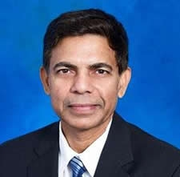
Incoming Chair Initiatives
Chandra Reddy
Dean & Director,
Tennessee State University

Slide 68

2025 – 2026 agInnovation Priorities
Enhance Funding for Agricultural Research:
Advocate for increased appropriations for USDA-NIFA to boost capacity program funding.
Engage relevant federal funding agencies and organizations to diversify and expand the competitive research funding portfolio.
Address Critical Infrastructure Needs:
Identify and implement both short- and long-term strategies to increase funding for the Research Facilities Act.
Provide guidance on the Research Facilities Act implementation to meet the infrastructure needs of colleges of agriculture at Land-grant universities, small to large.
Increase Organizational Visibility and Impact:
Strategically enhance external communications, marketing, brand recognition, and public relations efforts to elevate the visibility and impact of the organization.
Expand partnerships and engagement within the Land-grant University community and with federal agencies, industry, and foundations to support collaborative initiatives.
Intensify Strategic Actions to Position Food Security as a Cornerstone of National Security:
Demonstrate how a stable food supply underpins economic growth and plays a critical role in reducing poverty.
Emphasize the importance of a well-nourished population in sustaining a productive workforce and maintaining national defense readiness.
Highlight the role of national security in ensuring resilience to food supply disruptions caused by natural disasters, pandemics, or cyber threats.
Underscore the strategic importance of protecting agricultural infrastructure and food distribution systems to safeguard national interests.

Slide 69
2025 – 2026 agInnovation Chair’s Initiatives
Build a Healthier Nation Through Prevention Research and Innovation
Role of diet in preventing chronic diseases (MAHA Report)
Ensuring a safe and nutritious food supply
Innovations in low/minimum processed foods
Innovations in minimizing chemicals/food additives
Extending shelf life through natural/alternate means
Transform Agriculture Production System through new Technologies
Labor Shortages & Rising Costs
AI, automation, and robotics address persistent labor shortages and reduce reliance on manual labor, which is becoming more expensive and scarcer.
Precision Agriculture using sensors, drones, and AI
Low and precise application of farm inputs and optimization of planting, irrigation, and harvesting to improve farm profitability and soil health.
Finalize the Roadmap
Create a formal framework to facilitate research collaboration between 1862 and 1994 Land-grant universities with 1890 Centers of Excellence
Use the multistate project portfolio as a tool to facilitate research collaborations across the land-grant system, institutional relationships among all LGUs.
Leverage 1890 Centers of Excellence as platforms to foster systemwide collaboration across the land-grant system.

Slide 70
agInnovation Chair-elect Vote
Notes:
.

Slide 72

Passing of the Gavel
Steve Lommel
Past Chair
Chandra Reddy
Chair

Slide 73
THANK YOU

