Slide 1
President’s Budget Request (and beyond…)
agInnovation-BLC
4-23-24
Jeanette Thurston

Slide 2
President’s Budget Request: Estimated Timeline of Activity
Jan. 2024
NIFA continues to implement FY23 programs
Mar.–May
FY25 President’s Budget released
June–July
NIFA submits proposed FY 26 budget to USDA Secretary through the Undersecretary for REE
Aug.–Sep.
Oct-Nov
December
OMB pass back (final changes prior to releasing President’s budget)
January 2025
February 2025
USDA submits FY26 budget proposal to the White House Office of Management and Budget (OMB)
FY24 Appropriations Act Signed by President, agency begins to implement programs
NIFA begins Budget Planning Process for FY26
FY25 begins
Final FY26 President’s Budget submitted to USDA via OMB
Ideally, FY26 President’s Budget Released
If missed the opportunity to engage NIFA last fall on FY26 priorities, now is the time (preferably before April)!
Secretary attends FY25 appropriations hearings and agency helps to address Congressional requests (March through June)
Great time to engage the agency on the FY27 budget
Every other year, NIFA will collect stakeholder input via NIFA Listens

Slide 3
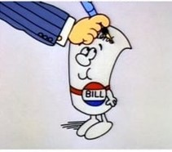
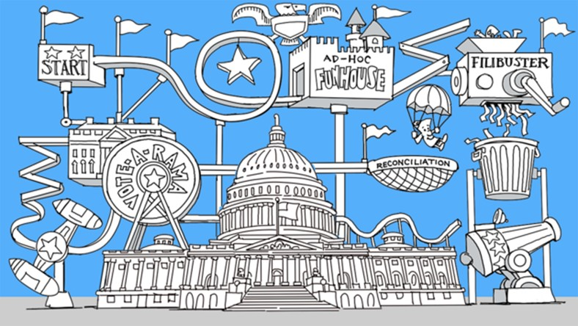
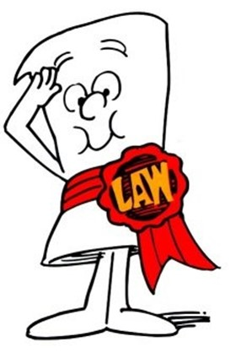
The rest of this crazy theme park ride…
https://www.politico.com/news/2021/09/30/how-a-bill-gets-passed-into-law-gridlock-congress-514532
FY20XX Appropriations Act

Slide 4
Questions/Thoughts: Engagement & Education for Research Support
When and who should carry the message?
Need to be engaging much earlier in the process
Should engage more than once—to manage this, should we “share the love”?
In addition to agInnovation chair: BLC chair, Incoming agInnovation chair, S&T chair, current and incoming Vice chairs
Our Message and Proactive planning
Priorities may be the same but should the message on the need be? Especially in consideration what the prior year’s appropriations looked like.
Who should we be engaging with concerning this process?—building relationships and maintaining them
NIFA—Director but also…Assoc Director for Programs, Institute Deputy Directors, Josh Stull
OCS—Office of the Chief Scientist
Chief Scientist
Deputy Undersec for REE
Director OCS
Others outside of USDA? Importance of agInnovation research in other agencies?

