Slide 1
The National Plant Germplasm System: 2023 Status, Prospects, and Challenges
Peter Bretting
USDA/ARS Office of National Programs
Peter.bretting@usda.gov
Cell: 1.240.447.9983

Slide 2
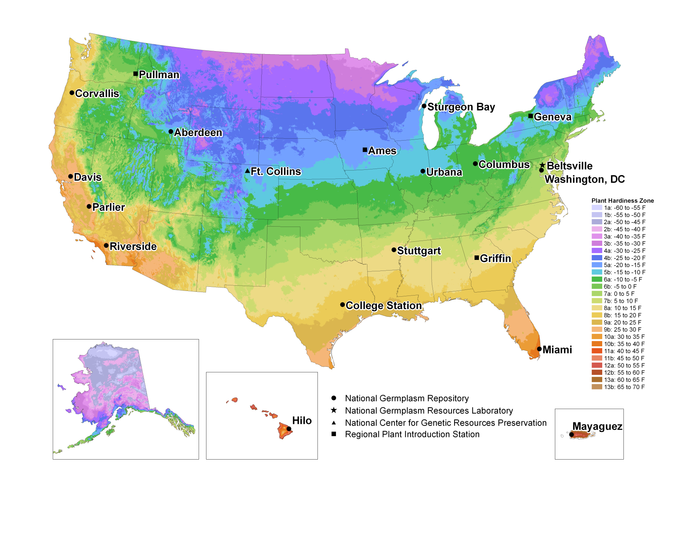
USDA National Plant Germplasm System (NPGS)

Slide 3
Number of NPGS Accessions
2013-2022
NPGS Accessions

Slide 4
Demand for NPGS Germplasm
2013-2022
Germplasm Distribution

Slide 5
ARS National Plant Germplasm System Budget
2013-2022

Slide 8
Some key challenges for the NPGS
Expanding the NPGS operational capacity and infrastructure to reduce PGR management backlogs and meet increased demand for PGR and associated information.
Increased operational costs (labor, inputs, overall inflation). See https://www.ers.usda.gov/amber-waves/2022/june/investment-in-u-s-public-agricultural-research-and-development-has-fallen-by-a-third-over-past-two-decades-lags-major-trade-competitors/?cpid=email#
NPGS personnel transitions—hiring, training, etc.
Developing and applying cryopreservation and/or in vitro conservation methods for clonal and some seed PGR.
BMPs and procedures for managing accessions (and breeding stocks) with an increasing diversity of GE traits in more crops, the occurrence of adventitious presence (AP), and the products of gene editing.
Acquiring and conserving additional PGR, especially of crop wild relatives.

Slide 9
PGR Management Priorities: Foundations for Crop Innovation
Acquisition
Maintenance
Regeneration
Documentation and Data Management
Distribution
Characterization
Evaluation
Enhancement
Research in support of the preceding priorities

Slide 10
NPGS Personnel Transitions
Farewell and best wishes to Stephanie Greene, Curator, (ARS- Ft. Collins); Karen Williams (ARS-Beltsville) and Kim Hummer, RL (ARS-Corvallis).
Welcome and best wishes to Robert Krueger, RL (ARS-Riverside); and Marilyn Warburton, RL, Sarah Dohle, Curator, Paul Galewski, Curator, and Bailey Hallwachs, SOS Coordinator (ARS-Pullman); Rebecca Povilus, Curator (ARS-Geneva) and Claire Heinitz, RL (ARS-Davis and Parlier).
We are recruiting staff at Ft. Collins, CO; Corvallis, OR; and Parlier, CA.

Slide 11
PGR Management Training Initiative
Numerous NPGS PGR managers have retired recently; no formal, comprehensive program existed for training new PGR managers.
G. Volk (ARS-Ft. Collins) and P. Byrne (CSU-Ft. C.) lead a project, supported by ARS and a NIFA grant, to design and develop a training program for PGR management to be delivered primarily through distance-learning.
A now three module, 3 credit hour Colorado State online course Plant Genetic Resources: Genomes, Genebanks, and Growers to be taught in Aug.-Sept. 2022-- the first time for the three-part course. http://pgrcourse.colostate.edu/
Numerous PGR training/educational materials are freely accessible from GRIN-University at https://grin-u.org/
Infographic posters for PGR, genebanks and conservation, and PGR and food security in 6 languages; download at http://genebanktraining.colostate.edu/trainingmaterials.html

Slide 12
FY 22 ARS NPGS Budgetary Increases
Pecan PGR (ca. $600,000): College Station, TX.
Coffee PGR (ca. $250,000): Hilo, HI
Pulse PGR (ca. $100,000) Pullman, WA
Pulse PGR (ca. $100,000) Urbana, IL

Slide 13
Status of Congressionally-directed NPGS Plan
Reviewed by NPGCC
Extensive input from National Genetic Resources Advisory Council (NGRAC)
Reviewed and approved by ARS and REE
Reviewed and approved by WH OMB
Process estimated as 85% complete

Slide 14
Adapting the NPGS to rapid global warming
Crop Science article published 25 May 2023
Includes case studies, software for estimating future conditions, identification of potential adaptive strategies and actions.

