Slide 1
NEIPMC Advisory Council October 12, 2023

Slide 2
Deborah g. Grantham
Director

Slide 3
A little ne news
NEERA-1604 was renewed last year or so and now is NEERA-2104
NYS PSEP has merged with NYS IPM Program
Anna Wallingford is leaving UNH to work at ARS and Amber Vinchesi-Vahl has arrived from CA to fill her position

Slide 4
Northeast ISSUES
Newly-funded Augmentative Biocontrol Working Group highlights need to address costs and other issues related to biocontrol in specialty crops and small farms
Continuing turnover in IPM experts and professionals resulting in lost expertise and declining workforce numbers remains a concern
Ed Rajotte, Art Agnello, John Sanderson, Mary Conklin
Concern about navigating state and federal regulations, such as ESA and chemicals such as neonics and PFAS
Additional concern about legislative actions driven by general public rather than underlying science: general public misperceptions about pesticides
Herbicide resistance, and resistance in other pests
Climate change impacts on pests

Slide 5
Evaluation
IPM Adoption and Impacts in the United States, 2023, David E. Lane, Tegan J. Walker, Deborah G. Grantham, Journal of IPM, doi.org/10.1093/jipm/pmac028.
David Lane and Tegan Walker, Southern IPM Center evaluator, are working on a questionnaire that will help standardize and hopefully streamline annual NEERA and other reporting for state IPM coordinators
Initiated with help of Anna Wallingford, who is leaving UNH for ARS
David working on revising evaluation training for NE
6 new Impact Statements about to be published
Return on Investment re-calculated

Slide 6
Partnership grants ROI
Years | Funding Amount | Leveraged | Leveraged Ratio
2007-21 | 4,764,415 | 39,737,815.8 | 1 to 8
2018-2021 | 915,637 | 14,343,600 | 1 to 16
2018 | 323,945 | 7,964,349 | 1 to 25
2019 | 186,747 | 1,075,000 | 1 to 6
2020 | 186,282 | 211,517 | 1 to 1
2021 | 218,663 | 5,092,734 | 1 to 23

Slide 7
2023 Partnership Grant awards
Weed-Management Decision-Making for Wild Blueberry Growers in Maine (Lily Calderwood, University of Maine)
Optimization of Biologicals and ASD Combination Treatment for Managing Soilborne Diseases to Promote Adoption (Mahfuz Rahman, West Virginia University)
Evaluation of Insect Exclusion Screens on Pests and Biocontrol Agents in Commercial High Tunnels (Carlos Quesada, West Virginia University)
#BeReadyForTicks: A Digital Media Tick-Bite-Prevention Education Campaign With Just-in-Time Learning Tools (Thomas Mather, University of Rhode Island)
Establishing an Augmentative Biological Control Working Group for the Northeast Region (Hillary Peterson, Maine Department of Agriculture, Conservation, and Forestry)

Slide 8
PMSPs and Production/Management Profiles
Completed in 2023:
Production/management profile for arthropod pests of horses in Maine (Allison Gardner, University of Maine)
Hemp production/management profile for New York State (Marion Zuefle, New York State IPM Program, Cornell University)

Slide 9
Grants RFAs open
Partnership Grant RFA is open: deadline November 9, 2023
https://www.northeastipm.org/grant-programs/ipm-center-grants/ipm-partnership-grants/
Pest Management Strategic Plan and Production/Management Profiles RFAs: November 9 deadline
https://www.northeastipm.org/grant-programs/ipm-center-grants/pmsp-and-pmp-grant-program/

Slide 10
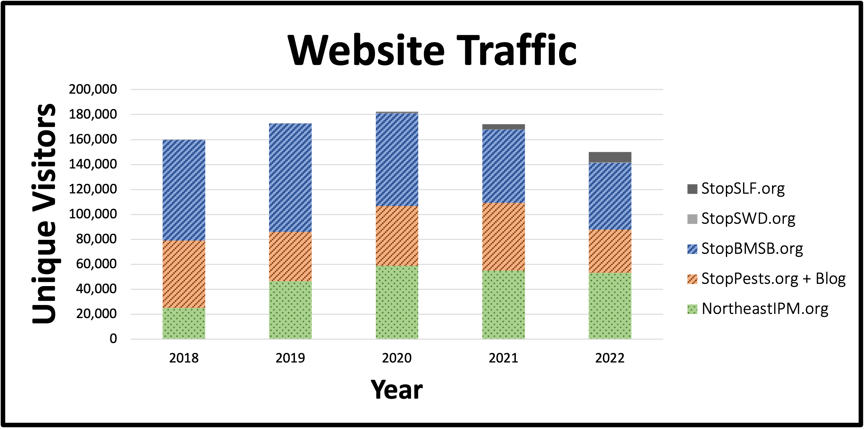
communications
Notes:
2021
NortheastIPM.org: 54,905
StopPests.org: 54,343
StopBMSB.org: 58,608
StopSWD.org: 443
StopSLF.org: 4,049

Slide 11
IPM award
Outstanding Achievements in IPM: deadline October 27, 2023 https://www.northeastipm.org/about-us/publications/ipm-insights/call-for-nominations-2022-outstanding-achievements-in-integrated-pest-management-award/
2022 recipients:
Diana Obregon Corredor, nominated as a student, now a postdoctoral associate in pesticide risk assessment with the New York State IPM Program
Lori King, IPM manager, Claussen’s Florist, Greenhouse & Perennial Farm
Robyn Underwood, extension educator in apiculture, Penn State Extension

Slide 12
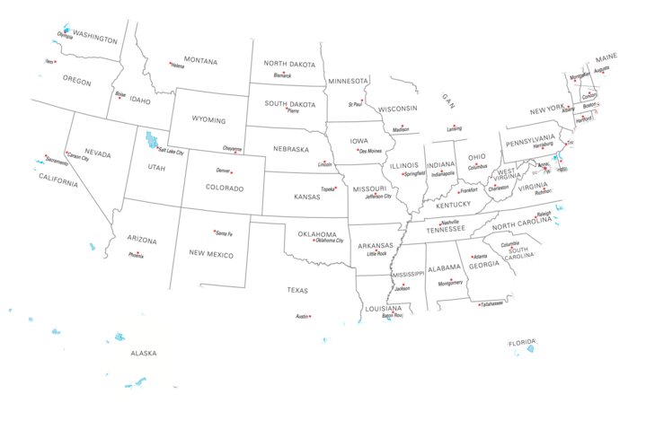
2023 Update:
6 conference presentations
12 sites trained online
9 on-site trainings
4 webinars including upcoming November 14th webinar: "Cucarachas vs Humanos: ¿Quién gana la batalla?"

Slide 13
Diversity, Equity, INCLUSION, and Justice
Series of articles/roundtables/talks about Diversity in IPM
Goals are to:
Create a welcoming environment in IPM.
Develop awareness of career trajectories.
Increase awareness about resources available for young scientists to build their careers.
Build community among professionals and develop awareness about inclusivity in IPM.
Expand capacity in the Northeast for creating programs such as the PA/NY extension programs for the Hispanic community
See https://www.northeastipm.org/ipm-in-action/deij-in-ipm/ for the full list and additional resources on the topic

Slide 14
2023 NE IPM Research Update Conference
Two days of lightning talks by NE researchers
Updates from active projects funded by the:
NEIPMC’s Partnership Grants Program
USDA-NIFA’s Applied Research and Development Program (ARDP) and Extension Implementation Program (EIP)
Northeast Sustainable Agriculture Research and Education (SARE) Program
Day 1: November 13, 2023, 10:30 a.m. – 12:00 noon EST
Day 2: November 16, 2023, 10:30 a.m. – 12:00 noon EST

Slide 15
Northeastern IPM Center Questions?

