Slide 1
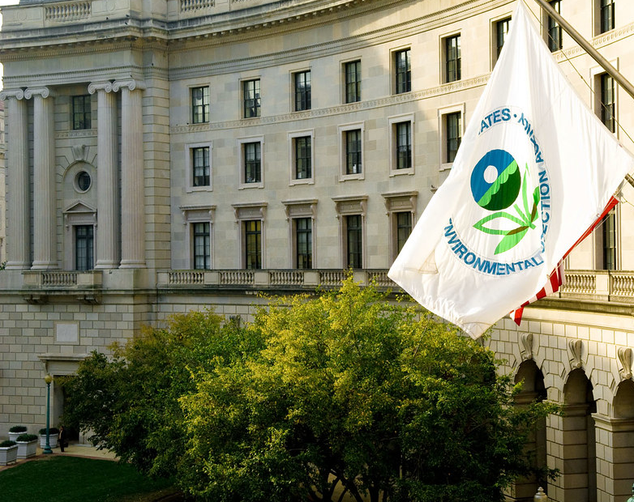
Overview of Recent EPA Activities Related to the ESA Efforts
NIPMCC ESA Panel
Kelly Tindall
Senior Science Advisor
Environmental Protection Agency
Office of Pesticide Programs
Biological and Economic Analysis Division
tindall.kelly@epa.gov

Slide 2
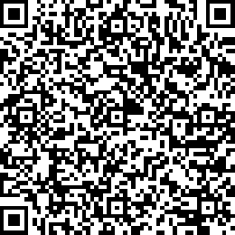

EPA’s Pesticide Programs ESA Workplan
Released April 2022
Released November 2022

Slide 3

FIFRA Interim Ecological Mitigation
A menu of FIFRA Interim Ecological Mitigation (IEM) measures
  Focuses on agricultural crops uses of conventional and biological pesticides
  Proposing in registration review, to be adapted to new use registrations
  To be adjusted to account for varying risks and benefits of the pesticide
  Proposed for inclusion on product labels (not Bulletins)
FIFRA Interim Ecological Mitigation measures do not include
  Pesticide-specific measures (e.g., application rate reductions)
  Listed species-specific mitigation measures being developed for the Vulnerable Species Pilot
  Mitigation measures being developed for listed species under Additional ESA Strategies

Slide 4
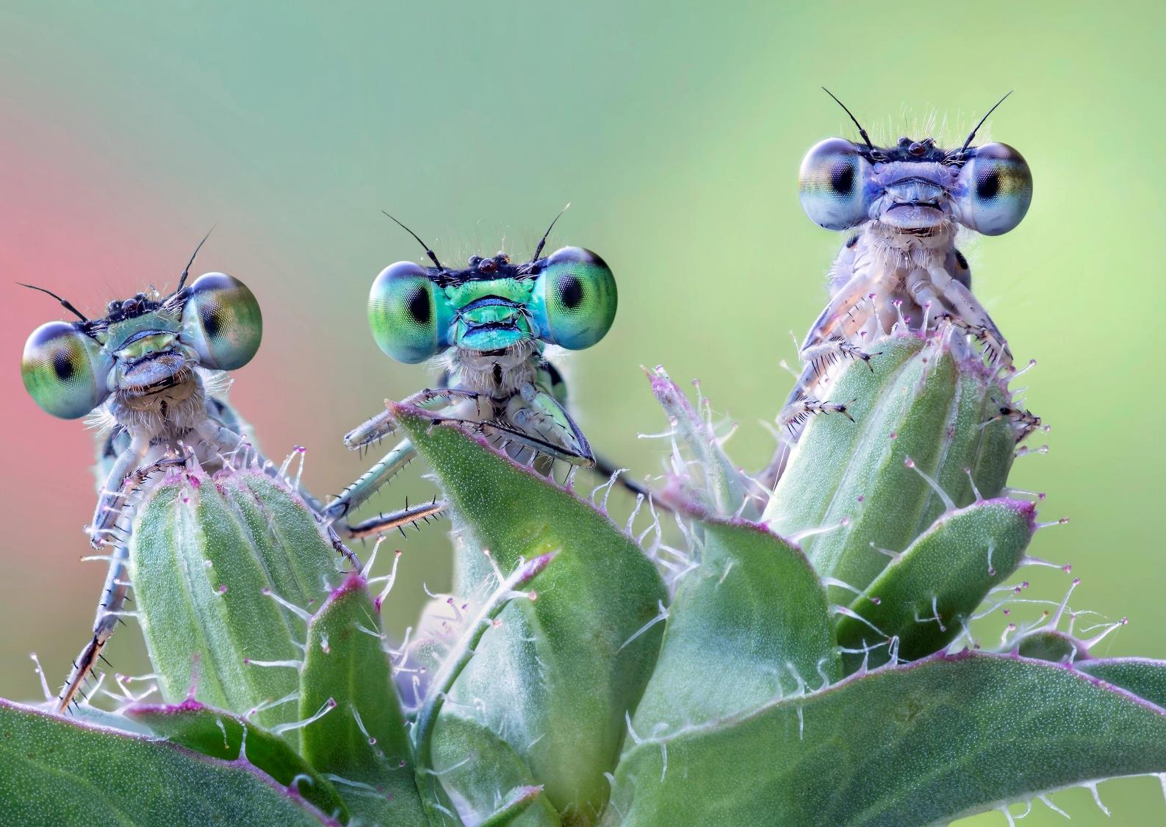
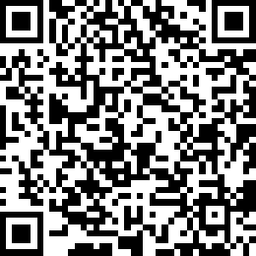
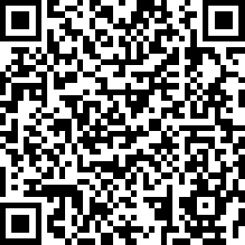
Update on Recent ESA Efforts – Vulnerable Species Pilot
Released on June 22, 2023
  Includes all outdoor pesticide uses excluding homeowner products
  45-day public comment period closed Aug 6 , 2023
  USDA- hosted webinar July 2023
  >10,000 comments received
  EPA is reviewing comments to determine if mitigation should be revised by Dec 30, 2023
Docket
Webinar

Slide 5
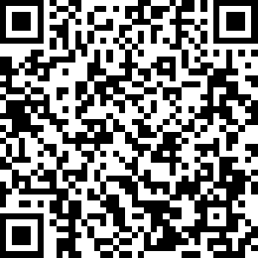
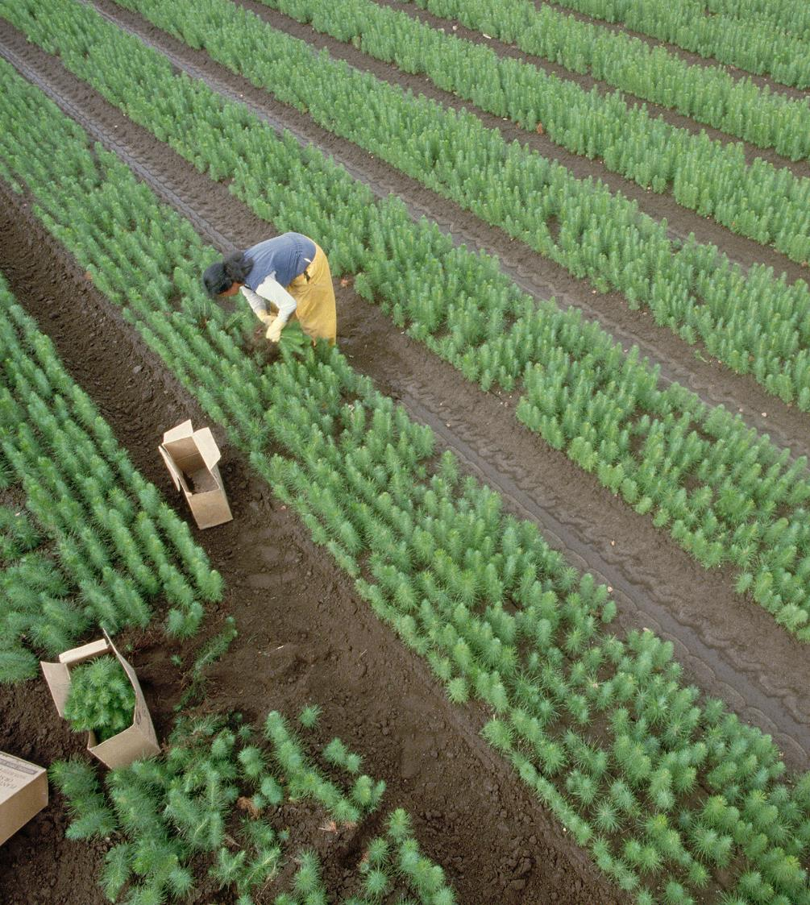
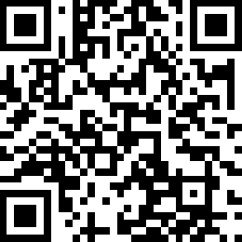
Update on Recent ESA Efforts – Herbicide Strategy
Released on July 24, 2023
  Supporting documents are available in Docket
    Framework, Case Studies, Technical Support for Mitigation, Example Application of Proposed Strategy to Crop Production Systems
  60-day Public Comment Period Extended 30 days to Oct 22, 2023
  USDA- hosted webinar
Docket
Webinar

Slide 6
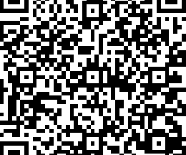
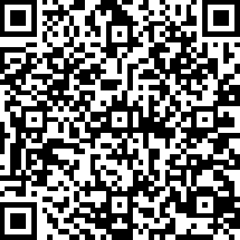
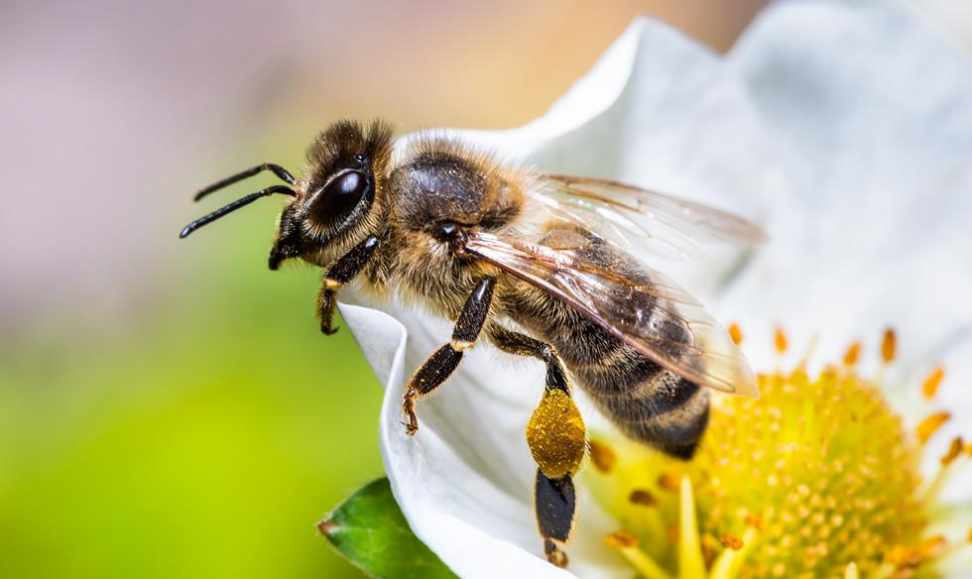
Webinar on Understanding Bulletins Live! Two (BLT)
November 9 @ 2:00-3:00 pm EST
Describe how Bulletins relate to pesticide labeling.
Explain the use of BLT to determine if there are geographically specific mitigations for intended pesticide application areas.
Demonstrate Bulletins Live! Two using malathion as an example.
Address frequently asked questions.

