Slide 1
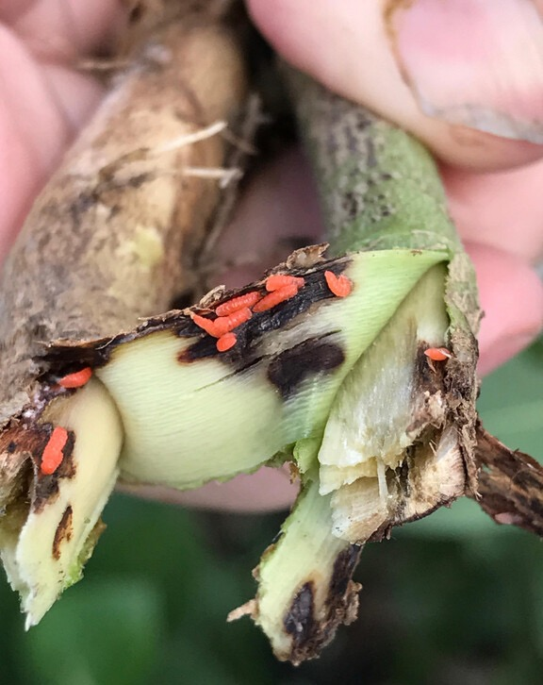
Identifying the Foundation of the IPM Network – Laying the Groundwork for Growth
Daren Mueller, Laura Iles, Carol Pilcher, Roger Magarey and lots of other people
Soybean Gall Midge

Slide 2
Vision
A nation where everyone can access the IPM information, tools and services they need to protect their health, home and livelihood.

Slide 3
IPM Network
Existing IPM network
53 state IPM programs
4 regional IPM centers
Primarily supported by USDA-NIFA (Crop Protection and Pest Management (CPPM) program)
Funding is competitive with state programs applying every 3 years and centers every 4 years

Slide 4
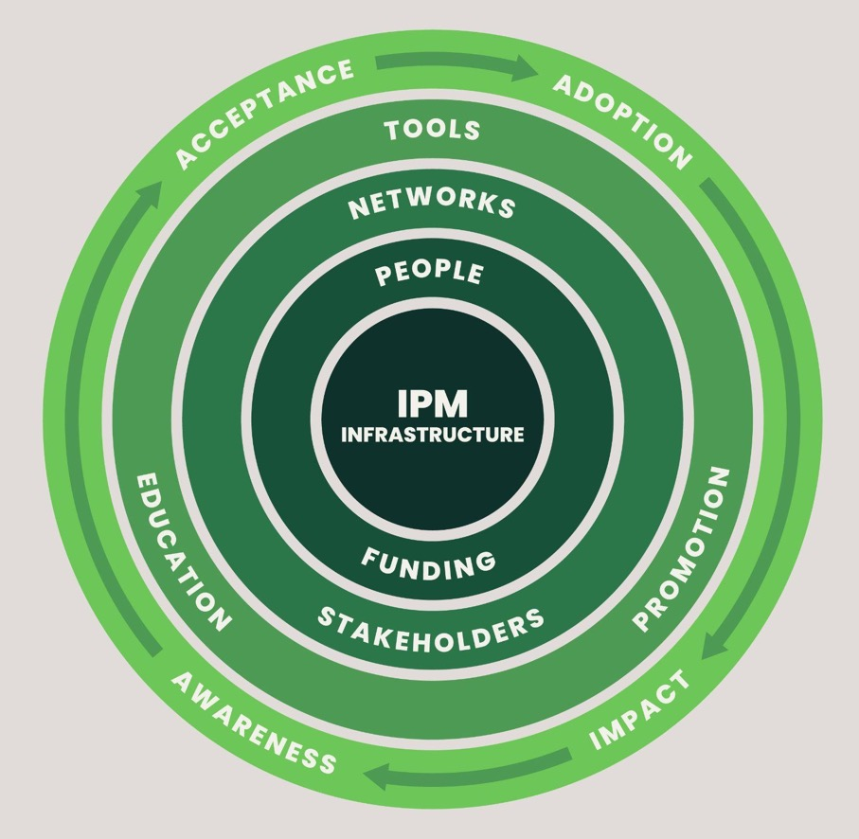
Surveyed state IPM programs
Questionnaire sent out in November 2022, closed August 2023
Received responses from 52 of 53 IPM programs
Gathered complementary data

Slide 5
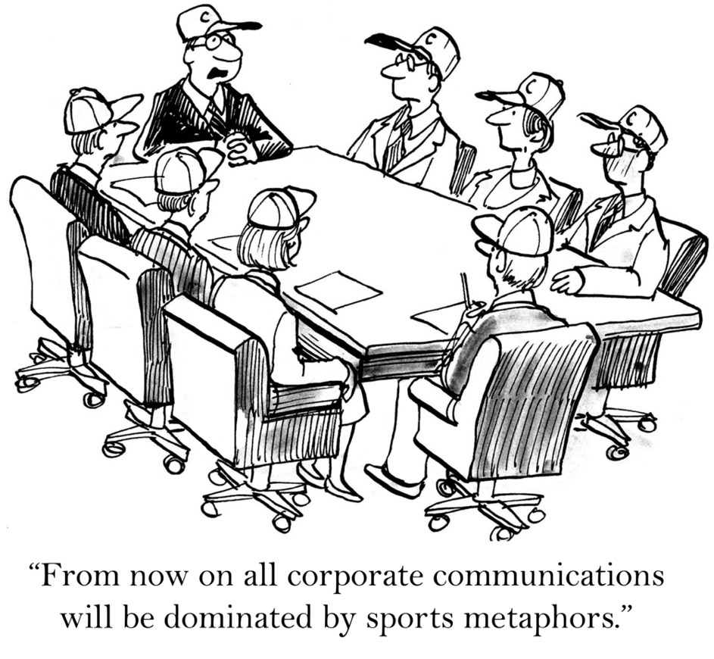
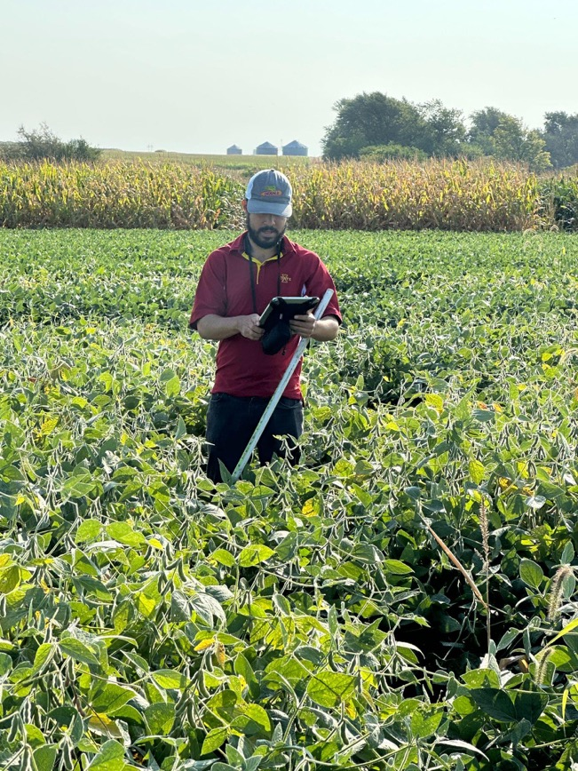
People and Funding
IPM Experts
1,050 IPM specialists across network
Average of 20 IPM specialists associated with each program
~40% of specialists are listed as PI, Co-PI, or collaborator on EIP proposals
IPM Support
Only 31 communication specialists and 18 evaluation specialists “with at least 25% of time designated towards IPM”
69% of IPM programs with NO dedicated communication specialist; 80% of IPM programs with NO evaluation specialist

Slide 6
People and Funding
 | # states | County Agents* | IPM Specialists
# Commodities |  | per program | per program
3 to 9 | 16 | 32.9 | 12.4
11 to 18 | 22 | 43.8 | 19.7
20 to 64 | 12 | 63.9 | 35.8
# Farm Operations
565 to 12,400 | 15 | 8.5 | 9.7
17,900 to 47,300 | 23 | 48.9 | 27.7
52,700 to 247,000 | 14 | 80.8 | 20.5
$ in Farm Sales (1,000s)
3,335 to 1,838,610 | 16 | 9.4 | 9.3
2,472,805 to 7,758,884 | 18 | 53.6 | 23.7
8,220,935 to 45,154,359 | 18 | 70.4 | 27.6
* 6% of county agents have specific IPM responsibilities; others cover IPM through broader agriculture or horticulture duties

Slide 7
People and Funding
 | # states | County Agents* | IPM Specialists
Farm Size (Acres) |  | per program | per program
55-191 | 17 | 42.5 | 16.0
204-372 | 16 | 51.9 | 29.2
410-2430 | 17 | 48.5 | 18.9
Land in Farms (millions)
0.06-8.0 | 18 | 21.6 | 13.1
8.4-16.0 | 16 | 66.6 | 30.4
24.5-127.0 | 16 | 57.3 | 21.1
Region
North Central | 12 | 41.6 | 22.9
Northeastern | 12 | 16.3 | 12.6
Southern | 15 | 86.3 | 32.5
Western | 13 | 29.3 | 12.2
* 6% of county agents have specific IPM responsibilities; others cover IPM through broader agriculture or horticulture duties

Slide 8
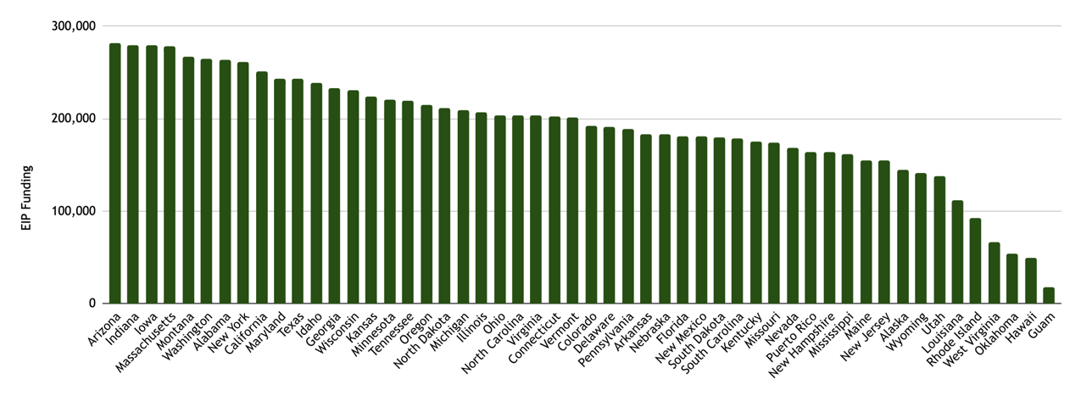
People and Funding
EIP funds range from $17,500 to $281,500 per year
Wide range of legislative support
Programs with more external support tend to receive more EIP funds
Average annual funds | Lower EIP funding levels (25 programs) | Higher EIP funding levels (26 programs)
EIP | $150,940 | $236,036
Legislative | $164,435 | $607,683
Other | $10,208 | $68,194
Notes:
What are the 26 programs doing differently that may be impactful in receiving significantly higher state support compared to the other 25 institutions? Is an opportunity to evaluate factors (strategic education of key stakeholders)?

Slide 9
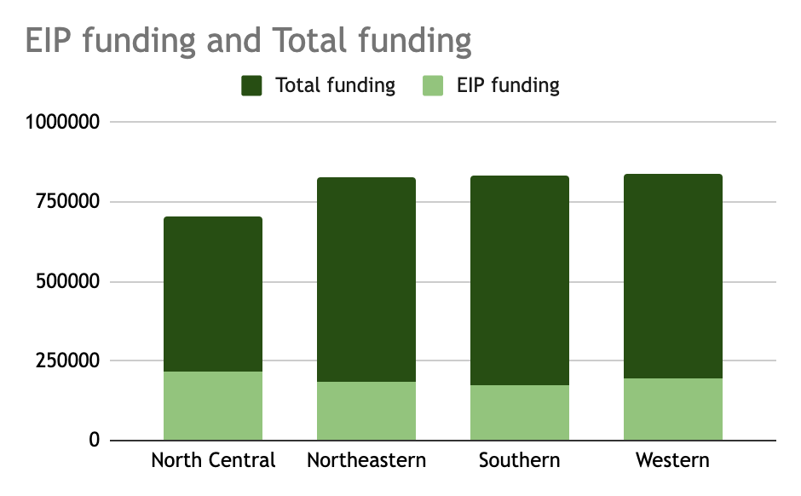
People and Funding
Average annual funding per program within each region
Discrepancy largely driven by a few programs (e.g., NY, GA, TX, CA, WA)

Slide 10
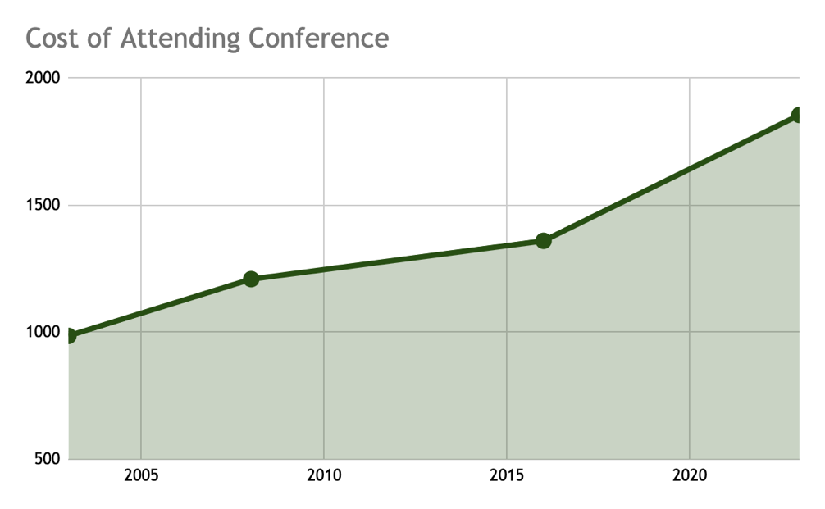
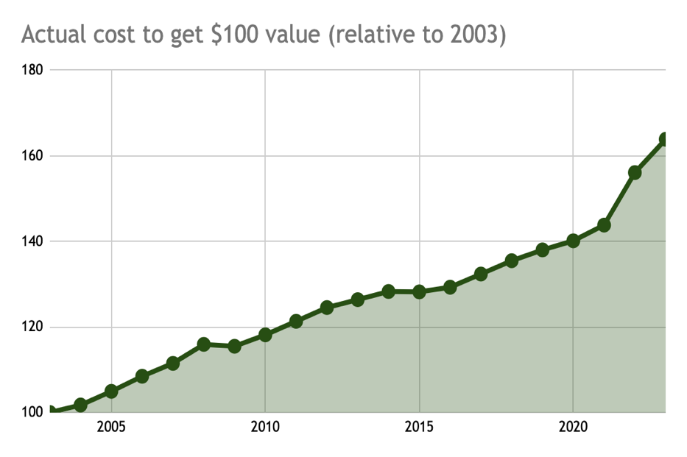
People and Funding
Funding is not keeping up with cost of doing business
APS meeting, 4 nights in hotel with weekly car rental
https://www.bls.gov/data/inflation_calculator.htm
Notes:
While travel expenses are important to point out (rising costs and no program funding increases) I wonder if also pointing out cost of living increases and need for offering competitive salaries for recruiting and retaining talent could be a point here?

Slide 11
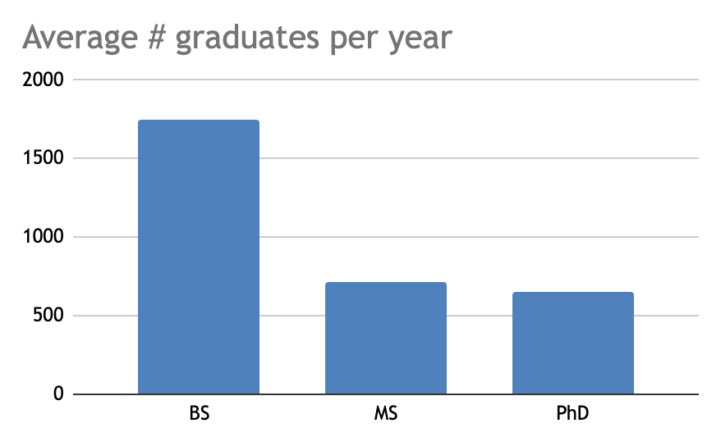
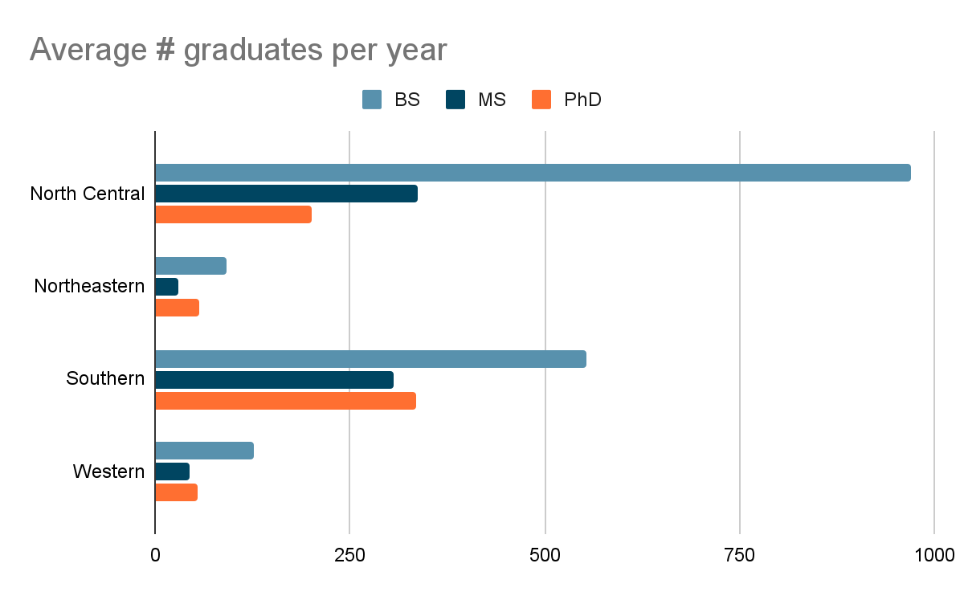
People and Funding
Training the next generation
Approximately 20% of programs did not fill out this information
Notes:
Good to understand how many of these grads get jobs in their fields or take other positions due to lack of good paying positions or other reasons.

Slide 12
People and Funding
Strengths 1000+ IPM specialists across the network Stable funding - at least it is not going down 😁 | Weaknesses Lack of support staff - communications, evaluation Flat-level funding does not account for inflation
Opportunities Re-imagine what constitutes an “IPM specialist” - train the basics of IPM in new disciplines Better communicate need for support to university administration, commodity groups, and state legislature | Threats IPM specialists retiring or leaving quicker than being replaced With sparse staffing, relationships within the network, and with key partners and stakeholders are weakened
Notes:
Why is there such a lack of comms staff? Due to lack of funding to pay for these positions?

Slide 13
Networks and Stakeholders
IPM programs
EIP funds competitively available through USDA-NIFA CPPM program starting in 2008
Confusion still remails if IPM programs should apply for funds to support infrastructure vs. projects
With flatlined budgets and significant inflation, IPM coordinators are often unwilling to share even basic information with one another to prevent any competition. Essentially, there exists a disincentive for information sharing as other IPM programs are seen as competitors.
Each program identifies their own stakeholders and IPM needs

Slide 14
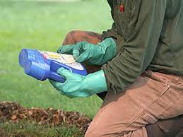
Networks and Stakeholders
University-based programs
Pesticide Safety Education Programs (PSEP)
Plant Diagnostic Clinics
Master Gardeners
Master Naturalists
Society-based programs
Certified Crop Adviser
NIFA funded programs
IR-4
SARE

Slide 15
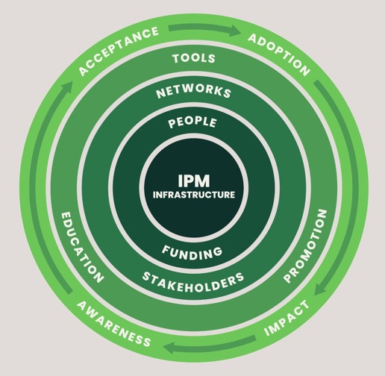
Networks and Stakeholders
88 staff work within Pesticide Safety Education Programs (PSEP)
Some staff work in both IPM and PSEP programs
Similar staffing across regions
North Central = 2.0
Northeastern = 1.5
Southern = 1.7
Western = 1.6
~3,500 events per year with 142,000 participants
Help stakeholders handle and apply pesticides safely, help steward pesticide tools

Slide 16
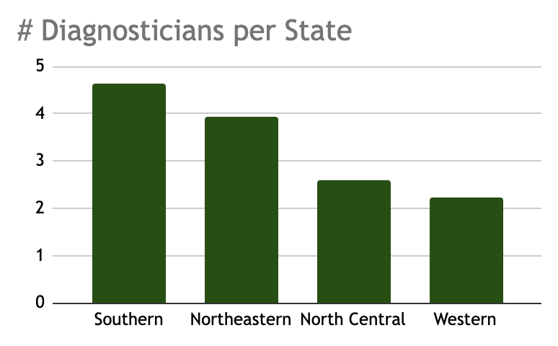
Plant Diagnostic Clinics
125 public clinics associated with universities
North Central = 18
Northeastern = 19
Southern = 60
Western = 28*
*California diagnostic clinics handled by CA Department of Food and Agriculture (CDFA)
# of diagnosticians per state differs across regions ranged from 2.23 (Western) to 4.64 (Southern)
Connect diagnoses with science-based management information

Slide 17
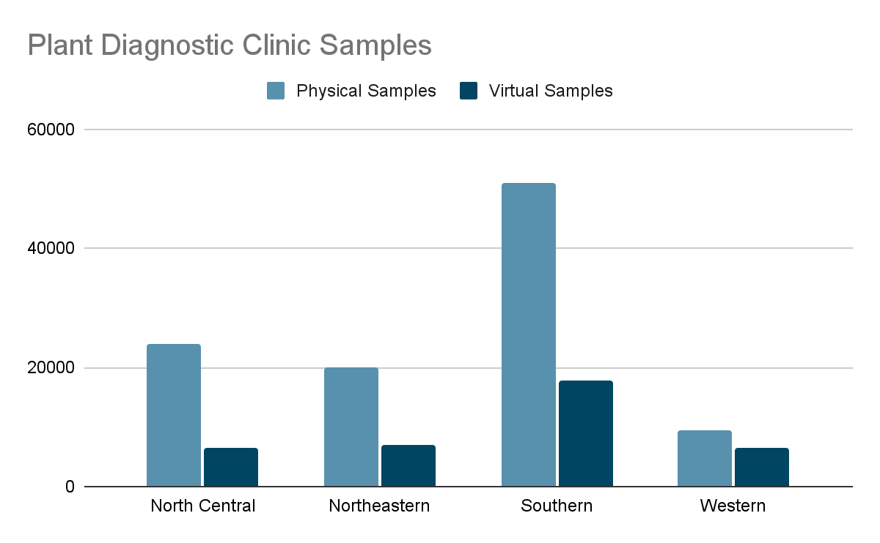
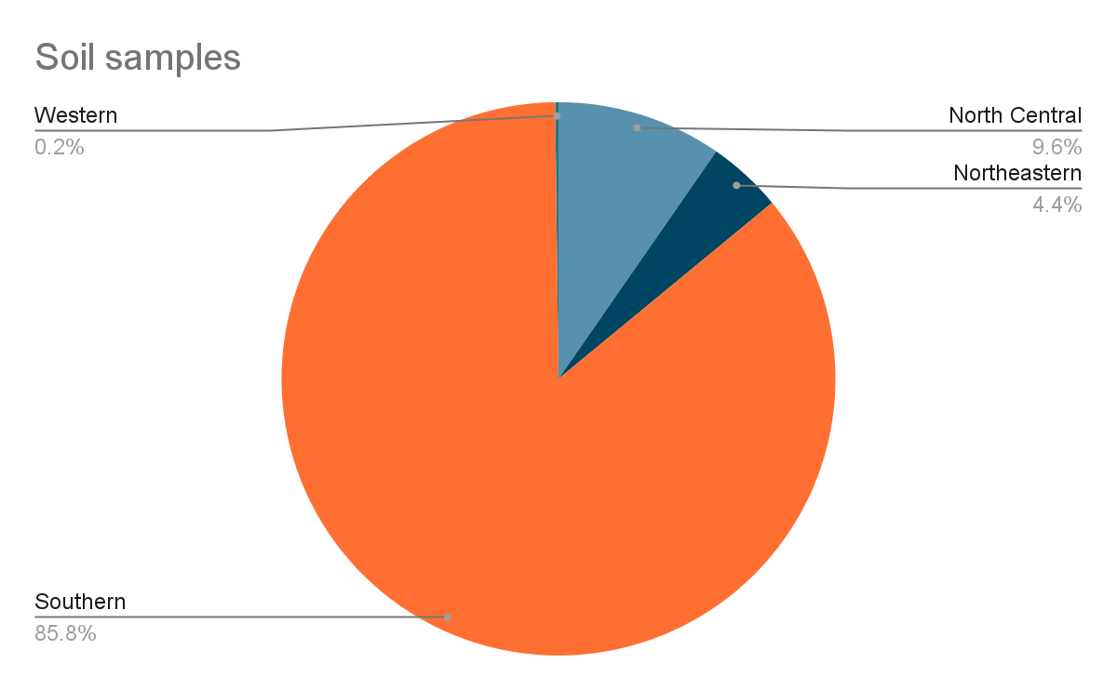
Plant Diagnostic Clinics
Diagnostic Samples: Varies across states and regions; virtual samples ranged from 21.5 to 40.3% of total samples across regions
Soil Samples: Southern region processed 85.6% of the total soil samples
Some states collaborate (e.g., Indiana sends all soil samples to Missouri)

Slide 18
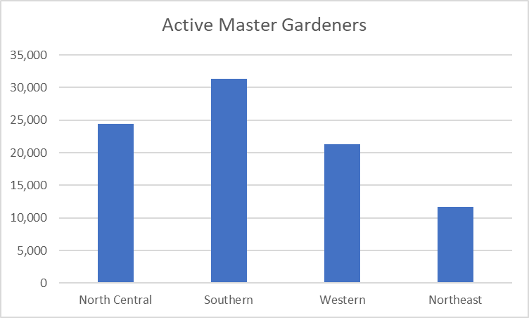
Master Gardeners (MGs)
~82,500 active MGs
Southern has most volunteers; Northeastern least number of MGs
States with higher population densities tend to have more MGs (e.g., California, Texas, and Florida)
States with a strong horticultural interest and a gardening culture tend to have more MGs (e.g., Michigan, California)
Educating and working with MGs is important to ensure they can provide appropriate education and outreach related to various gardening topics.

Slide 19
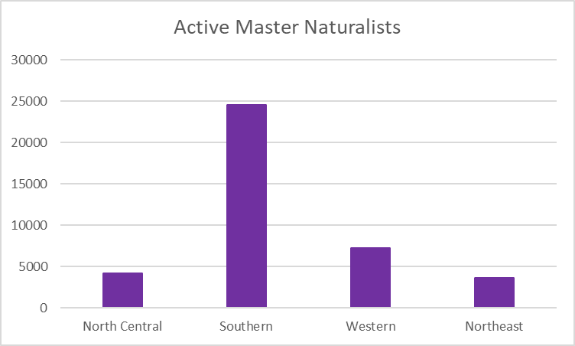
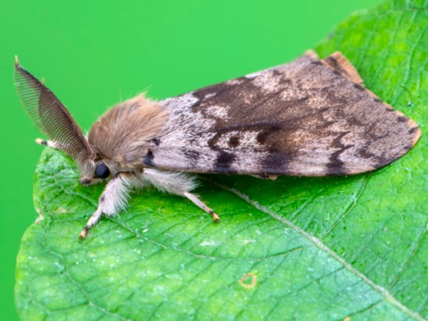
Master Naturalists
~34,000 active Master Naturalists; 30% did not respond to this question (no program in state or unaware of program)
Southern most volunteers; Northeastern and North Central least
Example: Spongy moth survey led by the Oregon Department of Agriculture - volunteers set and monitor traps contributing to essential pest population data.
Educating and partnering with Master Naturalists could extend IPM programs’ reach

Slide 20
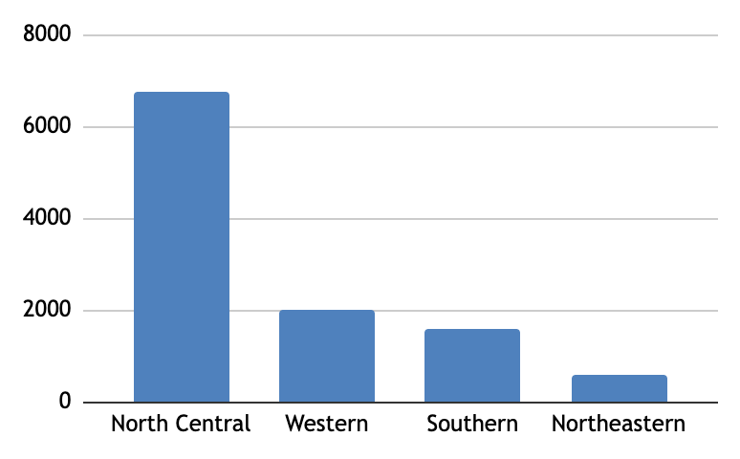
Certified Crop Advisers
~ 11,000 CCAs across U.S. and Canada; several companies actively encourage their employees to become CCAs
Committed to continuously learn and stay up-to-date with the latest research and developments in crop management and pest control to provide the best advice to their clients.
Dedicated to promoting sustainable agricultural practices that minimize environmental impact, conserve resources
CCAs self identify as wanting to be more engaged and aligning with similar IPM goals, making them an important stakeholder and feedback loop

Slide 21
Networks and Stakeholders
Strengths There is an active IPM program with an IPM coordinator in all 50 states and Guam, Puerto Rico and Virgin Islands IPM expertise is important to several stakeholders | Weaknesses Minimal IPM staff to build and maintain relationships with IPM stakeholders No national direction for IPM network; individual programs not all moving towards the same direction
Opportunities Better engage volunteers (e.g., Master Gardeners, Master Naturalists) Better engage with CCAs Develop partnerships with newer organizations in which IPM is important (e.g., NIAMRRE, GROW, etc.) | Threats People, organizations, or movements not acknowledging the importance of IPM Newer efforts (e.g., One Health) do not clearly incorporate plant health into their mission

Slide 22
Tools, Education, Promotion
IPM is a multidisciplinary science-based decision making process to manage pests
Tools: Science-based research develops the tools for pest management (i.e., surveillance/monitoring, forecasting, scouting and decision thresholds)
Education: IPM programs coordinate multidisciplinary information and transfer this knowledge to the end user (e.g., farmers)
Promotion: Dissemination of information uses effective delivery methods to encourage adoption of IPM

Slide 23
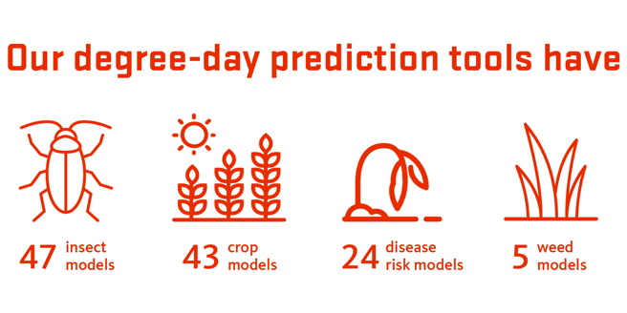
Tools, Education, Promotion
Tools
Pest Surveillance Programs
40 states reported they have a pest surveillance program
Examples: Cucumber downy mildew, Mexican rice borer, Bt resistance fall armyworm and corn earworm, Roseau cane borer, Southern pine beetle
Pest Forecast Systems
39 states reported they have a pest forecasting system
Examples: Insect pest models, crop models, TarSpotter, Sporecaster
Oregon IPM Center
Univ. Wisconsin-Madison

Slide 24
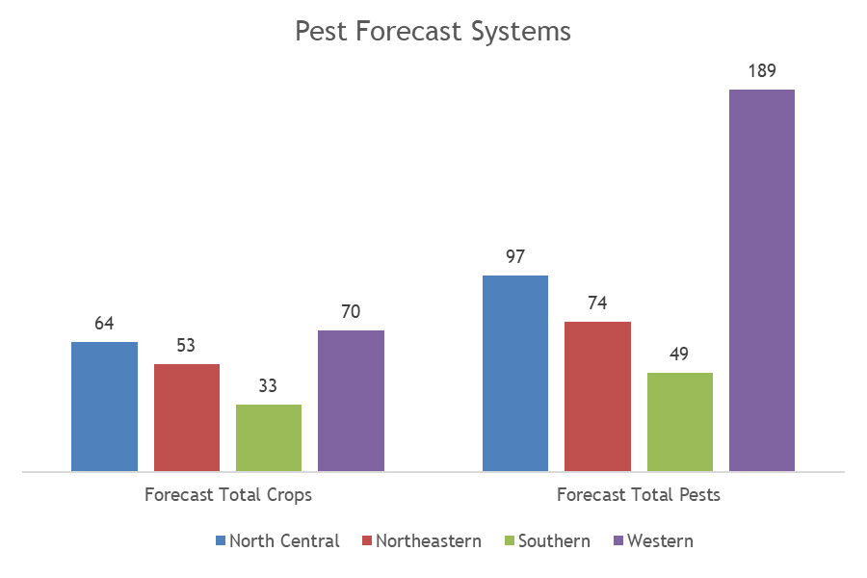
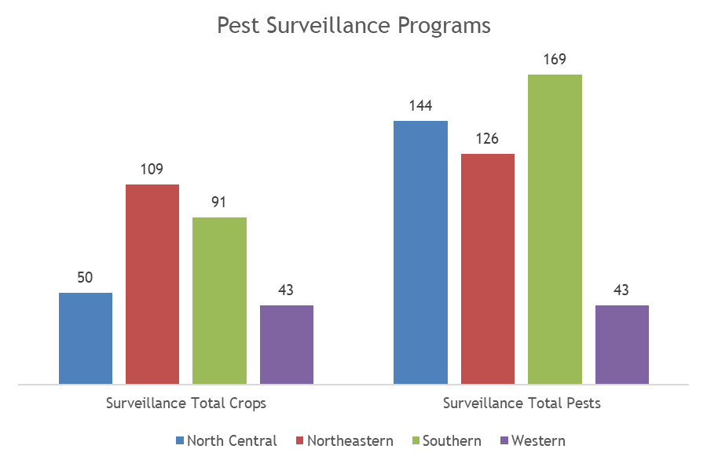
Tools, Education, Promotion
Total number of crops and pests involved in Pest Surveillance Programs and Pest Forecasting Systems in each region

Slide 25
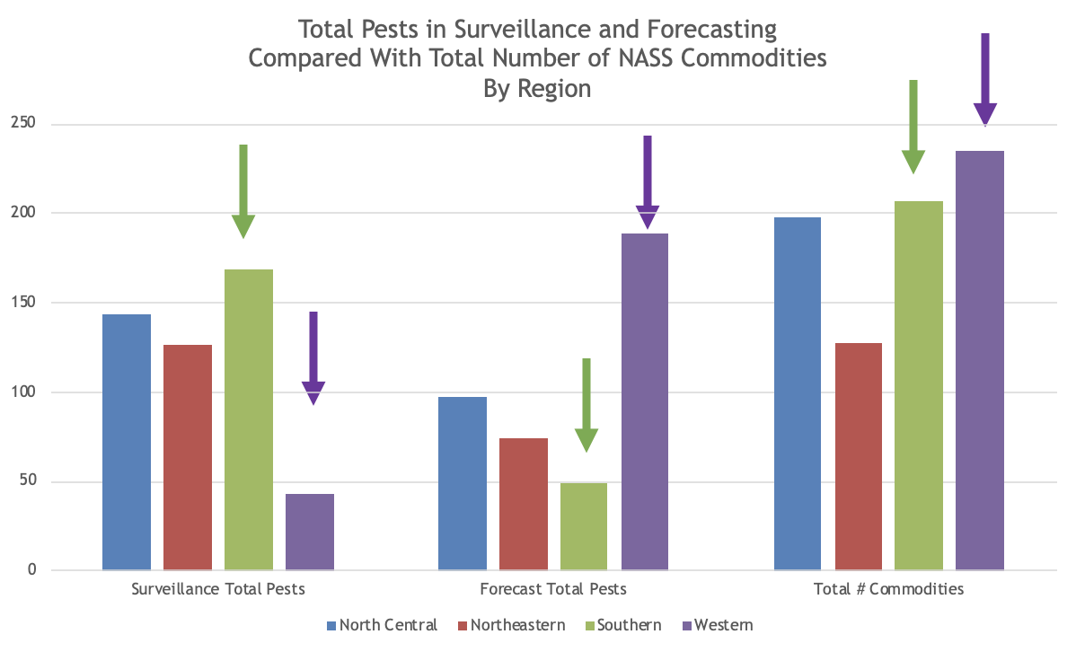
Tools, Education, Promotion
The Western Region reported the most forecasting systems, least amount of pests in surveillance programs, and has the most commodities.
The Southern Region reported the most pests in surveillance programs, the least amount of pests in forecasting systems, and has the second most commodities.
Notes:
Does the south rely less on forecasting since they have so many people hired to be out scouting?

Slide 26
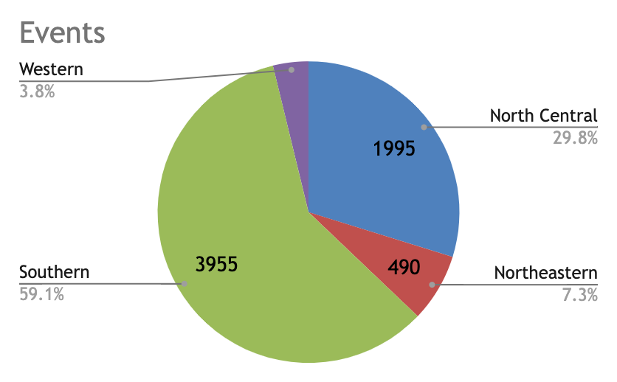
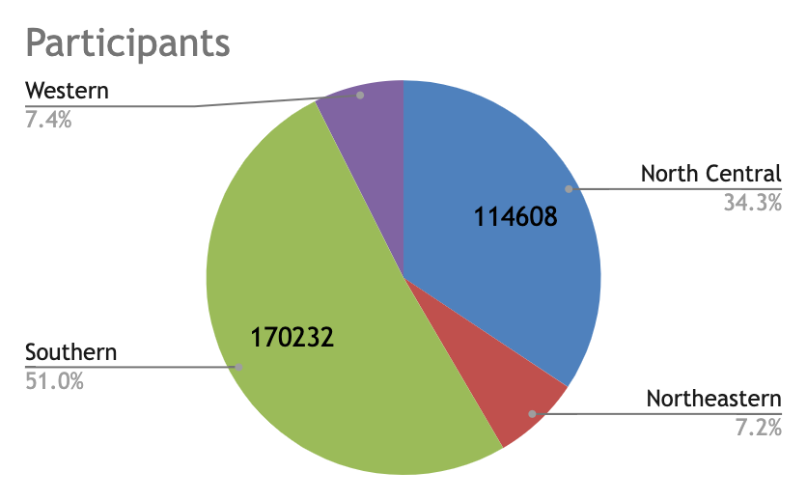
Tools, Education, Promotion
Education
IPM has traditionally relied on face-to-face meetings and other traditional modes of communication.
6,676 in person or virtual meetings with 333,396 participants

Slide 27
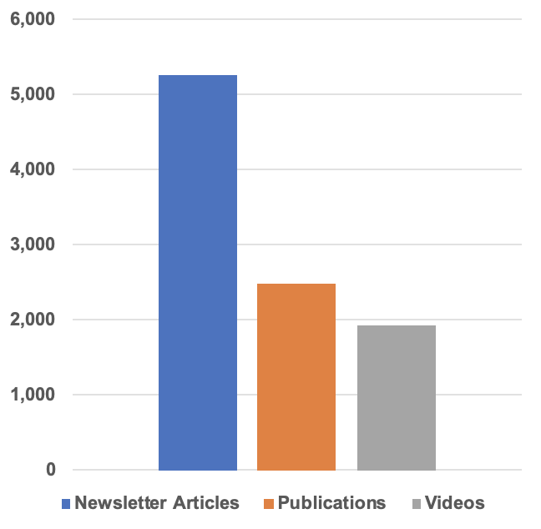
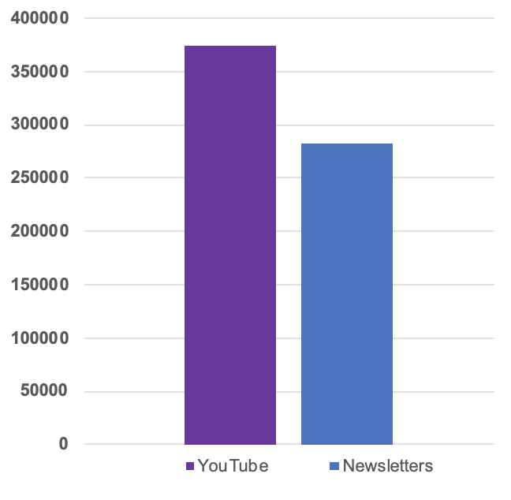
Tools, Education, Promotion
Number of Educational Products*
Number of Subscribers*
374,505
5,246
* IPM programs contribute to 138 newsletters
282,023
2,491
* Similar distribution for subscribers;
<10 of programs have ~80% of subscribers;
UT, IA, PA on both lists.
1,931
* 9 IPM programs have their own YouTube page; 33 contribute videos to a more general YouTube page
Notes:
Due to so many individual websites, videos, etc…how does the targeted audience find the information they need? Is this one of your points here (especially seeing that some of the websites are not maintained an have outdated information)? If so, perhaps this a weakness that can be identified on slide 28?

Slide 28
Tools, Education, Promotion
Promotion
Many Extension systems have a reduced or decentralized communications team
Only 31 communication specialists with at least 0.25FTE across the entire system
Are IPM programs (or Extension more broadly) staffed to do videos, podcasts, etc. well?
All IPM programs have their own webpage
Some are updated, some are not
Some have broken links
Food and Farm Narrative and Design Thinking project (2022 meeting) challenge us to think more creatively about IPM messaging

Slide 29
Tools, Education, Promotion
Strengths Surveillance programs used in ~80% of IPM programs More predictive models being released recently IPM educators are creative because of the complexity of the subject Passionate educators dedicated to protecting human and environmental health | Weaknesses Where are the videos? Complexity of IPM Complexity of IPM vs. shortening attention spans No catchy phrases or names IPM educators frequently reinvent the wheel due to turnover and limited networking
Opportunities Engaged volunteers World of technology used for educational purposes is rapidly changing; platforms such as YouTube and podcasts provide new levels of access to IPM information AI can revolutionize IPM education Recognition of need for sociologists and others to improve education | Threats People will not acknowledge role of IPM Lack of resources prevents IPM educators from utilizing new tools Lack of coordination of IPM information across network makes finding information difficult Maintaining old tools/information while adding new Negative view of term pesticide impedes education

Slide 30
Challenges
Increased Funding: Many states mention the need for more funding to support IPM programs, research, education, and outreach. Adequate funding is crucial for maintaining and expanding IPM initiatives, developing new strategies, and addressing emerging challenges.
Personnel and Expertise: Several states highlight the need for more personnel, experts, and specialists in IPM. Replacement of retired or lost staff, as well as hiring experts in different pest-related fields, is essential to maintain and enhance the effectiveness of IPM programs.
Training and Education: IPM personnel, extension agents, and growers need proper training and education on the latest pest management techniques, strategies, and technologies. Training efforts should encompass both traditional and emerging approaches to effectively address pest-related issues.

Slide 31
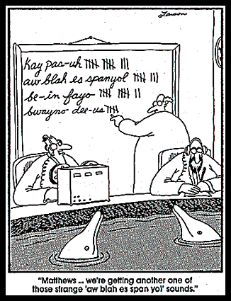
Challenges
Resistance Management: Addressing pest resistance, whether to pesticides or other control methods, is a significant concern. Developing strategies to combat resistance and promoting alternative pest management techniques that minimize the risk of resistance is a priority.
Communication and Collaboration: Improving communication and collaboration within the IPM community is crucial. Enhancing coordination between extension agents, researchers, stakeholders, and growers can lead to better knowledge sharing, increased adoption of IPM practices, and improved overall pest management outcomes.

Slide 32
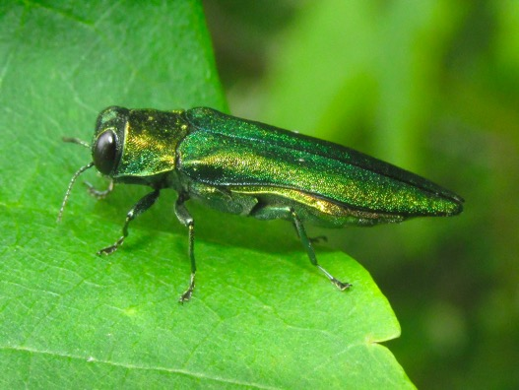
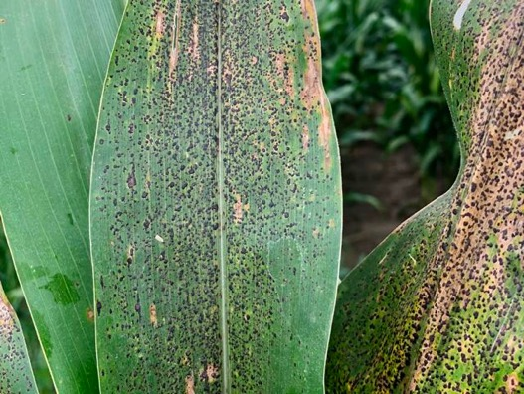
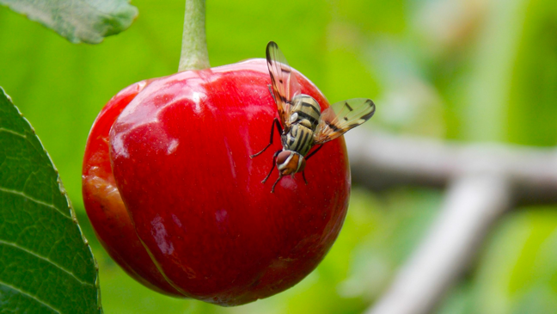
Invasive and Emerging Pests
North Central Region: Sudden oak death, boxwood blight, spotted wing drosophila, brown marmorated stink bug, jumping worms, emerald ash borer, spotted lanternfly, tar spot of corn, bacterial leaf streak of corn, soybean gall midge, kochia, sorghum aphid, hemp dogbane, and more.
Northeastern Region: Spotted lanternfly, sorghum aphid, Japanese beetles, brown marmorated stink bug, allium leafminer, herbicide-resistant weeds, beech leaf disease, European cherry fruit fly, box tree moth, and more.
Emerald ash borer
Tar spot of corn
European cherry fruit fly

Slide 33
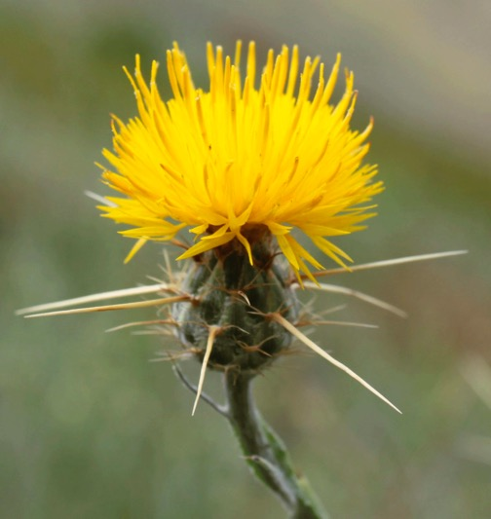
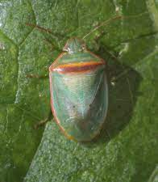
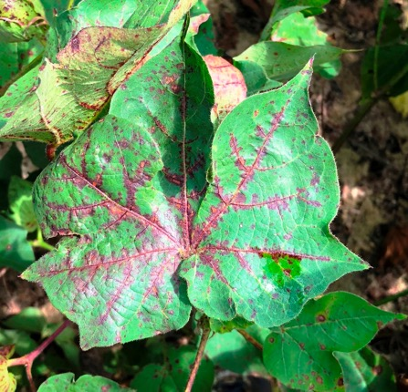
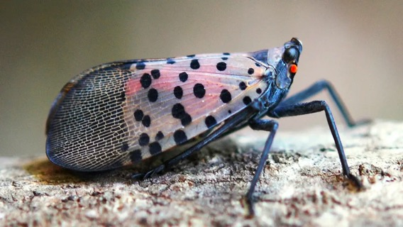
Invasive and Emerging Pests
Southern Region: Red banded stink bug, Asian longhorned tick, Asian longhorned beetle, box tree moth, Laurel wilt disease, spotted lanternfly, herbicide-resistant pests, citrus canker, cotton leafroll dwarf virus, soybean rust, tar spot of corn, invasive aquatic species, and various pathogens.
Western Region: Herbicide-resistant weeds, emerald ash borer, spotted lanternfly, orange hawkweed, Asian citrus psyllid, nutria, brown marmorated stink bug, invasive aquatic species, tomato brown rugose fruit virus, yellow starthistle, and more.
Red banded stink bug
Yellow starthistle
Spotted lanternfly
Cotton leafroll dwarf virus

Slide 34
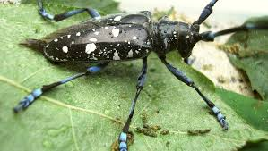
DEIA Barriers
Several factors were identified as barriers for DEIA
Language barriers
Limited resources (funding, personnel)
Access to technology (including internet)
Engagement and connection with underserved audiences
Cultural relevance (lack of research and resources to tailor IPM information to culturally relevant crops and practices)
Program accessibility (e.g., costs, transportation)
Awareness and outreach (some are not aware of IPM programs or resources)
Adaptation to changing needs
Asian longhorned beetle
Cotton leafroll dwarf virus

Slide 35
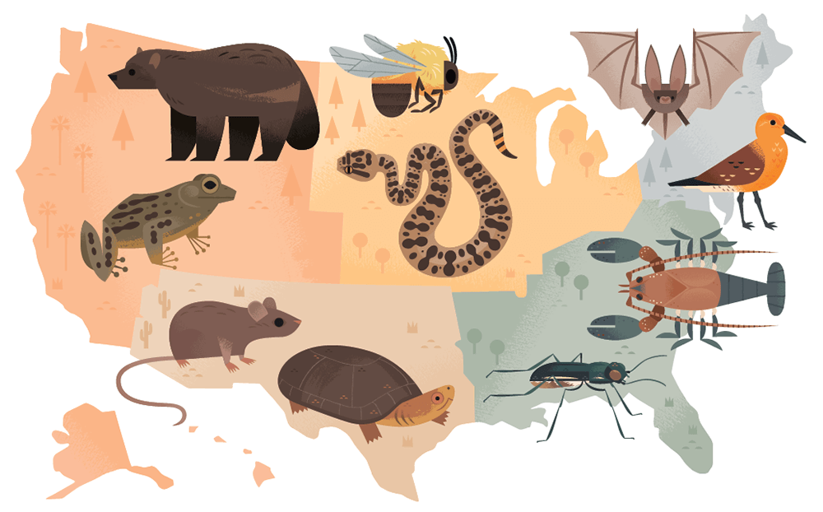
Our Conclusions
We have been talking about these challenges for quite some time, they should not surprise anyone
IPM Network is still needed (YAY!)
Existential IPM threats such as climate change and microbial resistance
Endangered Species Act and regulatory changes are here
Fast moving technological changes need a strong foundation
Endangered species of the U.S. (by Alexander Vidal, licensed under CC BY-NC-ND 4.0

Slide 36
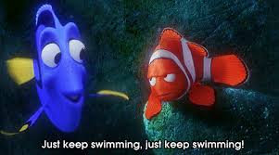
Our Conclusions
Are we at an inflection point?
Diminished funding
Weakening network; IPM programs are 15 years into the competitive funding model, but not all programs moving in the same direction
Lack of cohesive guidance or strategic plan
Challenges in promoting IPM
There is more of a need for IPM now
Next steps
Journal article highlighting these results
Develop strategic plan

Slide 37
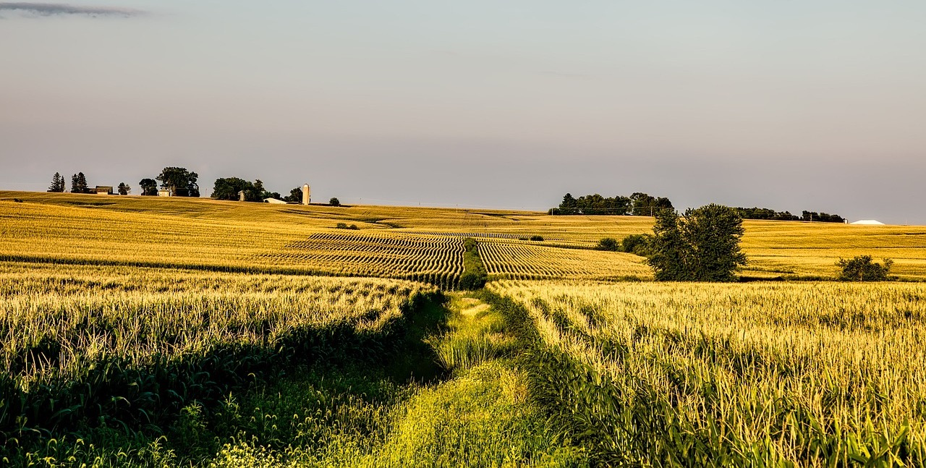
THANKS!
Everyone who filled out the survey and answered my countless questions
Kelsey Mueller for entering and organizing all the data

