Slide 1
Thesis Statement: how agricultural pesticides are used in Illinois will (already has) become more complex
More complex labels
what must be done in addition to “traditional” practices
more record keeping requirements
More complex regulations
where (counties, ranges, etc.) the product can/cannot be applied
can it be applied if pollinators are “visiting the treatment area?”
More complex misuse investigations
picklist practices will be enforceable by IL Dept of Agriculture
who is responsible for implementing picklist practices?

Slide 2
Have there been impacts from ESA so far
regarding crop protection products?

Slide 3
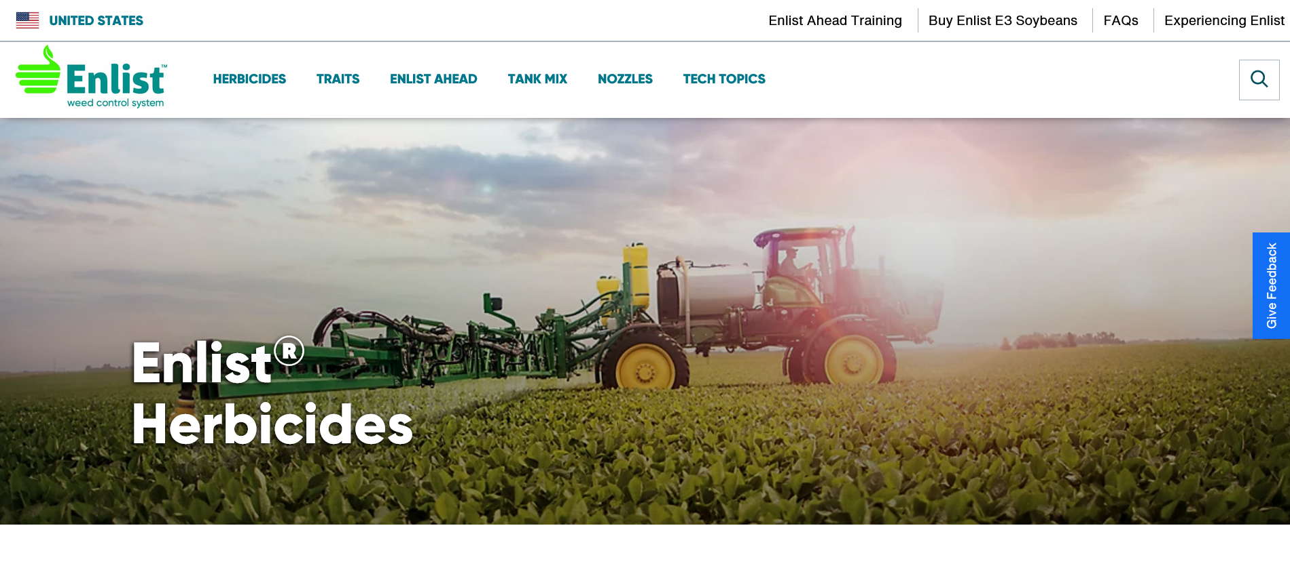
Anyone apply Enlist One or Enlist Duo to soybean in 2022,
2023, or plan to apply in 2024?

Slide 4
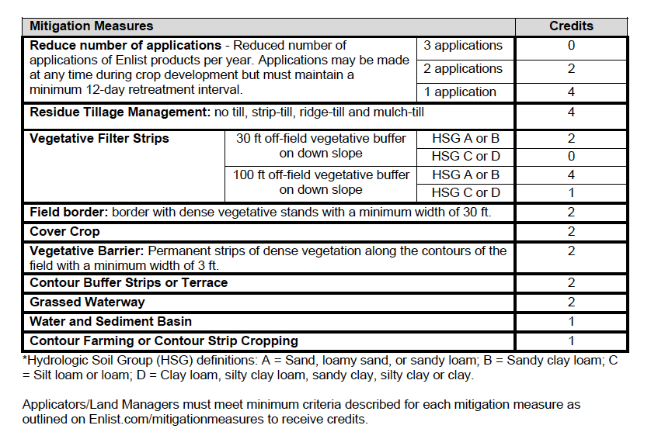
Curious to ask: which of these label-mandated runoff mitigation practices did you/will you use, based on the soil hydrologic group, to obtain 4 or 6 credits?

Slide 5
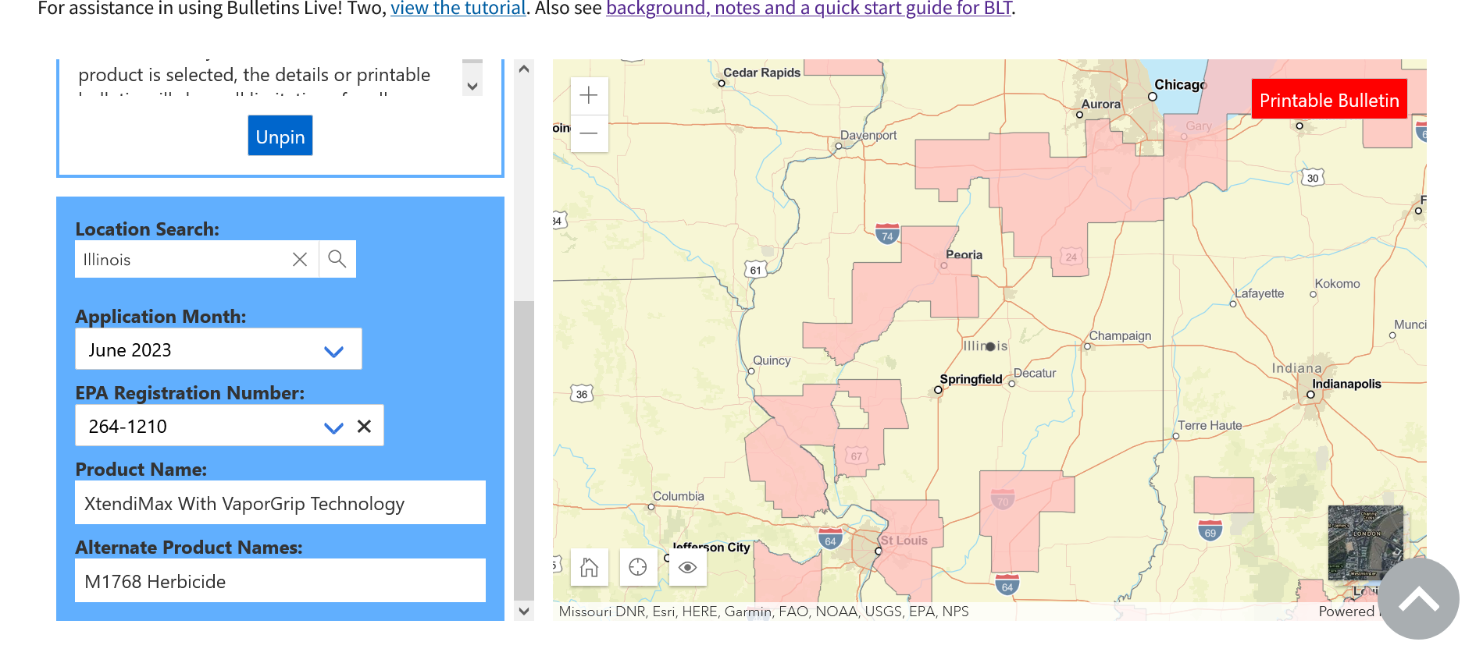
New buffers in 2021: 310’ downwind AND 57’
omnidirectional buffer for counties with ES

Slide 8
What to do moving forward?
Encourage all involved in agriculture (growers, consultants, landowners, ag lenders, etc.) to learn/study the proposals from US EPA
how will they potentially impact your operation/business/customers during future growing seasons?
Offer comments to US EPA
constructive comments that could lead to changes in proposed practices

