Slide 1
ESA Implementation for Pesticide Registrations: USDA Perspective
Elyssa Arnold, Office of Pest Management Policy
National IPM Coordinating Committee Annual Meeting
October 17, 2023

Slide 2
USDA’s Role in ESA Compliance for FIFRA Actions
Member of the FIFRA-ESA Interagency Working Group created under the 2018 Farm Bill
USDA provides the grower perspective so that EPA and the Services (Fish & Wildlife Service and National Marine Fisheries Service) understand:
how pesticides are typically used (e.g., rates, timing, locations, application methods, target pests), and
the implications of the proposed mitigations (e.g., feasibility, alternatives, potential unintended consequences).
USDA’s Office of Pest Management Policy submits public comments on many of EPA’s proposals, providing constructive recommendations.
We are focused on growers, but our goals are aligned with those of our Federal partners – we want to ensure that workable mitigations are put in place to protect listed species. If mitigations aren’t practical for growers, they can’t be effectively implemented.
Notes:
FIFRA = Federal Insecticide, Fungicide, and Rodenticide Act

Slide 3
Challenges for Growers and Applicators
Complex new requirements are being introduced at a rapid pace.
Need for technical and financial assistance to comply with runoff and erosion mitigation requirements.
Lack of compliance options for some cropping systems (e.g., orchards) and some growers (e.g., those who lease their land).
Need for substantial training, education, and outreach.
Notes:
Conservation program exemption
BLT

Slide 4
The Intersection of IPM and ESA Mitigation
The goal of many of EPA’s ESA mitigations is to keep pesticides on the field where they are applied.
Natural alignment with IPM and other efforts (e.g., climate smart agriculture)
Responsible pesticide use (PAMS)
Decreasing environmental risk
Mitigating environmental effects
USDA-OPMP has recommended adding IPM implementation with the support of a qualified professional (e.g., extension agent) as a runoff mitigation menu option.
Extension is included as a source of potential Conservation Programs and expert guidance on runoff/erosion mitigation.

Slide 5
Looking Forward
Outreach and education for the grower community is key
Bulletins Live! Two Webinar by EPA on Nov 9 (register here)
IPM professionals can comment on EPA’s proposals
Recommend organizing through the IPM Centers
OPMP is available to meet to answer questions or discuss new ideas
Notes:
Need to be aware and prepared
OPP Updates
Registration link for BLT webinar: https://register.gotowebinar.com/register/1074523460856637527

Slide 6
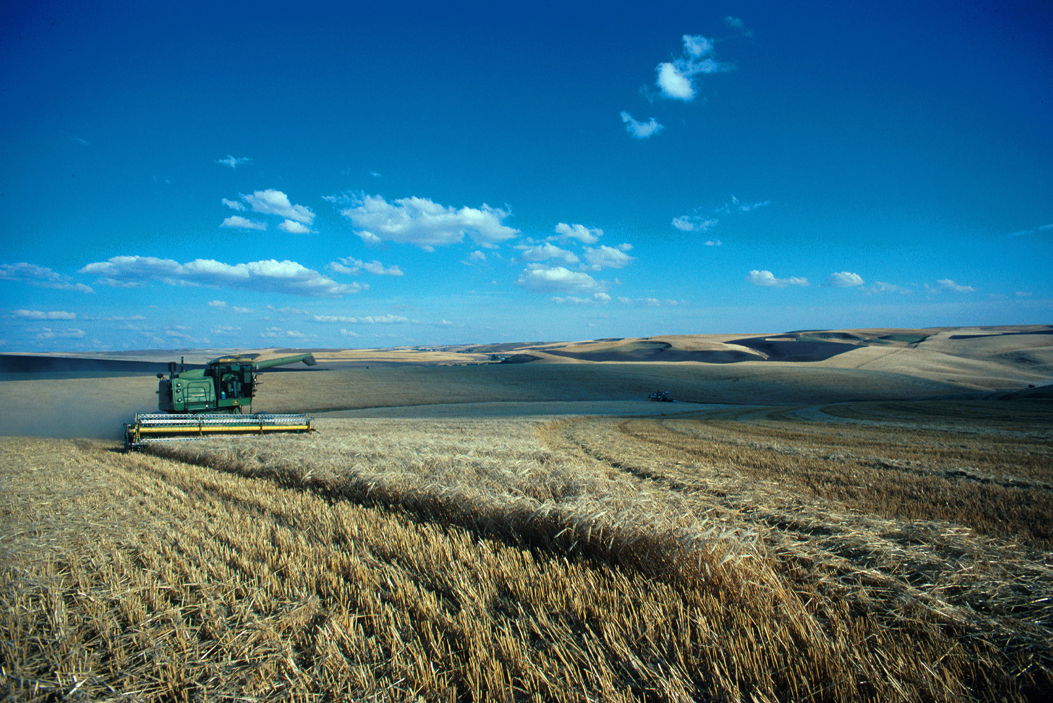
Questions?
Elyssa.Arnold@usda.gov

