Slide 1
Update | Fall 2023
Rubella Goswami, Ph.D., Director, Division of Plant Systems-Protection
Emmanuel Byamukama, Ph.D., NPL, Plant Systems-Protection
Vijay Nandula, Ph.D., NPL, Plant Systems-Protection

Slide 2
Non-Discrimination Statement
https://www.usda.gov/non-discrimination-statement
In accordance with federal civil rights law and U.S. Department of Agriculture (USDA) civil rights regulations and policies, the USDA, its Agencies, offices, and employees, and institutions participating in or administering USDA programs, are prohibited from discriminating based on race, color, national origin, religion, sex, gender identity (including gender expression), sexual orientation, disability, age, marital status, family/parental status, income derived from a public assistance program, political beliefs, or reprisal or retaliation for prior civil rights activity, in any program or activity conducted or funded by USDA (not all bases apply to all programs). Remedies and complaint filing deadlines vary by program or incident.
Persons with disabilities who require alternative means of communication for program information (e.g., Braille, large print, audiotape, American Sign Language, etc.) should contact the responsible agency or USDA’s TARGET Center at (202) 720-2600 (voice and TTY) or contact USDA through the Federal Relay Service at (800) 877-8339. Additionally, program information may be made available in languages other than English.
To file a program discrimination complaint, complete the USDA Program Discrimination Complaint Form, AD-3027, found online at How to File a Program Discrimination Complaint and at any USDA office or write a letter addressed to USDA and provide in the letter all of the information requested in the form. To request a copy of the complaint form, call (866) 632-9992. Submit your completed form or letter to USDA by: (1) mail: U.S. Department of Agriculture, Office of the Assistant Secretary for Civil Rights, 1400 Independence Avenue, SW, Washington, D.C. 20250-9410; (2) fax (202) 690-7442; or (3) email: program.intake@usda.gov.
USDA is an equal opportunity provider, employer and lender.

Slide 3
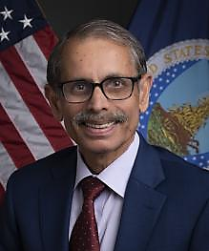
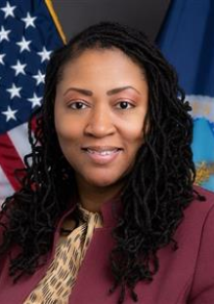
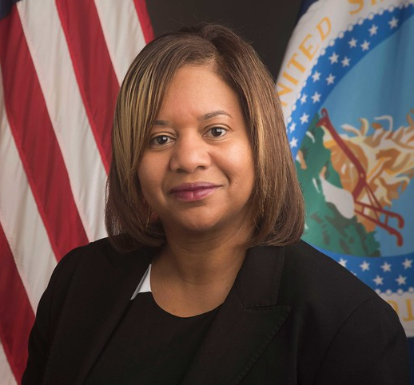
NIFA Leadership and Staffing
Assoc. Director for Programs
Dr. Dionne Toombs
NIFA Director
Dr. Manjit K. Misra
Associate Director for Operations
Drenda Williams
Institute of Food Production and Sustainability Deputy Director Dr. Venu (Kal) Kalavacharla – Acting
Division Director of Plant Protection
Dr. Rubella Goswami

Slide 4
NIFA Priorities
Addressing the Administration’s priorities
Supporting partners in addressing critical needs
Realizing the agency NIFA was created to be

Slide 5
USDA Priorities
Addressing Climate Change via Climate-smart Agriculture and Forestry
Advancing Racial Justice, Equity and Opportunity
Creating More and Better Markets Opportunities
Tackling Food and Nutrition Insecurity and Food Safety
Making USDA a Great Place to Work for Everyone
USDA Strategic Plan 2022-2026 https://www.usda.gov/sites/default/files/documents/usda-fy-2022-2026-strategic-plan.pdf

Slide 6
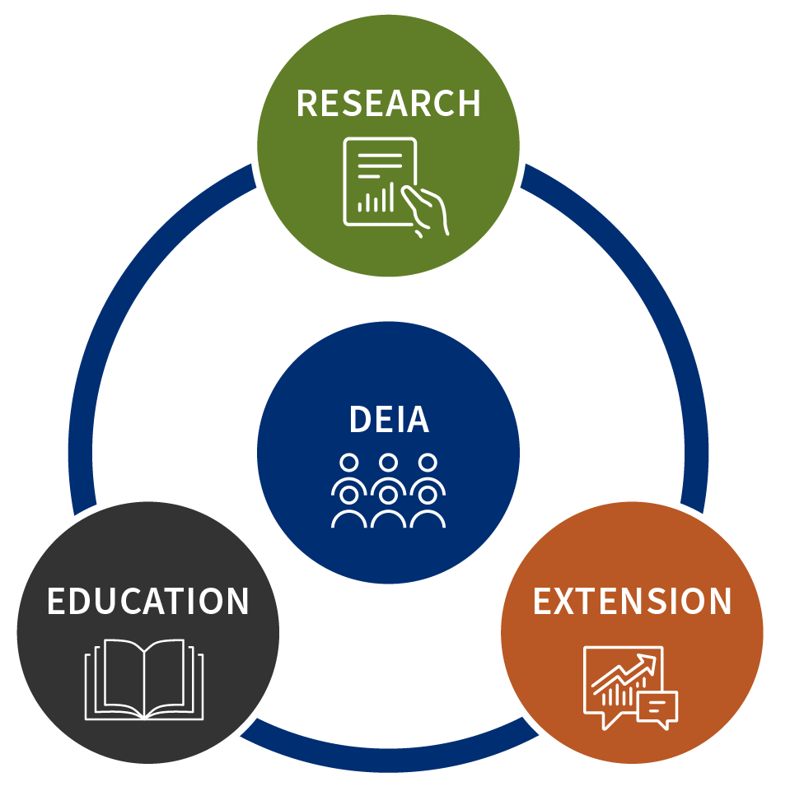
ALIGNMENT OF USDA AND NIFA STRATEGIES
Icon
Implementation strategy type
Research Activity
Education Activity
Extension Activity
DEIA Activity
Core NIFA support areas of Research, Education and Extension; unified through the lens of Diversity, Equity, Inclusion and Accessibility.

Slide 7
Climate Change
Expertise in climate-smart agriculture and forestry practices
Passion and commitment from stakeholders​
U.S. leadership in climate change mitigation​
NIFA taking action on NIFA Climate Adaptation and Resilience Plan​
New AFRI program area priority in Environmental Justice (A1461)
New $5 million investment to reduce enteric methane in AFRI SAS
Actively assessing all programs for ways to incorporate climate change, environmental justice and Indigenous and traditional ecological knowledge
Climate change road map development near completion​
Notes:
federal research projects and programming.

Slide 8
Environmental Justice
Environmental justice: just treatment and meaningful involvement of all people, regardless of income, race, color, national origin, Tribal affiliation, or disability, in agency decision-making and other Federal activities that affect human health and the environment so that people:
Are fully protected from disproportionate and adverse human health and environmental effects (including risks) and hazards, including those related to climate change, the cumulative impacts of environmental and other burdens, and the legacy of racism or other structural or systemic barriers; and
Have equitable access to a healthy, sustainable, and resilient environment in which to live, play, work, learn, grow, worship, and engage in cultural and subsistence practices.

Slide 9
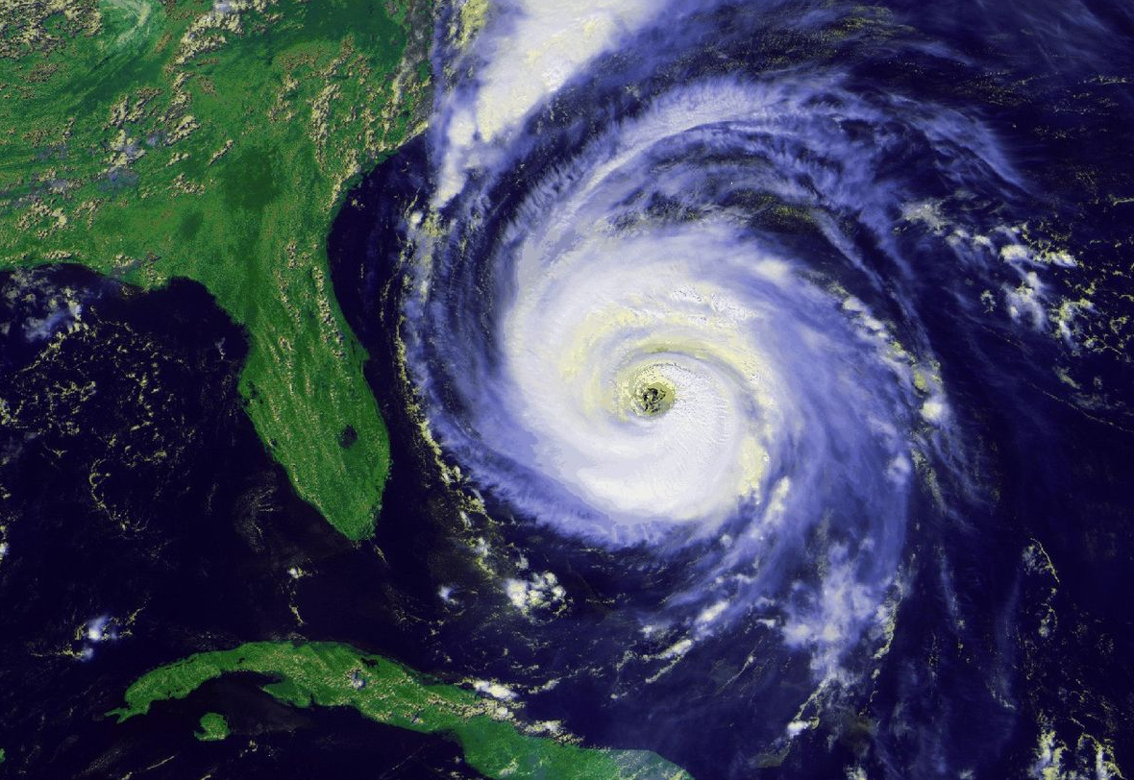
NIFA Support for Responding to Emergencies
Smith-Lever Special Needs Competitive Grants Program
Supports emergency preparedness and response education programs
Smith-Lever, 1890 Extension Capacity Funds
Trained agents on the ground, ready to respond
Rapid Response to Extreme Weather Events, AFRI ​A1712 , Foundational and Applied Science
Supports urgent solutions in rapid response to extreme weather; rolling letter of intent deadline
Picture of a hurricane image off the East coast of Florida

Slide 10
NIFA Support for Responding to Emergencies
AFRI A1712 Rapid Response to Extreme Weather Events,
Supports urgent solutions in rapid response to extreme weather; rolling letter of intent deadline
Kentucky State University (A. Bernard), Mitigating Health Disparities Among Flood Victims: The Case of Eastern Kentucky
New Mexico State University (C. Gifford), Implementation of Virtual Fencing Technology to Build Resiliency of Agriculture Systems Impacted by Wildfire and Subsequent Flooding
Louisiana State University (S. L. Conger), Decision Support, Education, and Outreach for Managing Agricultural Drought

Slide 11
FY 2024 President’s Budget Request
2024 USDA Budget Summary:
https://www.usda.gov/sites/default/files/documents/2024-usda-budget-summary.pdf
USDA Congressional Justifications (Explanatory Notes):
https://www.usda.gov/cj
NIFA 2024 Budget Brochure:
https://www.nifa.usda.gov/archived-budget-information (2024 not yet published)
NIFA Congressional Justifications (Explanatory Notes):
https://www.usda.gov/sites/default/files/documents/22-2024-NIFA.pdf

Slide 12
Addressing needs of partners
Funding collaborative projects that deliver solutions
Listening through input sessions
Adding more webinars and feedback sessions
Focusing on high-quality customer service
Enhancing the 4-H Headquarters with strong, experienced leaders and new science advisors at LGUs
Hiring strategically to provide for better support

Slide 13
Diversity, Equity, Inclusion, & Accessibility (DEIA)
Assess current practices and develop action items to advance diversity, equity, inclusion and accessibility across the agency.​
Awarded $325K to NCIPMC to enhance DEIA activities within IPM programs across the nation

Slide 14
NIFA Funding Overview
FISCAL YEAR 2022:
More than 2,500 grants
Approximately 70 programs
TOTAL FUNDING AMOUNT:
$2.2 billion
FISCAL YEAR 2023 TOTAL FUNDING: $1.9 B

Slide 15
NIFA Funding Overview
Fiscal Year 2023 Appropriations Highlights
$1.71 billion in discretionary funding, a 3% increase
$231.9 million in mandatory funding, a 13% increase
Research and Education
AFRI — $455 million, $10 million increase
SARE — $50 million, $5 million increase
Capacity
Hatch: $265 million, $5 million increase
Evans-Allen: $89 million, $9 million increase
McIntire-Stennis: $38 million, $2 million increase
Education grants for MSIs: $56 million overall, $4.5 million increase
Extension and Integrated
Smith-Lever 3(b)(c): $325 million, $5 million increase
Extension Services at 1890s/1994s: $83 million, $8.5 million increase
Comparisons against FY 2022 enacted

Slide 16
Programs Supported by FY 2023 Legislation
AMERICAN RESCUE PLAN ACT
Ag Career Development at Minority-Serving Institutions (NEXTGEN) ($250M)
Technical Assistance to Underserved Producers ($100M+)
GusNIP, Community Food Projects, WIC Workforce ($62M)
Meat and Poultry Processing Agriculture Workforce Training ($59M)
Extension Risk Management Education ($2.5M)
Sustainable Agriculture Research and Education ($2.5M)
Community Colleges ($20M)
Centers of Excellence at 1890 Land-grant Universities ($10M)
BIPARTISAN INFRASTRUCTURE LAW
Bioproduct Pilot Program ($10M)
FY23 CONSOLIDATED APPROPRIATIONS ACT
Institutes for Rural Partnerships ($28M; University of Vermont, University of Wisconsin, Auburn University)

Slide 17
NIFA Funding Overview
Fiscal Year 2024 President’s Budget Proposal
$1.868 billion: for NIFA discretionary programs, a 9% proposed increase
$892 million: for NIFA capacity programs, about a 3.5% proposed increase
Program-Specific Funding
AFRI: $550 million, a 21% proposed increase
$20 million for Cancer Moonshot
Increased investment for education and workforce development
SARE: $60 million, a 20% proposed increase
IR-4: $2 million proposed increase for Minor Crop Pest Management
Budget submitted in Spring 2023

Slide 18
Realizing NIFA’s Potential
Fully staffed NIFA workforce
Improving NIFA processes
Increasing customer service
New NIFA website launched
Re-engineering RFAs
Grants management system
NIFA Reporting System

Slide 19
Competitive Funding Opportunities

Slide 20
Crop Protection and Pest Management
Applied Research and Development Program Area (ARDP)
Funds applied IPM research and Extension projects that will ensure food security and respond effectively to major societal pest (insects, pathogens, weeds, nematodes) management challenges with comprehensive IPM approaches that are economically viable, ecologically prudent and safe for human health
Proposed Budget Requests: $200,000 - $325,000 per project (2-3 years)
Project Types: Standard: Research only, Research-led, Extension-led
Application Deadline: TBD for FY 2024
Contacts: Vijay Nandula vijay.nandula@usda.gov Emmanuel Byamukama Emmanuel.Byamukama@usda.gov

Slide 21
Crop Protection and Pest Management
Extension Implementation Program Area (EIP)
The EIP funds projects based on selected priorities intended to increase IPM implementation among the clientele served
Proposed Budget Requests: $300,000/year (3 years)
Project Types: Standard
Application Deadline: TBD for FY 2024
Contacts: Emmanuel Byamukama Emmanuel.Byamukama@usda.gov Vijay Nandula vijay.nandula@usda.gov

Slide 22
Crop Protection and Pest Management
Regional Coordination Program Area (RCP)
The RCP funds projects to increase coordination and improve efficiency of IPM research and extension efforts; facilitate collaboration across states, disciplines, and purposes; and promote further development and adoption of IPM
Proposed Budget Requests: $4.15 M/year (4 years)
Project Types: Standard
Application Deadline: Continuations in FY 2024
Contacts: Vijay Nandula vijay.nandula@usda.gov Emmanuel Byamukama Emmanuel.Byamukama@usda.gov

Slide 23
CPPM Listening Session held on 8/2/2023
The main objective of the virtual listening session was to solicit stakeholder input with regards to all the three components of the CPPM program.
During the session, stakeholders shared their thoughts regarding the structure and priorities of the current CPPM program and suggestions for changes/improvements
Additionally, written comments were submitted via an email (CPPM.NIFA@usda.gov) up to one week after the listening session webinar.

Slide 24
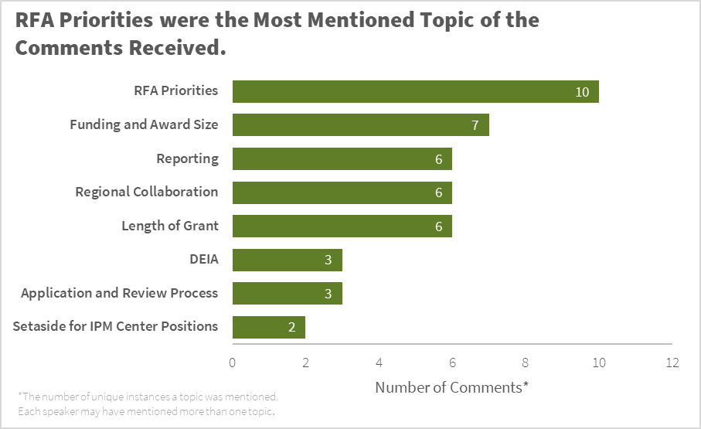
CPPM Listening Session – Summary
127 unique participants; 68 institutions; 17 presenters at LS; 12 provided written comments; some overlap between both

Slide 25
Listening session – Main comments
Increase the award duration for EIP and RCP
Reduce on the burden of reporting for EIP (REEport)
Primary and secondary priorities are confusing
Increase the funding levels for EIP and RCP
Eliminate the logic model

Slide 26
Listening session – Main comments cont’d
Could HBCUs and other MSIs apply for EIP funds
Engineering solutions for pests not being funded
Other comments were about streamlining the RFA language
The importance of EIP funding was acknowledged

Slide 27
Methyl Bromide Transition (MBT) program
The purpose of the MBT program is to support the discovery and implementation of practical pest management alternatives for commodities and uses affected by the methyl bromide phase-out.
The MBT program seeks to solve pest problems in key agricultural production and post-harvest management systems, processing facilities, and transport systems for which methyl bromide has been withdrawn or withdrawal is imminent.
Proposed Budget Requests: $500,000 (2-3 years)
Project Types: Integrated, Extension only
Application Deadline: TBD, 2024
Contact: Amer Fayad amer.fayad@usda.gov

Slide 28
AFRI Critical Agricultural Research and Extension (CARE – A1701)
Goal: Address critical challenges and opportunities to improve the nation’s agricultural and food systems and address issues that need immediate attention. Should lead to readily and rapidly adoptable practices
Proposed Budget Requests: Up to $300,000 per project (1-3 years)
Project Types: Integrated Projects (Research and Extension) only
Application Deadline: was September 14, 2023 (5:00 pm ET)
Contacts: Vijay Nandula vijay.nandula@usda.gov
James Dobrowolski, james.dobrowolski@usda.gov

Slide 29
AFRI Agricultural Biosecurity (A1181 )
This program area priority focuses on increasing U.S. national capacity to prevent, rapidly detect and respond to biological threats to U.S. agriculture and food supply. Supported activities will be aimed at increasing agricultural biosecurity at the regional and national levels, and across the public and private sectors.
Detection and diagnostics of transboundary, emerging, or re-emerging pests and diseases associated with animal production systems and/or transboundary, emerging, re-emerging and invasive diseases, insects and weeds associated with plant production systems.
Rapid response to, and recovery from, pests and diseases that pose large-scale biosecurity threats to plant and animal production, including existing and imminent threats to U.S. agricultural production and food supply systems.
Proposed Budget Requests: up to $650,000 for single-function projects (3-5 years); $800,000 with specific partnerships; up to $1 million for integrated projects (3-5 years); up to $300,000 for seed grants (up to 2 years)
Project Types: Research, Extension and Integrated Projects only
Application Deadline: October 19, 2024 (5:00 pm ET)
Contacts: Amer Fayad amer.fayad@usda.gov and
Michelle Colby michelle.colby@usda.gov

Slide 30
Equipment Grants Program (EGP)
Not AFRI
Not Education
Funds the acquisition of shared-use special purpose equipment/instruments for fundamental and applied research for use in the food and agricultural sciences programs including data science and data systems.
EGP grants are not intended to replace requests for equipment in individual project applications through other NIFA capacity/competitive programs.
Funding Request: $25,000-$500,000
Duration: 3 years
Proposals per Institution: Two maximum
Awards per Institution: One maximum
Application Submission Deadline: TBD, FY 2024
Program Contacts: Carlos Ortiz (carlos.ortiz@usda.gov ) or Mallory Koenings (mallory.koenings@usda.gov )
Pictures of field and laboratory equipment
This Photo by Unknown Author is licensed under CC BY-SA

Slide 31
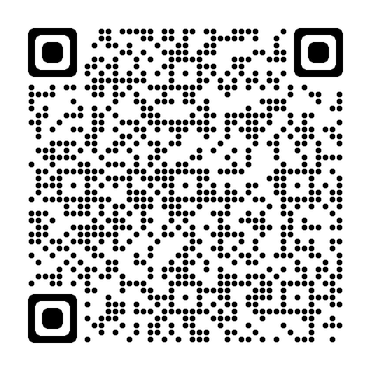
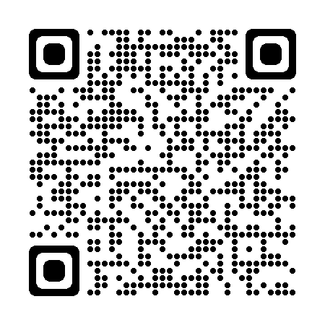
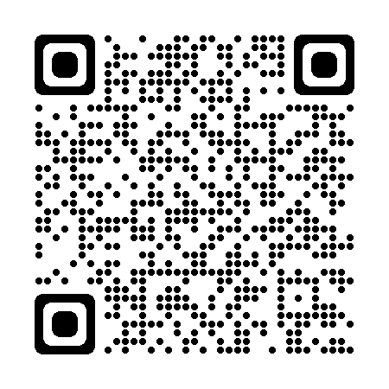
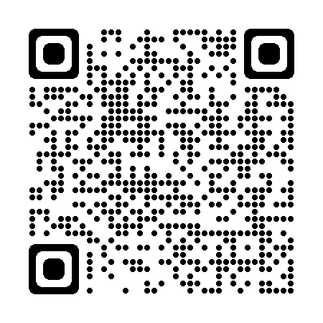
Engage with NIFA
Visit www.nifa.usda.gov and follow us on social media
Explore
our programs
Bookmark
the RFA schedule
Participate
as panel reviewer
Subscribe
to NIFA Update
Notes:
But engaging with NIFA is easy.
The programs I mentioned earlier are easily searchable on our website—nifa.usda.gov. We invite HSIs to engage with us by visiting our website, reaching out to agency staff, serving on our peer-review panels, following our social media accounts, and by subscribing to our NIFA Update newsletter, which provides weekly updates from the agency.
We look forward to enable your institutions find ways to change agriculture and your student lives with the support of NIFA programs
Thank you.

Slide 32
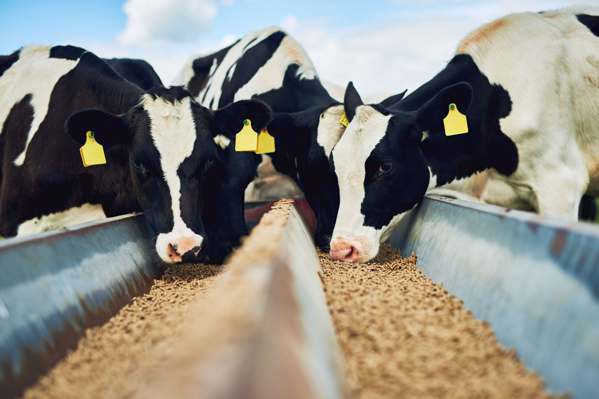
Together On A Mission

