Slide 1
SIPM Center and SERA 3 Update
National IPM Coordinating Committee
San Juan, Puerto Rico

Slide 2
Southern IPM Grants
Arkansas Pest Monitoring
SERA IPM Prioritization
Connecting IPM

Slide 3
2023 Funded Projects
SIPMC received 24 proposals with total requested funds of $747,468.
We funded eight projects, including four working groups, for a total of $264,324.
Disciplines, many interdisciplinary, range from Human Health, Entomology, Plant Pathology, Weed Science, Soil Health, and Nematology.
Notes:
Roger/Kayla to replace with SERA -03

Slide 4
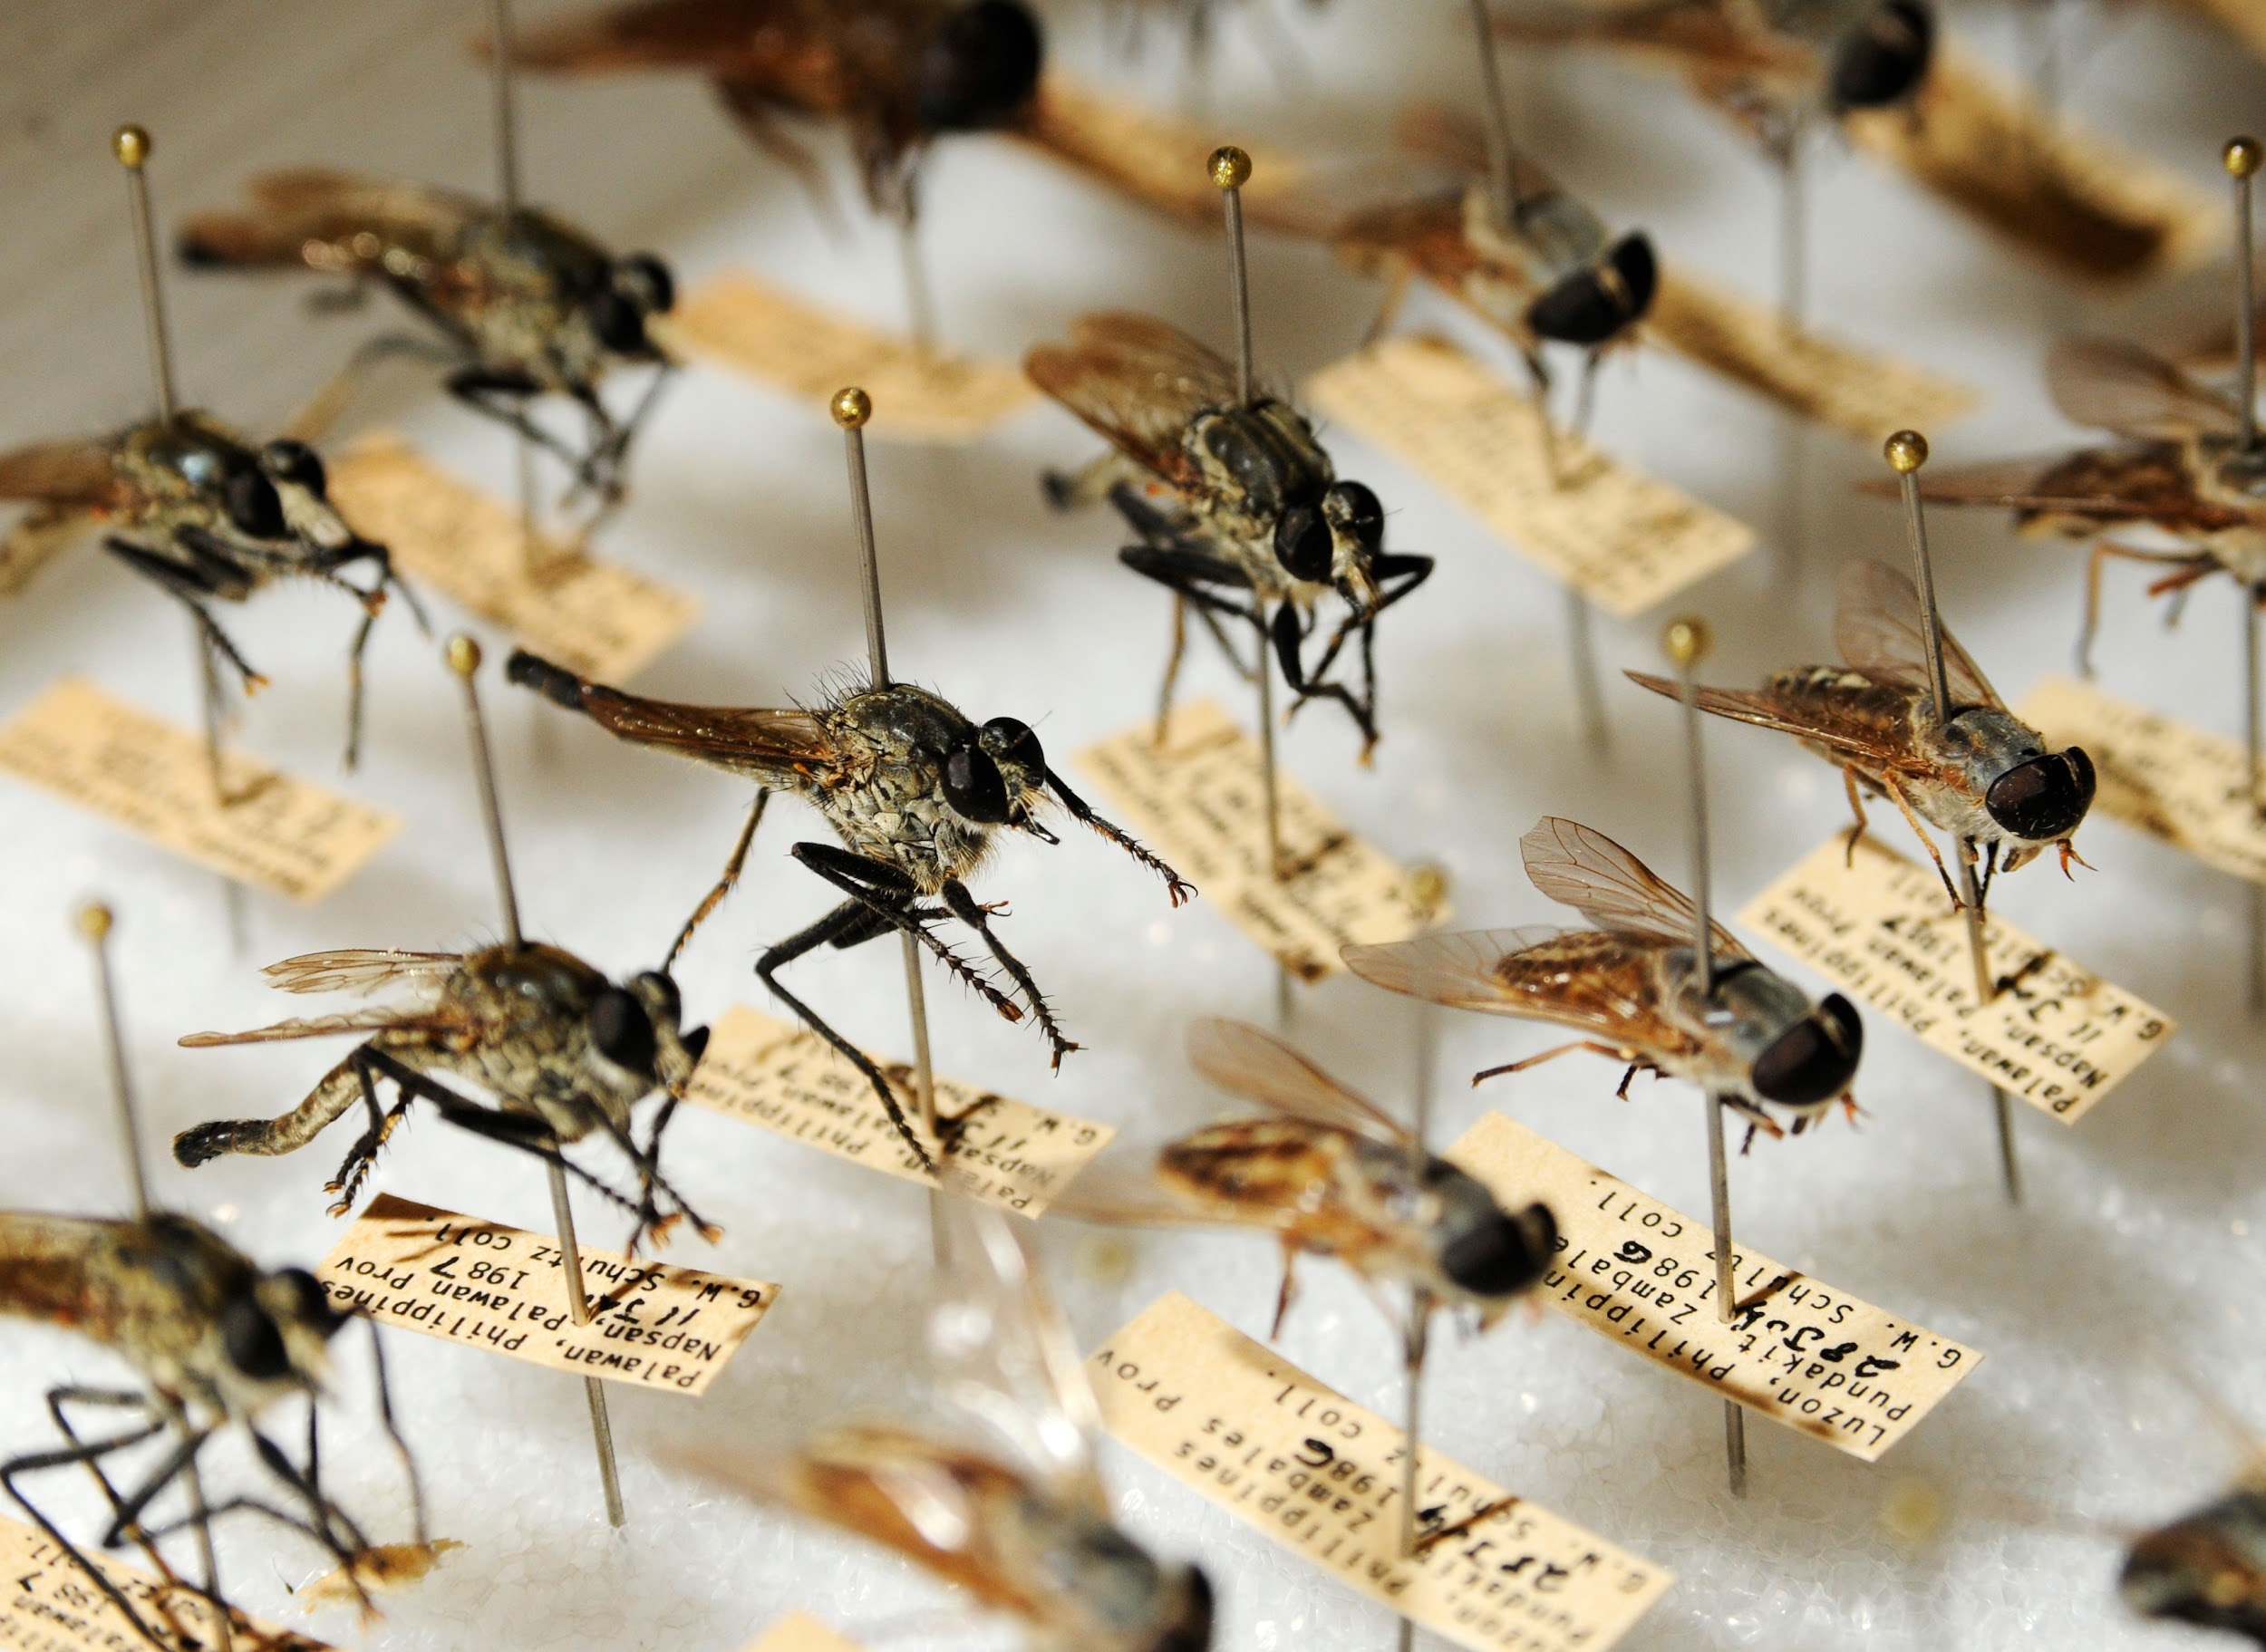
2023 Funded IPM Grants
IPM Working Group: Mosquito BEACONS - Biodiversity Enhancement And Control of Non-native Species, Dr.Yoosook Lee
Pecan Leaf Dieback Working Group, Dr. Young-Ki Jo
Relay Intercropping Soybean into Wheat: An IPM Tool for Sustainable Weed Management, Dr. Jason Norsworthy
Management of Insecticide-resistant western flower thrips in fruiting vegetables, Dr. Jim Walgenbach
Suppression of Guava Root Knot Nematode using Sesame as a rotational alternative, Angela Post, NC State

Slide 5
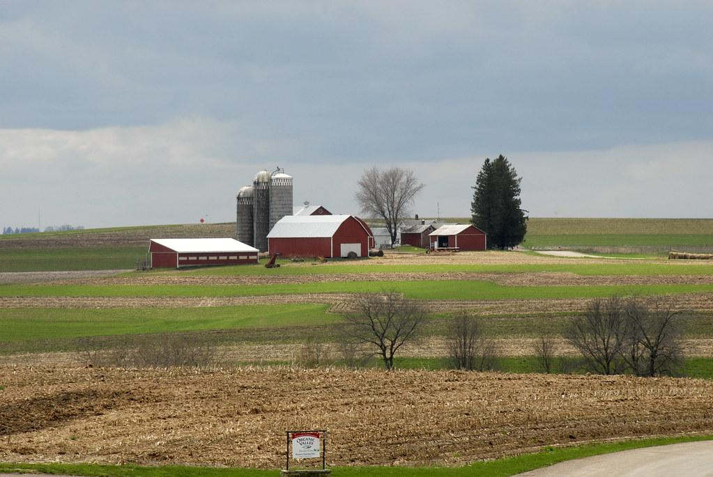
2023 Funded IPM Grants
Delusional Infestation Working Group, Dr. Karen Vail
Incorporating allelopathic cover crops, soil steaming, and biochar herbicide protection pods (HPPs) for integrated weed management and improved soil health in tomato, Dr. Te Ming (Paul) Tseng
MyIPM: Vegetables- Expanding the Reach of the MyIPM App and Southeast Vegetable Extension Workers, Dr. Rebecca Melanson

Slide 6
Southern Region Delusional Infestations Working Group
Funded by SIPM Center
One Health approach, including a psychologist and psychiatrist along with Extension entomologists and pest management professionals, to better equip the Extension agents, entomologists and pest management professionals in the southern region to handle suspected delusional parasitosis.
WASHINGTON
MONTANA
NORTH
MINNESOTA
MAINE
DAKOTA
VT
OREGON
WISCONSIN
NH
IDAHO
SOUTH
MASS
WYOMING
DAKOTA
MICHIGAN
NEW YORK
RI
IOWA
PENN
NEW
CONN
NEVADA
NEBRASKA
OHIO
JERSEY
UTAH
ILLINOIS
INDIANA
DELAWARE
COLORADO
WV
MARYLAND
KANSAS
MISSOURI
KENTUCKY
VIRGINIA
CALIFORNIA
NORTH
TENNESSEE
CAROLINA
ARIZONA
OKLAHOMA
ARKANSAS
SOUTH
NEW MEXICO
CAROLINA
MISS
ALABAMA
GEORGIA
TEXAS
FLORIDA
LOUISIANA
Notes:
After the success of the UT One Health Initiative DP Working Group Model, we sought cooperators to apply this model to the southern region. In this SR IPM Center funded project, we now have 33 urban Extension entomologists or pest management professionals, and a psychologist and psychiatrist with representatives from 12 of 13 states (missing Oklahoma)

Slide 7
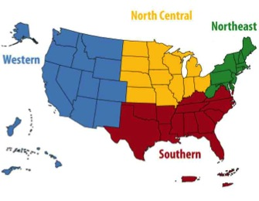
Southern Region Delusional Infestations Working Group
WASHINGTON
1) create a Southern group to define and prioritize needs to resolve Delusional Infestations (DI) better,
2) develop outputs to describe DI and how entomology, Extension, and pest management professionals can assist DI sufferers safely, caringly and respectfully to lead them toward a resolution of the condition, and
3) deliver these DI materials to assist these professionals with cases.
MONTANA
NORTH
MINNESOTA
MAINE
DAKOTA
VT
OREGON
WISCONSIN
NH
IDAHO
SOUTH
MASS
WYOMING
DAKOTA
MICHIGAN
NEW YORK
RI
IOWA
PENN
NEW
CONN
NEVADA
NEBRASKA
OHIO
JERSEY
UTAH
ILLINOIS
INDIANA
DELAWARE
COLORADO
WV
MARYLAND
KANSAS
MISSOURI
KENTUCKY
VIRGINIA
CALIFORNIA
NORTH
TENNESSEE
CAROLINA
ARIZONA
OKLAHOMA
ARKANSAS
SOUTH
NEW MEXICO
CAROLINA
MISS
ALABAMA
GEORGIA
TEXAS
FLORIDA
LOUISIANA
Notes:
Currently, our biggest funding source will likely be the regional IPM centers which has a mission of:
*** read mission***
Southern region IPM centers POCs have been contacted and 11 of 13 states have already very excitedly expressed interest in following the TN Model for approaching DP cases collaboratively using a one health initiative
Were missing a response from OK
And MS declined due to other obligations

Slide 8
Southern Region Delusional Infestations Working Group
Develop a digital and print version:
simple fact sheet on potential causes of skin irritations
checklist of potential irritated skin causes
protocol for county Extension agent (Ag & FCS) to respond to suspected DI cases
A digital manual with in-depth explanations of the three publications listed above
Develop new products identified in needs prioritization (Biting and Stinging Pub)
Develop PowerPoint presentation for training in each state
Deliver training in each state
Notes:
Currently, our biggest funding source will likely be the regional IPM centers which has a mission of:
*** read mission***
Southern region IPM centers POCs have been contacted and 11 of 13 states have already very excitedly expressed interest in following the TN Model for approaching DP cases collaboratively using a one health initiative
Were missing a response from OK
And MS declined due to other obligations

Slide 9
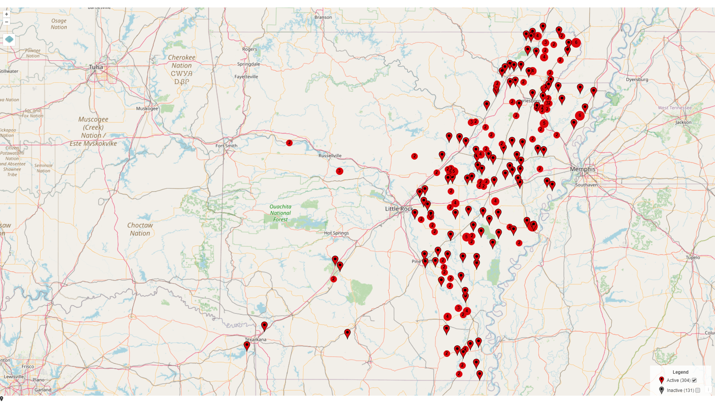
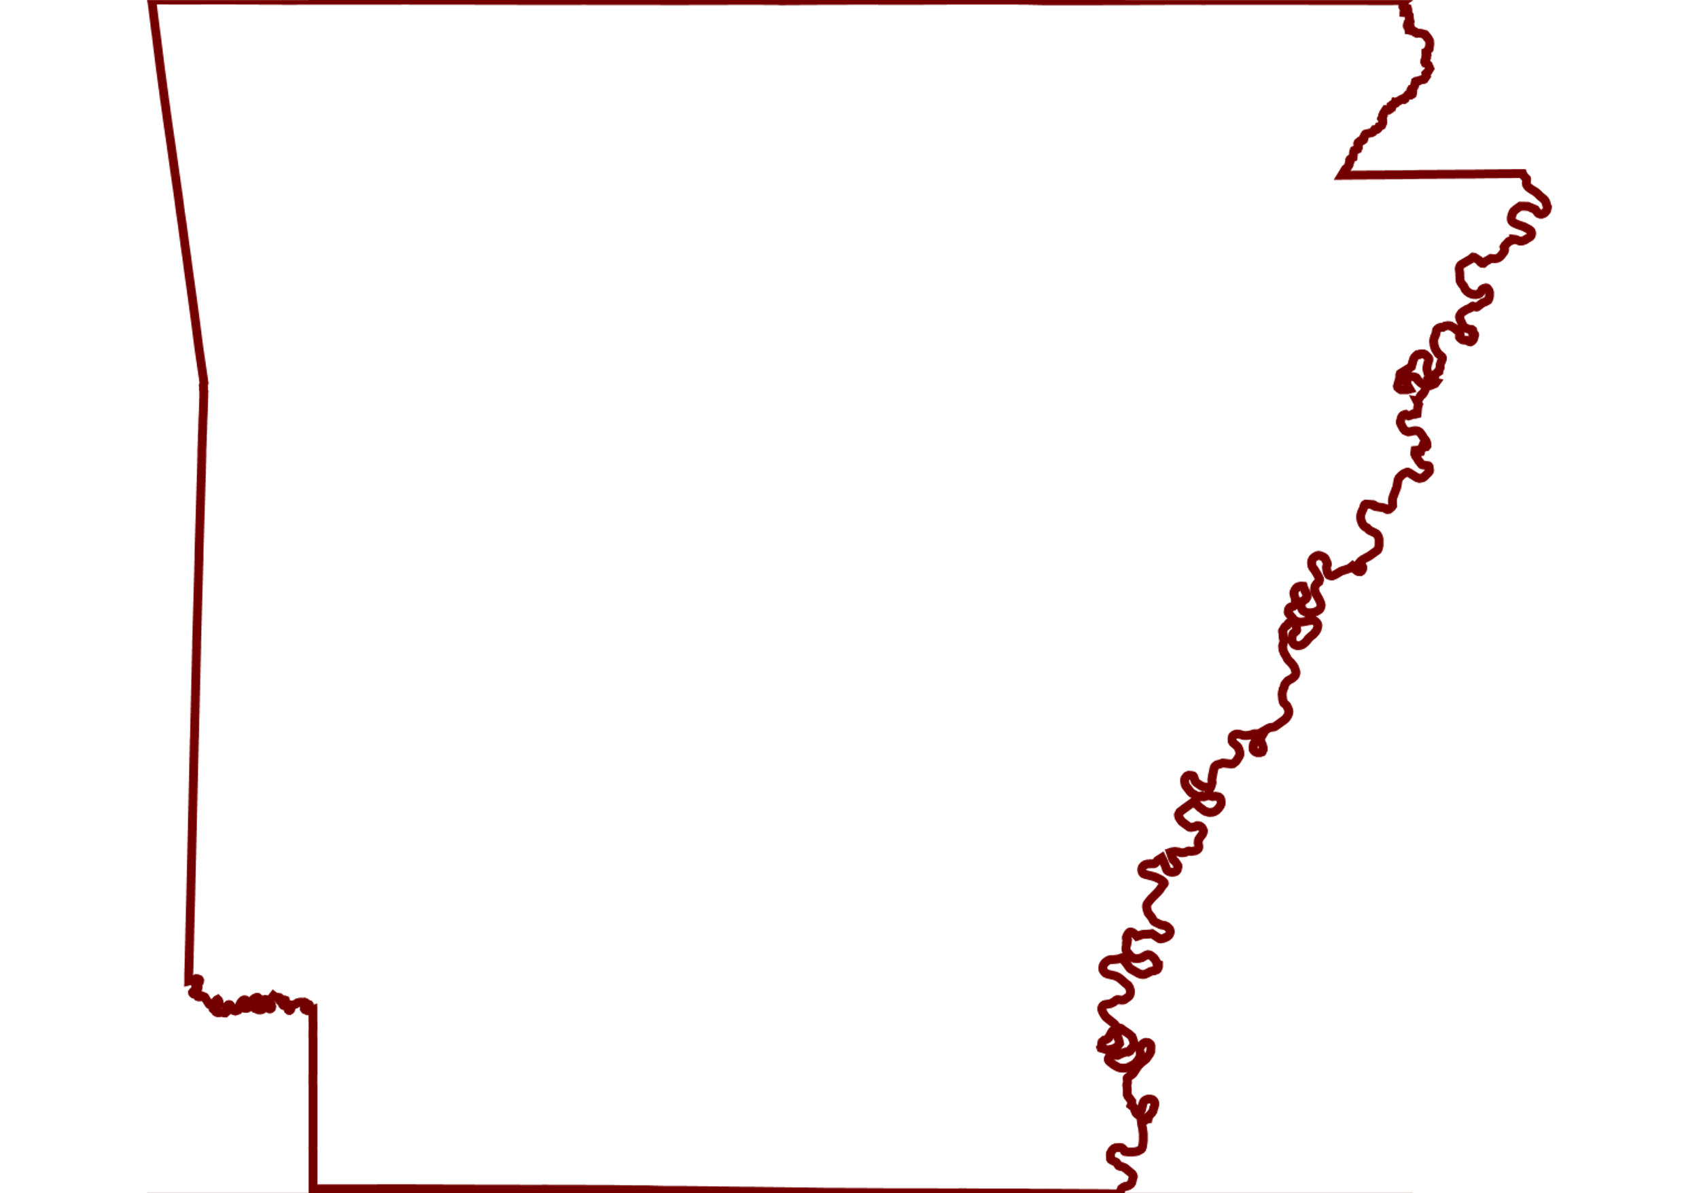
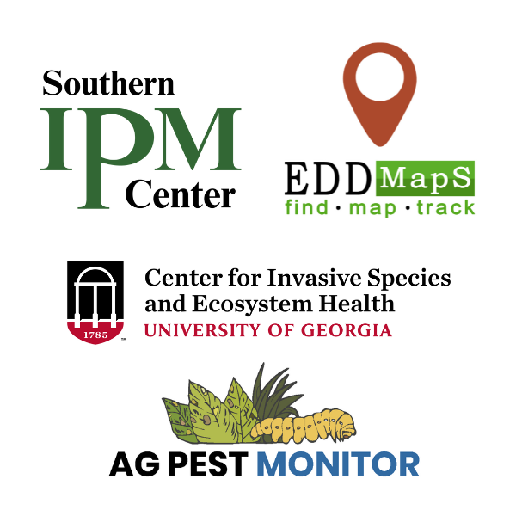
Arkansas Pest and Disease Monitoring
Led by Glenn Studebaker & Matthew Mann
Supported by agents, specialists, & University IT

Slide 10
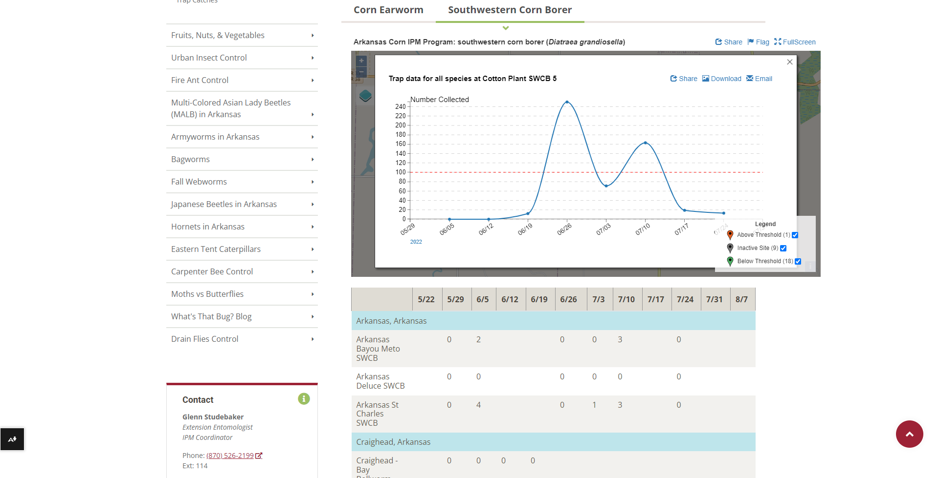
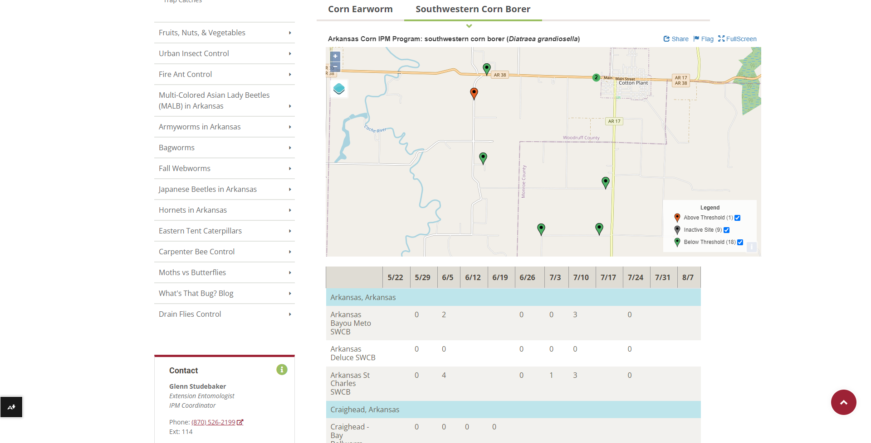

Slide 11
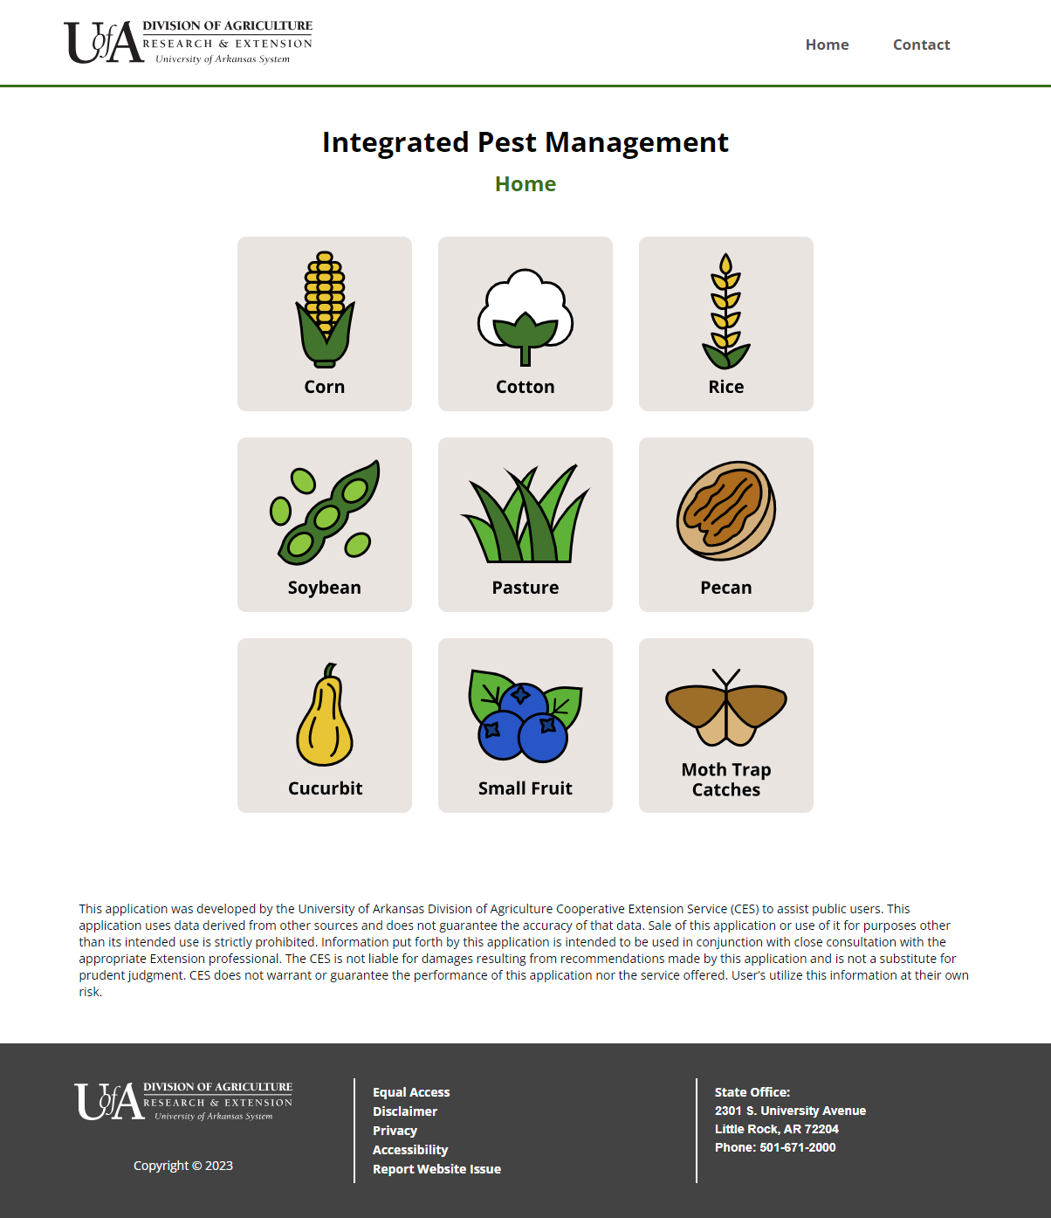

Slide 12
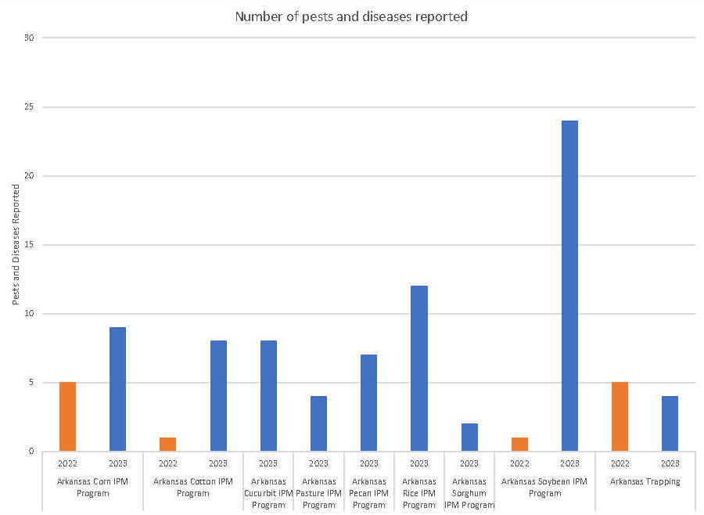

Slide 13
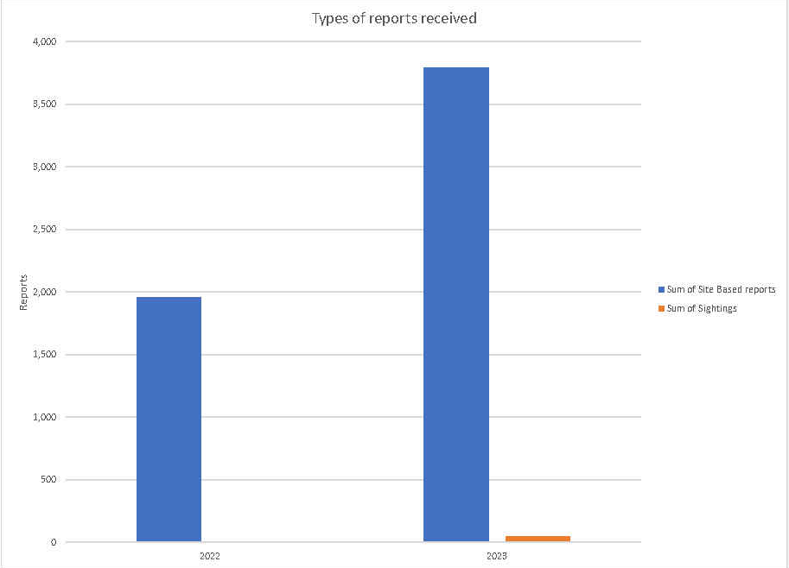

Slide 14
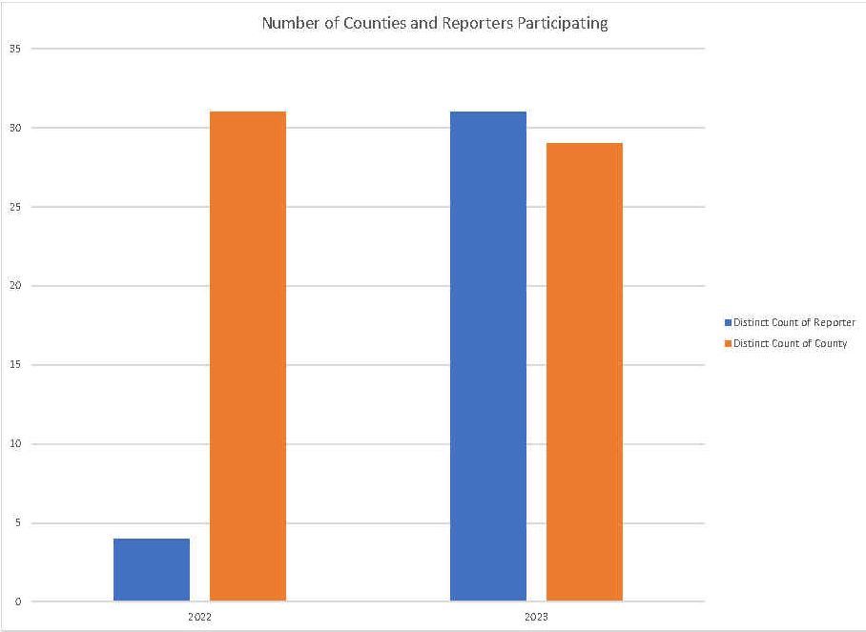

Slide 15
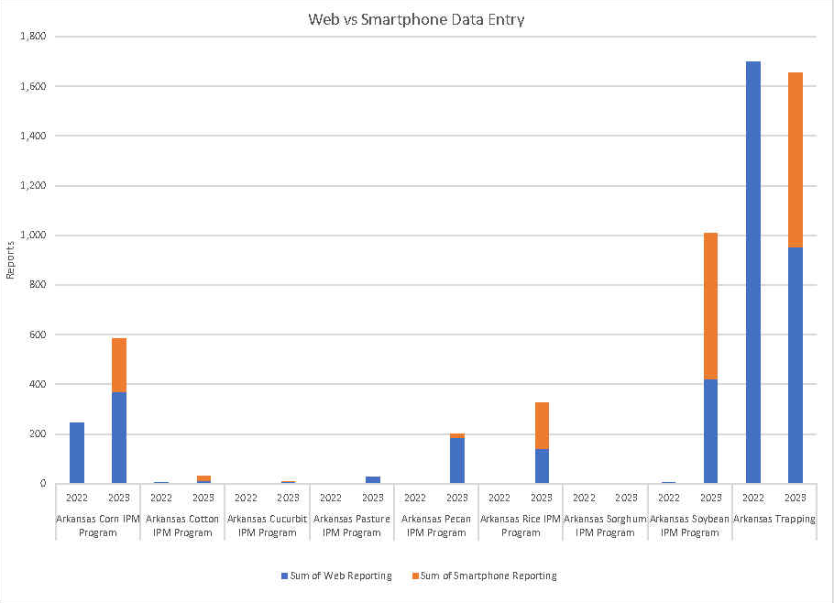

Slide 16
SERA3 & SIPMC: Improving how the South sets IPM priorities

Slide 17
Improved Prioritization Process
Multi-vote survey to collaborators/EIP co-PIs
Collection of more robust data
Multiple data sources from each state
Aggregated State data used to compile regional priorities
Reduced burden on State IPM coordinators

Slide 18
Improved Prioritization Process
SERA3 Compiles list of collaborators/EIP co-PIs
SIPMC prepares & distributes survey
Collaborators/EIP co-PIs respond to survey
SERA3 reviews State data
SIPMC analyze results & updates priority document
SERA3 finalizes priority document at annual meeting
SIPMC publishes document

Slide 19
Connecting IPM Working groups, organizations, individuals
Who is involved now?
Is anyone missing?
How do I recruit?
Better way to make new groups?

Slide 20
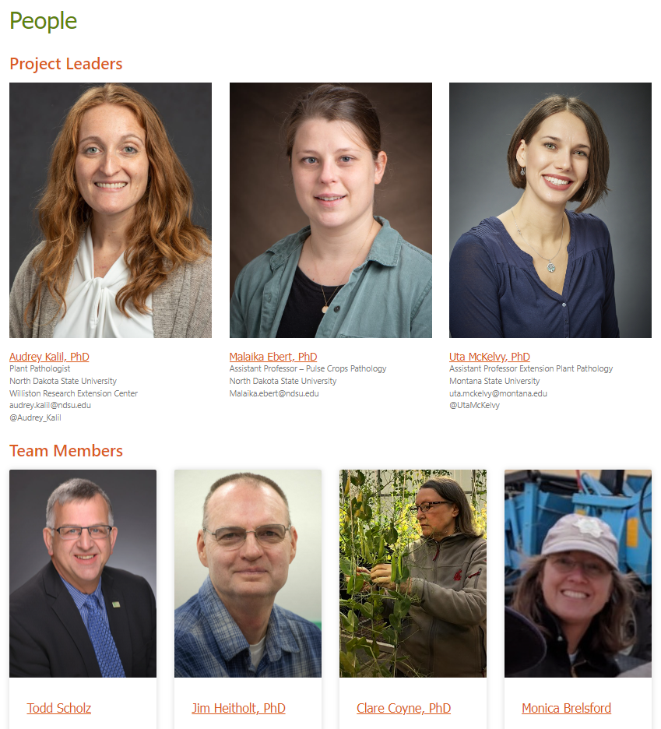
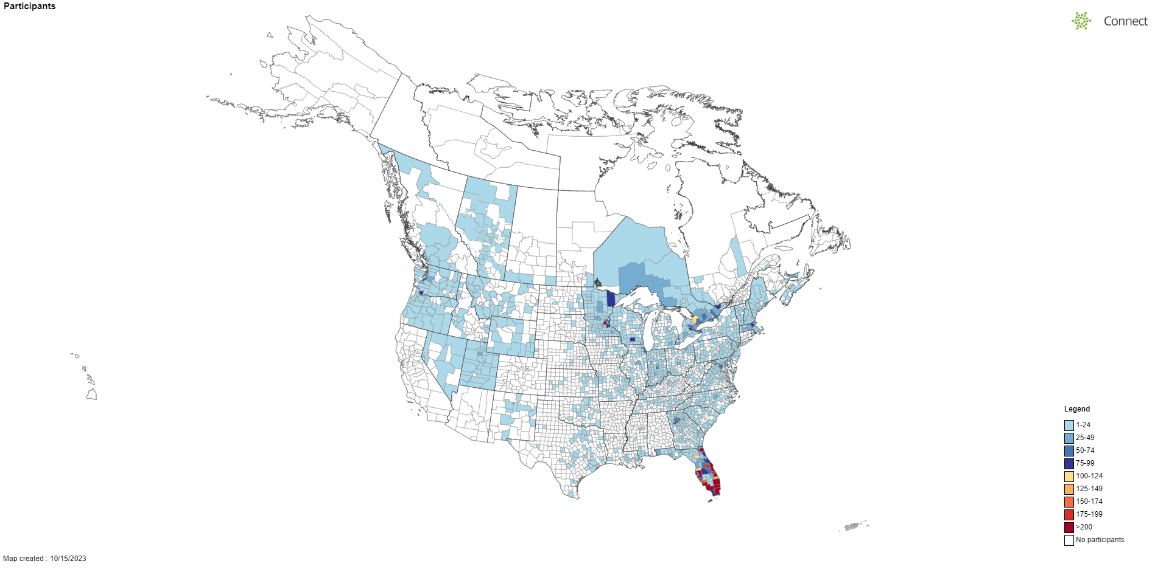
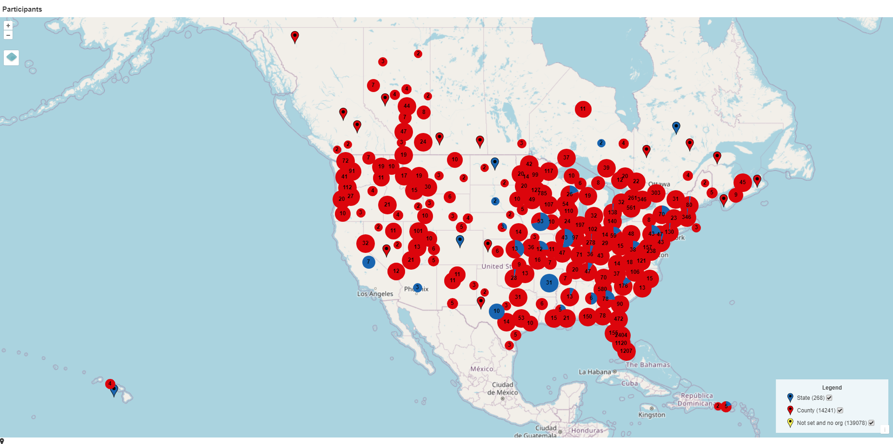
One user profile for ALL groups
One step to add or update groups
Automated correction of e-mail addresses
Composition reports
User demographics
Organizational breakdowns
County and Point maps for participants
Add to website – ANY website!
Look for release this Fall!

Slide 21
Questions?

