Slide 1
Farming and Food Narrative Project
A Collaboration of IPM Voice, Red Tomato, and Frameworks Institute

Slide 2
Problem
Difficulty communicating IPM to the public
Expanded to difficulty communicating good farming (crop production) practices to the public
Binary good/bad traps
Difficulty communicating science
More data, more science is not working
Can social science help us communicate more effectively?

Slide 3
Frameworks Institute Research Process
1
E
2
3
CM
Descriptive
Expert
Interviews
Cognitive Interviews
Media Content & Field Frame Analysis
What needs to be communicated?
How does the public think?
What frames are in play already?
4
5
OTS
6
7
On-the-Street / On-line
Interviews
Reframe Candidates
Controlled
Experiments
Qualitative Frame Testing
Prescriptive
What reframes are plausible?
Which reframes seem to work?
Which reframe drives people’s preferences?
How will this frame fare in the world?
Notes:
Neglect experiment: 4,550 members of the British public, recruited to match demographic baselines
provided by the UK’s OfGice for NationalStatistics.

Slide 4
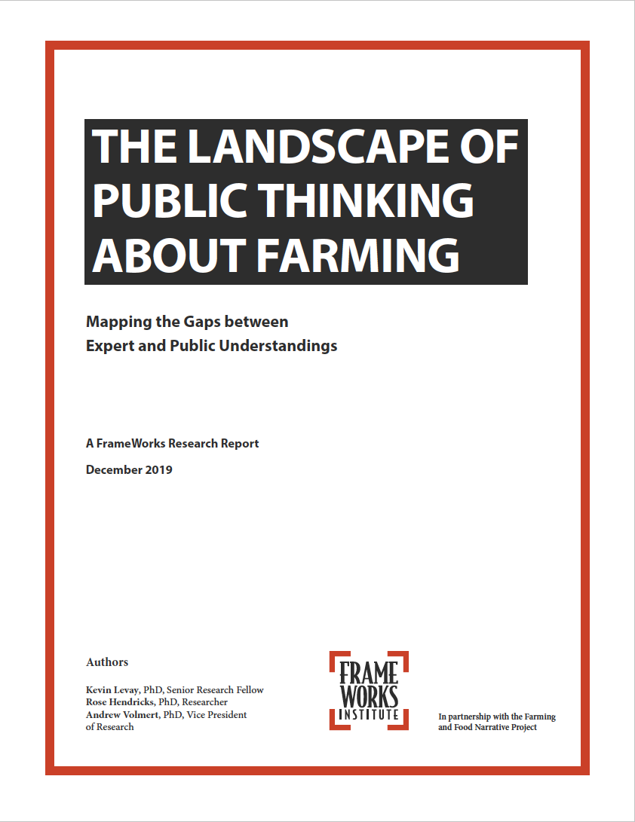
What is farming?
Why is farming important?
What are the challenges involved in farming?
How can farmers effectively meet the challenges of farming?
What should society do to help meet the challenges of farming?

Slide 5
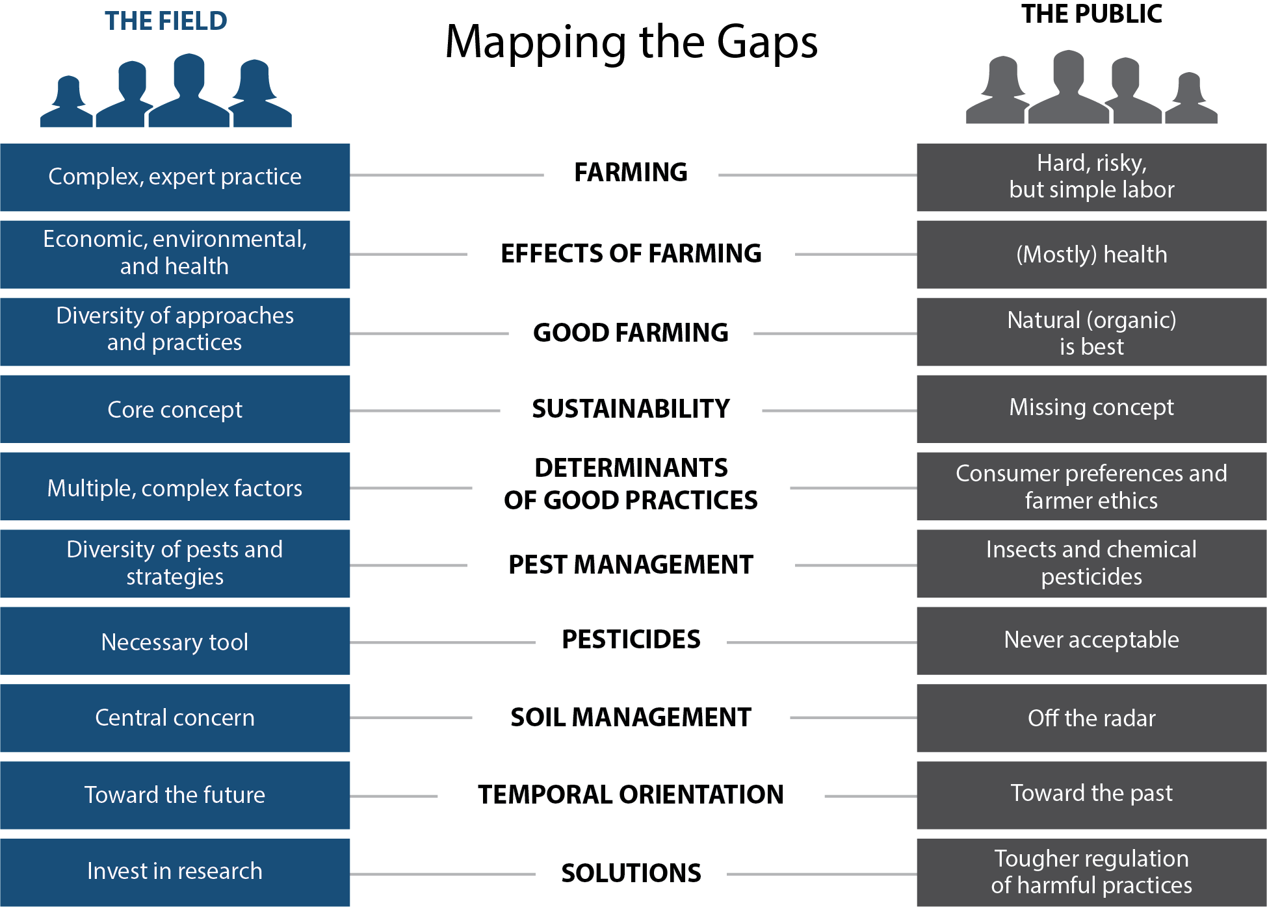

Slide 6
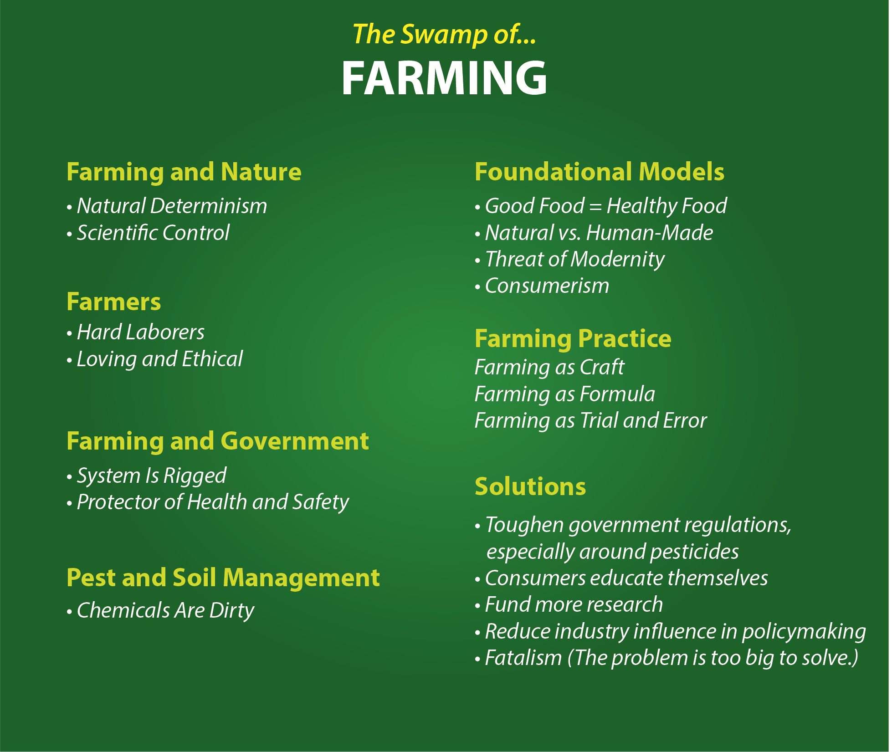

Slide 7
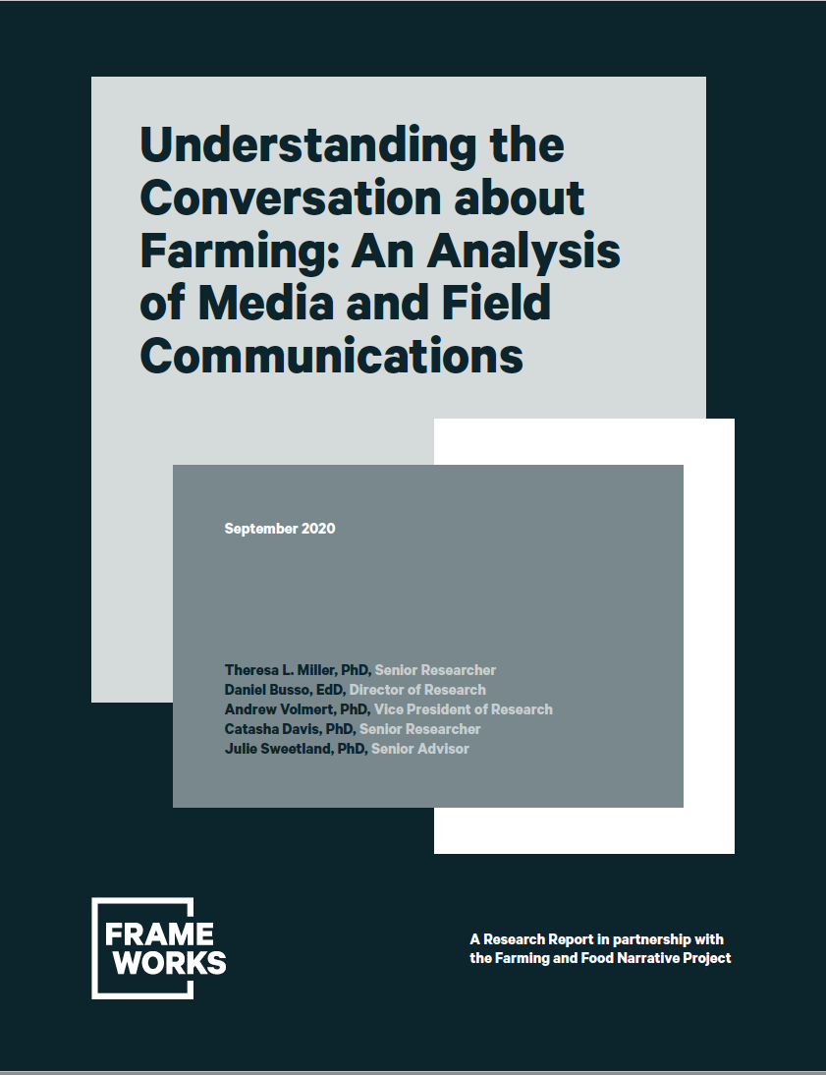
How are farming and its impacts portrayed?
How are farmers portrayed?
How is pest management portrayed?

Slide 8
General Takeaways
General media – Farmers are older, white males at the mercy of weather and macro-economic forces. Descriptions romanticized and nostalgic for a simple agrarian past.
Farming media – Describes farming using terms that are understood in the field but not by the public.
No-till farming, adaptive soil health systems, sustainability, science-based decision making, bioenergy feedstocks
Neither provide clear explanations of pest management practices.

Slide 9
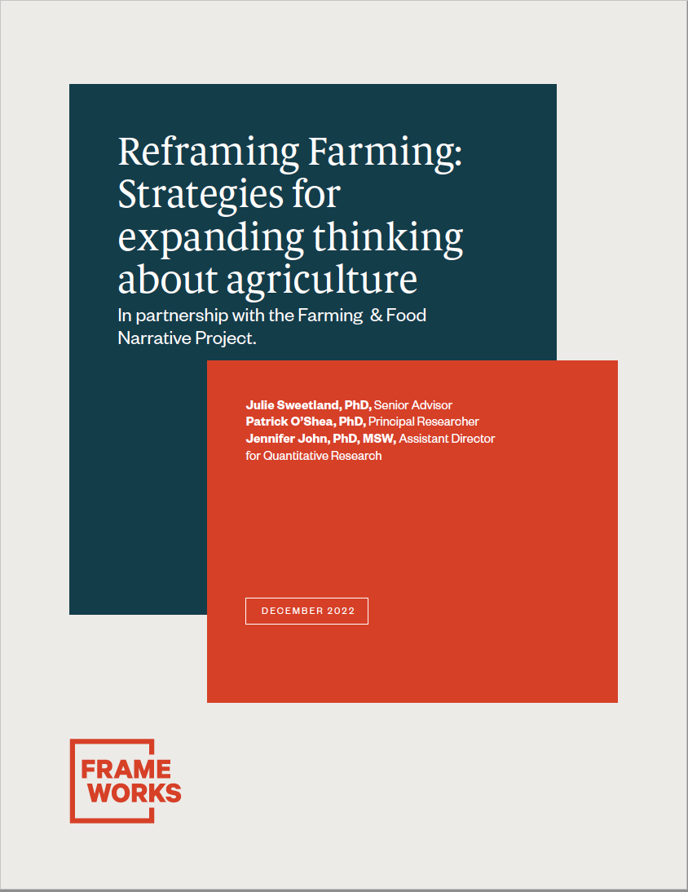

Slide 10
Recommendations
Start with farming, not food
Make the story about interconnection
Show how adjusting farming practices and policies can contribute to the type of communities we want
Talk about the tightrope that farms must cross
Tell science-rich stories about innovative practices on farms
Speak directly to historic and contemporary inequities

Slide 11
Tightrope Metaphor
Can help explain risky, complex decision making in farming and how current policy and market conditions make balance more difficult
Testing showed the tightrope metaphor was “sticky”
Person to person communication
Helped people incorporate additional information to increase understanding

Slide 12
Pest Management Communication Is Difficult
Limit use of words with pest as a root
Be more specific – insect, disease resistant varieties, herbicide
Tell science rich stories (Appeals to curiosity and love of ingenuity)
Offer essential background
Provide examples of biological interventions
Talk about barriers or trade-offs
Provide a balanced, realistic solution

Slide 13
Take Aways
Be aware of common mental frames in the public and navigate them to achieve the purpose of your communication
Avoid triggering unproductive frames
Provide more context and detail in plain language
www.farmingandfoodnarrative.org

