Slide 1
Certification of Pesticide Applicators Regulation in the Time of COVID-19
2020 National IPM Coordinating Committee (NIPMCC)
October 21, 2020
Tom Smith
Executive Director

Slide 2
Challenges and Issues
States and Territories were not prepared for a shut-down of face-to-face testing and training
Most do not have online testing capabilities in place
Some specifically mandate in-person testing only
Issues:
How do regulators verify applicator identity?
How do regulators prevent applicators from using outside resources during online testing (manuals, internet, notes, cell phone, co-workers)?
Exam security - questions and answers “getting out”
Online recertification

Slide 3
University of Minnesota Extension
The UMN Extension PSEE project team (Linda Johns, Tana Haugen-Brown and Jolene Hendrix) distributed a survey in the spring of 2020 to all the PSEPs, SLAs, and Tribes that have pesticide applicator certiﬁcation and recertiﬁcation standards. The survey was designed as a mechanism to determine which states and tribes utilize an online portal system to conduct exams and/or recertiﬁcation workshops.
Funded by EPA Region 5

Slide 4
MN Survey Response
Since COVID-19 we are offering online testing for a Temporary Certification that expires on Oct 31st. The online tests are only a temporary band aid to get through the spray season. In-person testing is anticipated to resume at some point (when, I am not sure if anybody knows).
Three of the largest challenges to this online testing are:
The university's complicated and difficult registration system
Test security
Technological capabilities and modernization to process the data
The development of a secure, unified, easy to register testing service might be something that States might buy into. However, the unique diverse way this is handled in each state makes that very difficult. The tests themselves are very similar, but how that information is then processed, and the details therein make that hard.

Slide 5
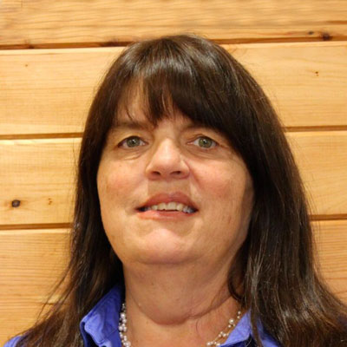
Kerry Richards NPSEC Education Program Developer
Review of providers
Description of services
Summary of security
Costs

Slide 6
American Association of Pesticide Safety Educators (AAPSE)
AAPSE Professional Development Webinar Series Session 1: The New Look of State Recertification Training July 28, 2020
AAPSE Professional Development Webinar Series Session 2: Obtaining Certification During a Pandemic August 18, 2020
AAPSE Professional Development Webinar Series: Exploring the Benefits of Computer-Based & On-line Testing Sept 29, 2020

Slide 7
Selected Individual State Responses
Minnesota, a workshop state (vs CEU hours state), went from virtually zero online recert year before COVID to 100% online fall 2019/winter 2020. Logistics are massive on both SLA and CES sides. MN SLA temporally lowered standards and reduced other required criteria for recert for content, quality and participant verification. Plan is to revert to prior standards/criteria after the pandemic. MN had leeway as we have some of the highest standard and criteria for recert in the US.

Slide 8
Michigan & Virginia
MI: In response to MDARD offering private pesticide applicator’s the opportunity to renew their RUP certification with an oral exam (by phone), MSU Extension educators created an online review for the private applicators . The webinar is 4 hours and 18 minutes long and follows the core manual chapters.
In Virginia, we call them "online training courses" generally. Then we break it down. The ones for folks to study for exams are "online prep courses" and the recertification courses are called just that "online recertification courses."

Slide 9
Utah & Washington
Utah: considering…producing/creating one-hour/one-credit CEU courses individuals can take online. We would want some way of making sure individuals are actually attending and paying attention to the class.
WSU: has been doing Internet Recertification Courses since 1996. They can be taken 24/7 but must meet a time-completion standard. We also offer Internet pre-license review courses 24/7 that do not have time constraints.

Slide 10
Ohio & Illinois
Ohio is an in-person testing and recertification state. However, there is a possibility that we may need to have some flexibility with some of our applicators moving forward (on recert at least).
In Illinois, new online testing is being offered on a limited basis. Essentially, they extended licenses where they could but still had situations where testing was still needed. They are using Web-Ex I believe to monitor test takers. New exams were created for this purpose. There are fewer questions and testing for general standards and specific categories are combined.

Slide 11
Certification and Training Assessment Group (CTAG)
Part of the Michigan State University – EPA Cooperative Agreement http://ctagroup.us/
CTAG is currently working in four areas :
Online exams
Label mandated training
Asynchronous online training (on-demand)
Synchronous training (live webinars)
http://ctagroup.us/current-issues/

Slide 12
Conclusions
States are all over the board for certification and recertification requirements, including online testing and recertification
COVID–19 threw a big curve-ball to an already confusing and complicated mix of state-specific requirements
Some states already had online testing options (most in-person, proctored computer test sites) and online recertification options
Some states that legally could are moving to remote online testing and recertification
EPA has not conclusively weighed in on these issues
Remote online technology is available, is secure and reliable, but state regs may impede adoption
Quality and engagement must be a priority for remote online recertification
CTAG will hopefully provide some guidance to state SLAs and PSEPs

