Slide 1
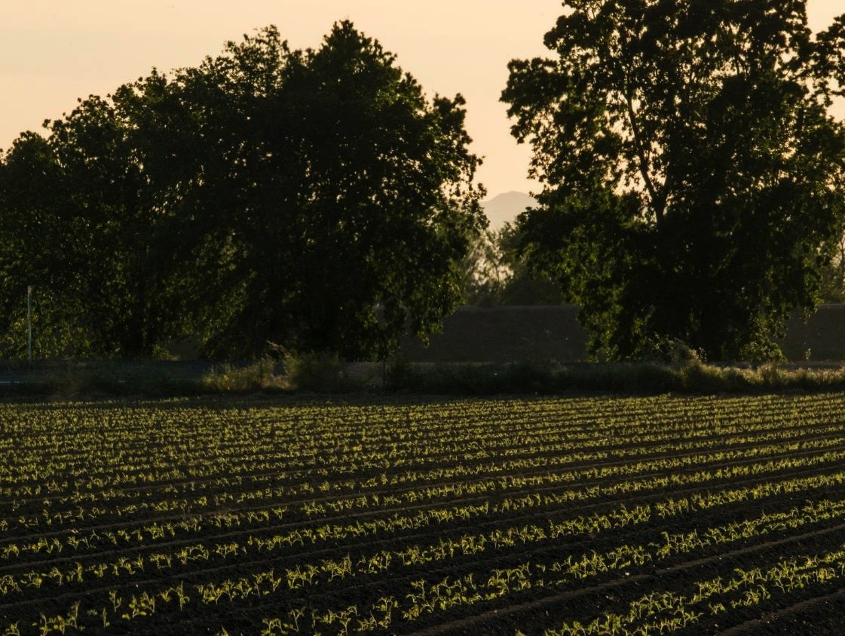

The Foundation For Food And Agriculture Research
Sally Rockey, Executive Director
Foundation for Food and Agriculture Research
@FoundationFAR | @RockTalking
2018 ESS/SAES/ARD | October 3, 2018

Slide 2
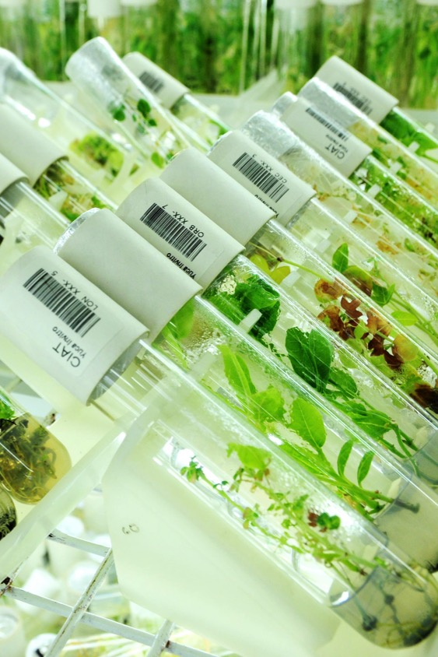

Agriculture is the place to be in these days in science!
Importance of the issues
Take fundamental knowledge almost immediately to application
New technologies often apply directly to agriculture before any other sector
Growing consumer interest in the food system

Slide 3

Burgeoning Fields for Ag
Advanced genetic technologies
Data Analytics
Imaging, drones, GPS
Block Chain
Whole system modeling
Artificial intelligence and deep learning
Rapid progress happens when our knowledge of how things work converges with technological advances to accelerate discovery
Notes:
We will see others coming in from other fields

Slide 4

Why is agricultural research funding not commensurate with its value in improving the quality of life?
“When it comes right down to it, food is practically the whole story every time.”
- Kurt Vonnegut, Galápagos

Slide 5
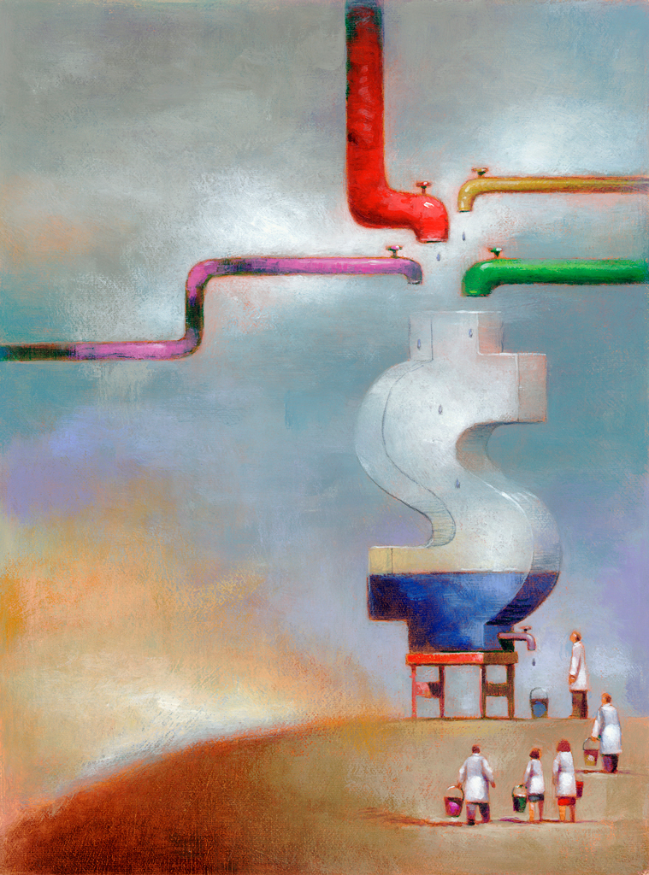
Funding for Agricultural Research:
How stagnant funding has led to new funding models and opportunity

Slide 6
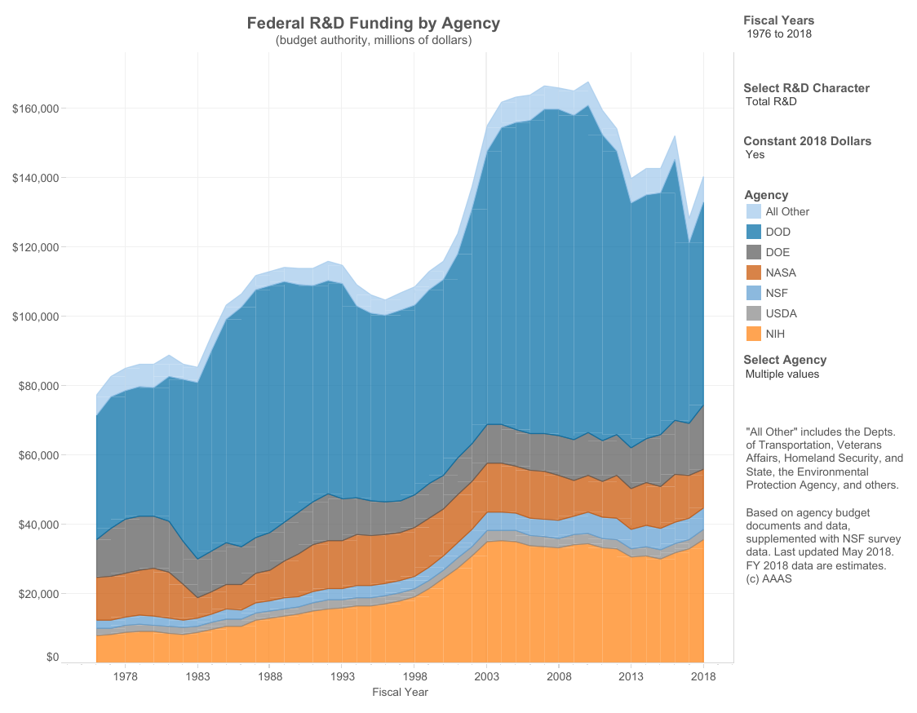
Notes:
This is a critical time for agriculture. We need to take advantage of the swirl of technology and innovation.
Source: AAAS Report:

Slide 7
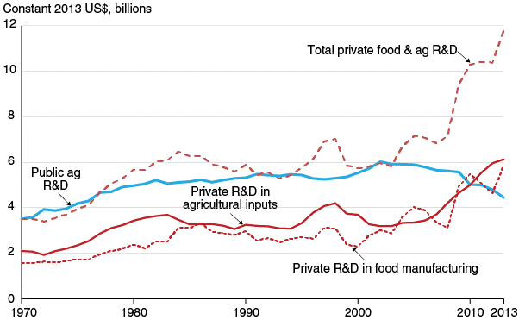
The FFAR model leverages private funds for public good
Opportunity
Source: USDA ERS
Notes:
(Focus on the top 2 lines on the graph)
You can see from the blue line that US public funding for agricultural R&D has been declining in recent years.
The red dotted line that inclines sharply at the top right of the graph is private funding for R&D – this is an opportunity.
FFAR is here to bridge the gap between declining public funds and increasing private investment.
We ask ourselves, how can we leverage this influx in private funding for public good? How can we ensure that this spike in private interest in agricultural R&D is lifting all ships? A lot of times the key is in the pre-competitive space.
[Annual spending on research is adjusted for inflation by ARS]

Slide 8
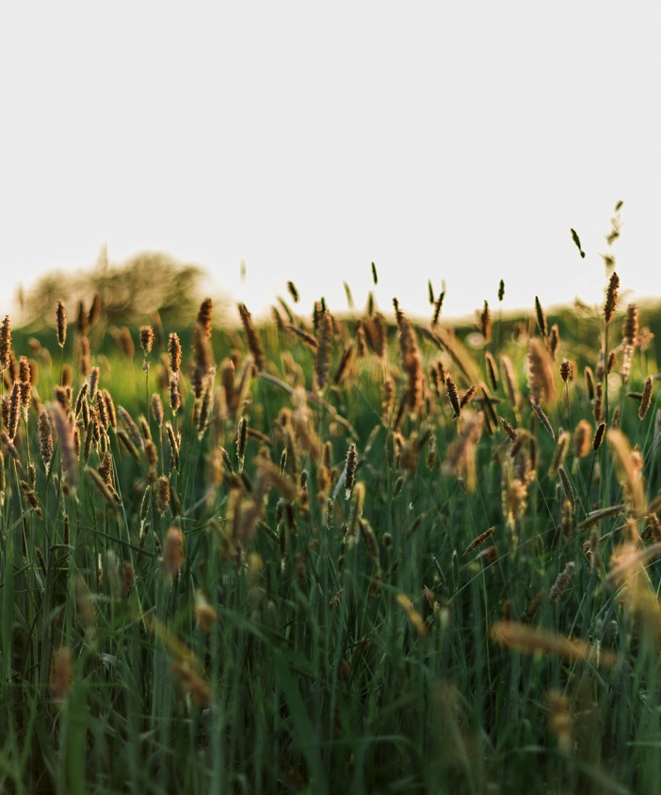
About FFAR
Nonprofit created through bipartisan congressional support in the 2014 Farm Bill
Governed by a Board of Directors, advised by expert Councils
FFAR complements the work of the USDA
Notes:
Very broad information about FFAR.

Slide 9
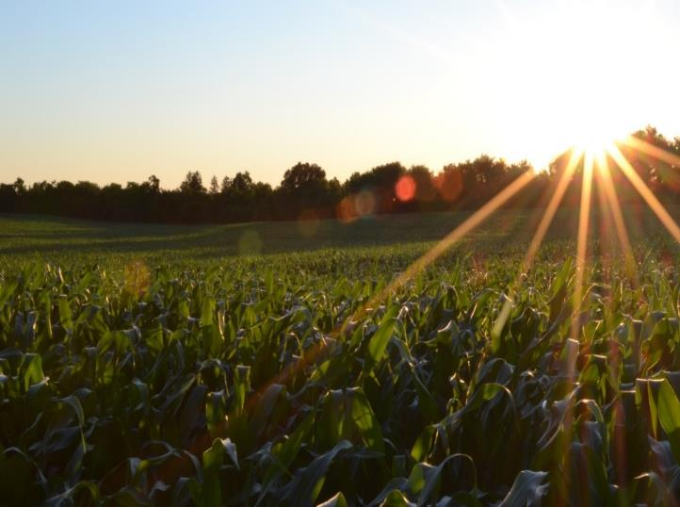
OUR VISION
We envision a world in which ever-innovating and collaborative science provides every person access to affordable, nutritious food grown on thriving farms.

Slide 10
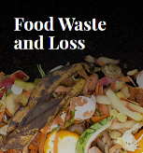

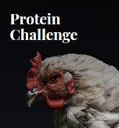
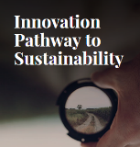

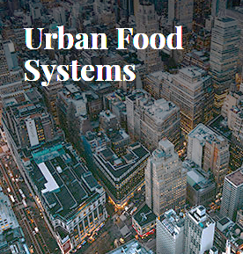
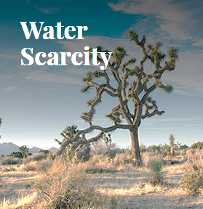
FFAR Challenge Areas
Notes:
These are FFAR’s grand challenges in agriculture.

Slide 11
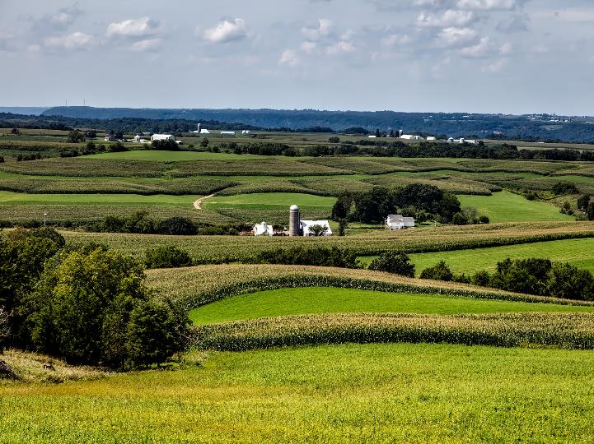

How We Work
$200M
+
$200M
FFAR
Investment
Non-Federal Match
Private-Public
Partnerships
“
We build unique partnerships to support innovative science addressing today’s food and agriculture challenges.
FFAR also brings together diverse groups that might not otherwise collaborate to solve big challenges
...the FFAR model delivers - and doubles the taxpayer's investment.
”
-Bob Stallman
Past President, American Farm Bureau Federation
Current FFAR Board Member
Notes:
Emphasize our private-public partnerships are built to achieve our vision.
Every $1 we spend is matched by $1 from a funding partner.

Slide 12

The FFAR Model
FFAR works directly and easily with private sector partners
Multiplying investment, currently matching each dollar invested with $1.40 from partners.
Filling gaps – can adapt quickly
Stakeholder input through Board and Advisory Councils
Flexibility and nimbleness
  FFAR can quickly pursue emerging issues.
  ROAR program fills a need for rapid response to pest and pathogen threats (Example: Grant to combat SWD in tart cherries)

Slide 13
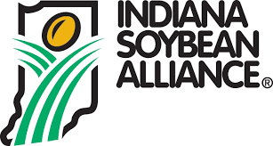







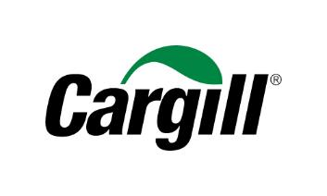

















Industry and Foundations
Notes:
This is a SAMPLING of the variety of partners that we work with to co-fund food and agriculture research. The majority of our matching funds are from foundations and private companies.
IF ASKED What is the difference between Donors and Funding Partners?
All funding partners provided matching funds for a research project whether or not that money was “donated” or given directly to FFAR.
Donors have contributed funding directly to FFAR, whether or not it’s used for a specific program. To date, the majority of donations have been for specific FFAR research programs.

Slide 14

How we work
1. Competitive RFAs
2. Direct Funds
3. Prizes

Slide 15

Major activities
Convene the community to set research agenda
Foster the next generation of ag scientists
Fund innovation through public-private partnership

Slide 16
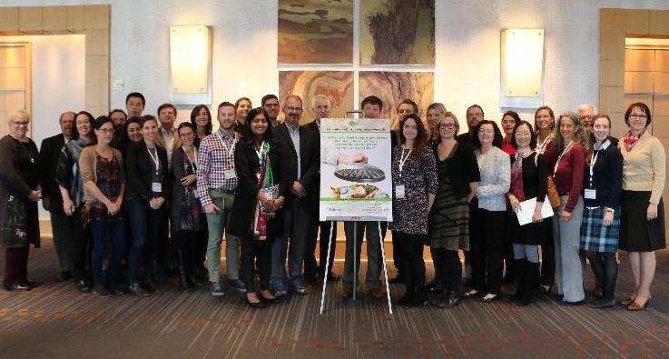
Convening Events
We bring experts and stakeholders to the table to inform research design and goals before launching programs.
Goal of FFAR-funded research: yield actionable outcomes
12 convening events in 2017
3 Events coming up
  Connection between Soil Health
    and Human Health
  Advanced in Gene Editing for Both Plants
  and Animals
  Growing Better Health
Notes:
Another example: we bring together scientists, producers, industry, and other stakeholders at our convening events. We want to find out where the biggest research gaps are that can yield actionable outcomes for produces and the food and ag industry.

Slide 17
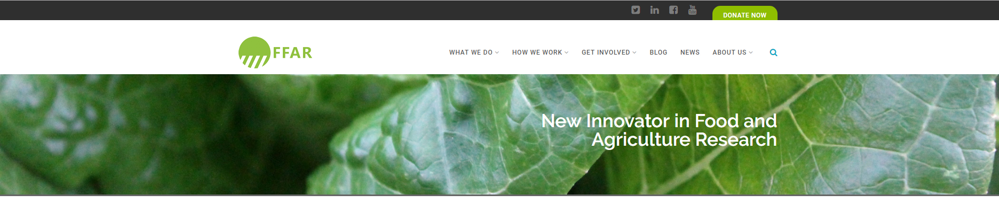
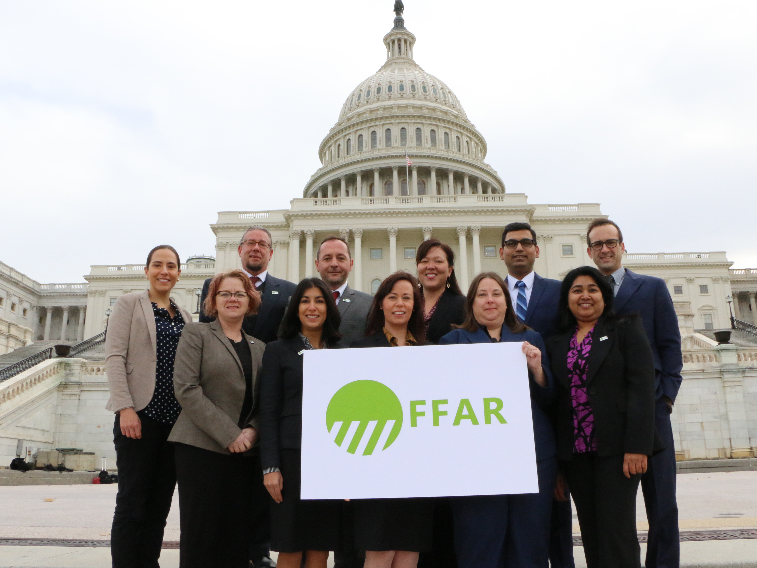

Slide 18
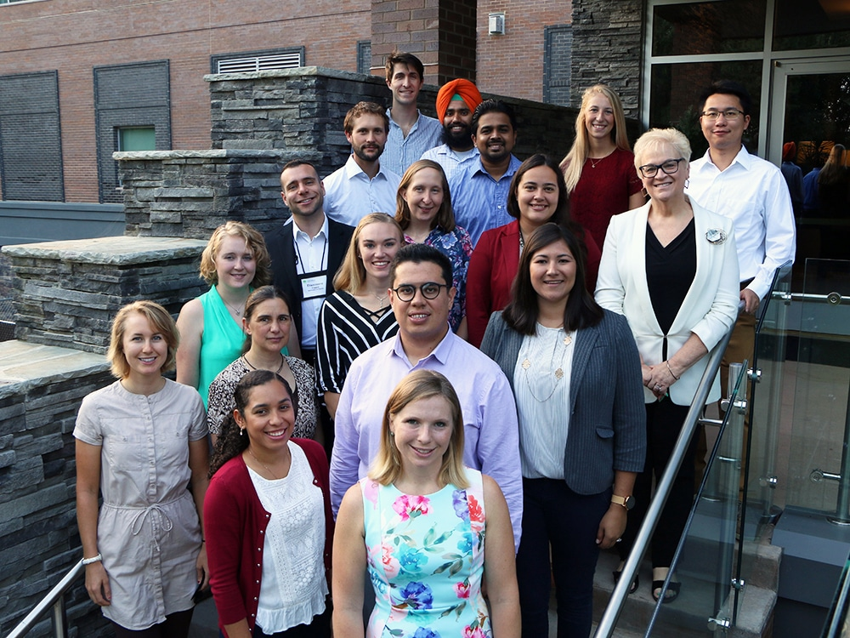
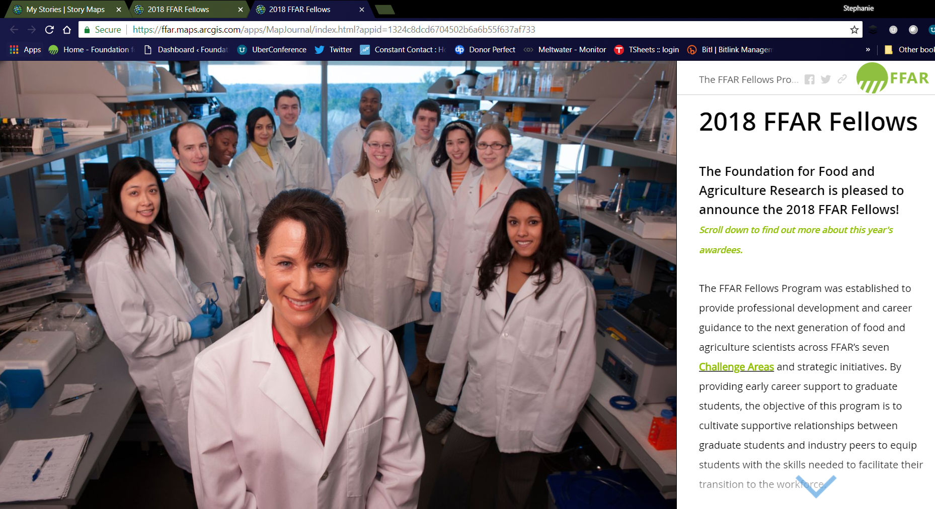

Notes:
Can click on this to show the Story Map. They will have a packet of information that has their own Story Map links.

Slide 19
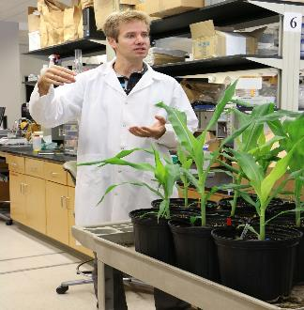
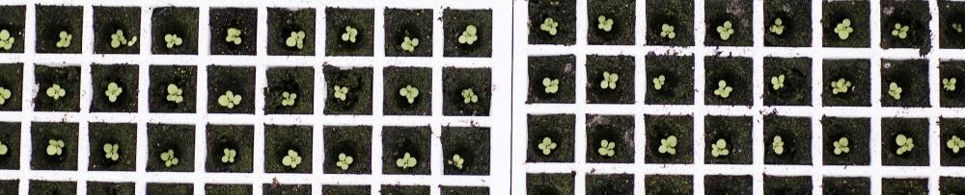
Realizing Increased Photosynthetic Efficiency (RIPE)
$45M Reinvestment in “Green Revolution 2.0”
University of Illinois researchers increased crop yield by 20% and decreased water use by 25%
Public-private funding supports work to develop (at least 20%) higher-yielding staple food crops: soybean, cowpea, cassava.
Funders: FFAR, Bill & Melinda Gates Foundation, U.K. Department for International Dev
Notes:
RIPE is harnessing photosynthesis to sustainably increase worldwide food productivity. Gold standard of public-private partnerships.
Institutions
University of Illinois
University of Essex
Lancaster University
Australian National University
Commonwealth Scientific and Industrial Research Organisation
Chinese Academy of Sciences-Max Planck Institute
University of California, Berkeley
Louisiana State University
USDA/ARS
(photo is tobacco seedlings from RIPE website)

Slide 20
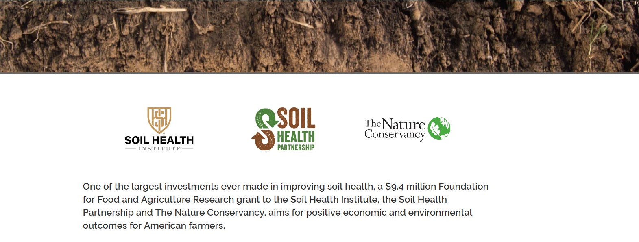





Slide 21
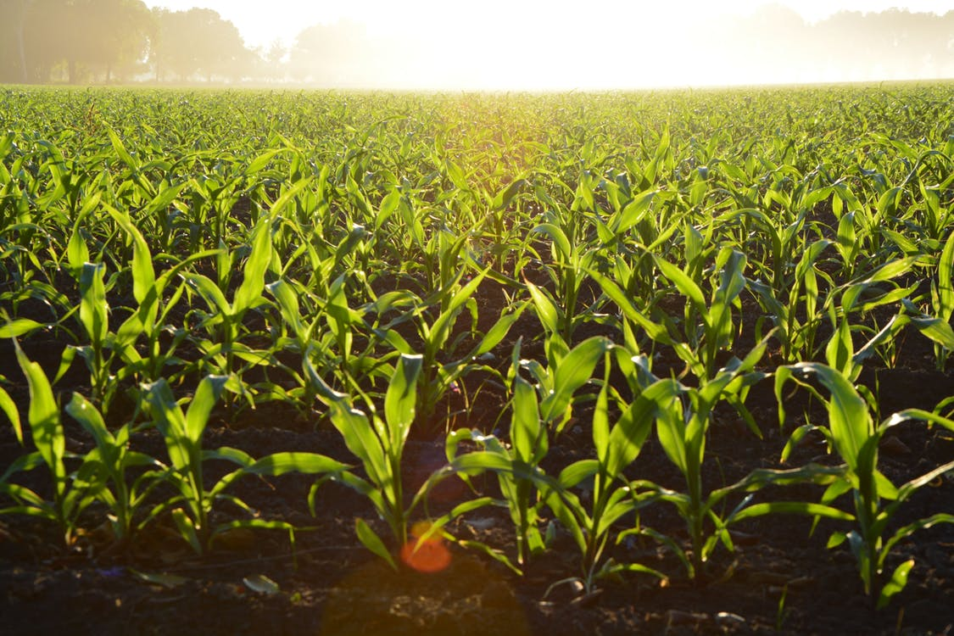
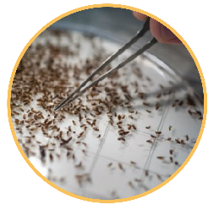
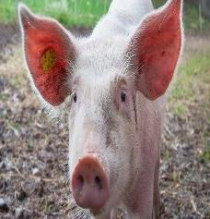

Programs
www.foundationfar.org/open-opportunities
Rapid Outcomes from Agricultural Research
Swine Health, Well-being and Productivity
Emergency funding for research and outreach that prevents or mitigates pest or pathogen damage.
Continuing Call for Applications
Up to $2 million available to improve swine survival rates during all stages of production. Project co-funded by National Pork Board.
Notes:
To date, FFAR has awarded nearly $1 million in rapid response funding to help farmers mitigate damage from pest and pathogen outbreaks.

Slide 22
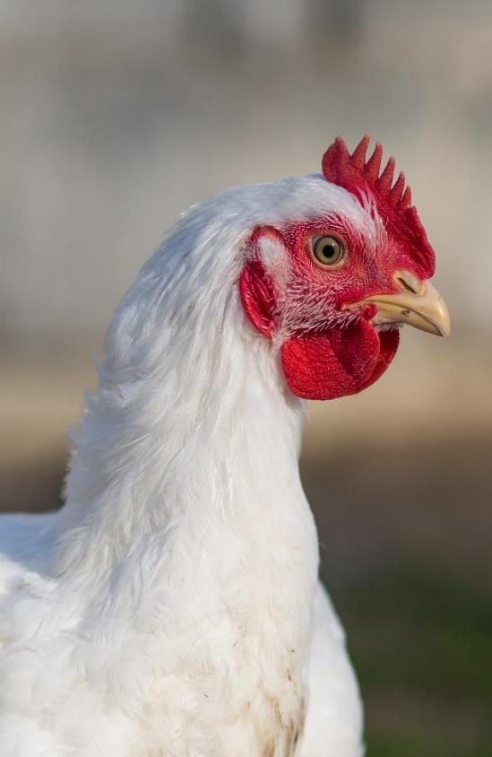
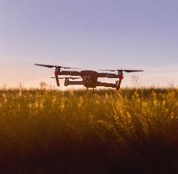
Commodity Programs
Enhancing Bone Health in Poultry
Seeding Solutions
Up to $1M to encourage the development of unique partnerships to support innovative and potentially transformative research focused on FFAR’s Challenge Areas.
$2 million to combat poor bone health in cage free environments Project co-funded by Open Philanthropy
Notes:
To date, FFAR has awarded nearly $1 million in rapid response funding to help farmers mitigate damage from pest and pathogen outbreaks.

Slide 23
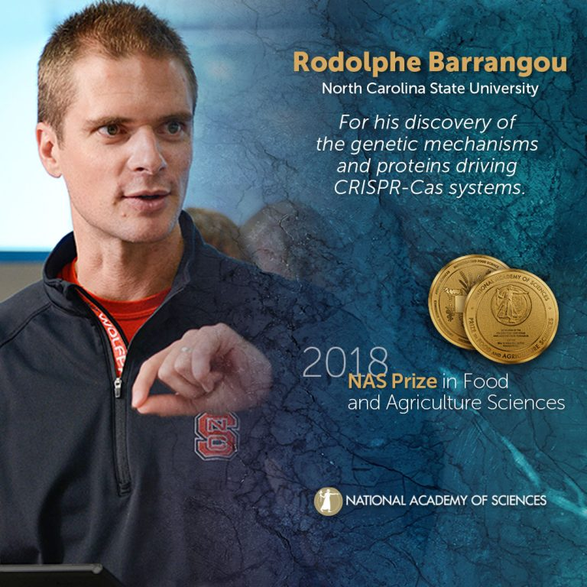


NAS Prize in Food and Agriculture Science
$100,000 prize
Endowed in perpetuity
Prestigious mid-career recognition
Notes:
We helped establish the first ever NAS Prize dedicated to food and agricultural science.
Dr. Ed Buckler was the inaugural winner for his groundbreaking work developing modified corn with increase vitamin A.

Slide 24


Founding Partners
Notes:
Examples of this New Model – This is an exciting example of the changing scientific environment where collaboration happens, even between would-be competitors
Idea started at an open convening event at Purdue University more than a year ago.
Executive Committee met for the first time in August and we expect launch the first research project before the end of the year.
Initial focus: Wheat, leafy greens, small grains, cross-crop technologies

Slide 25
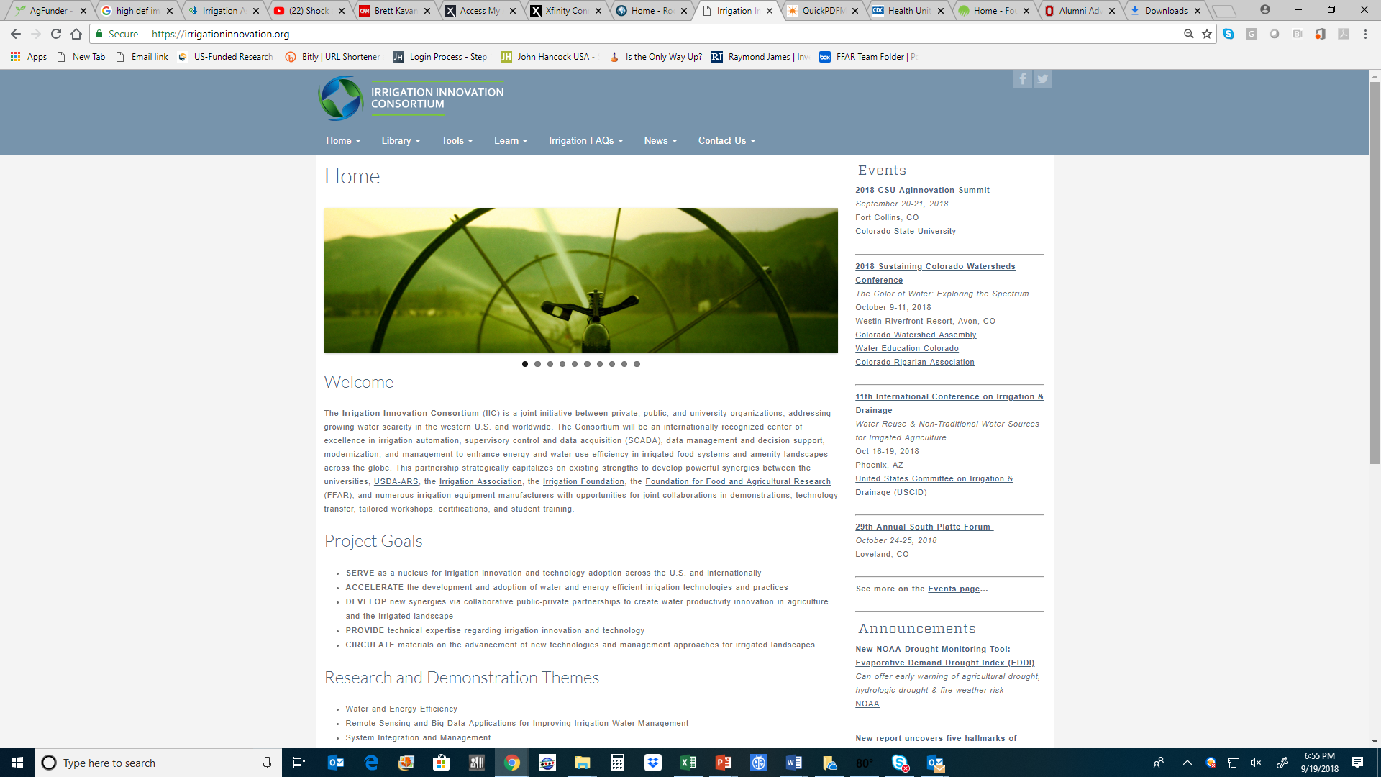
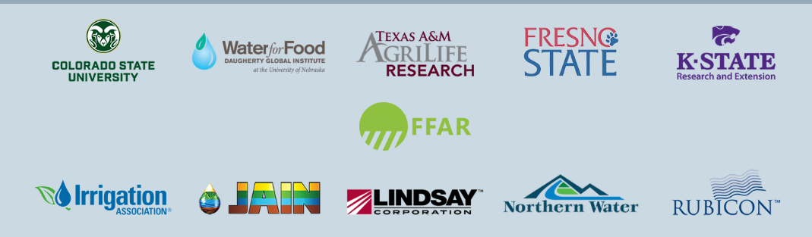

Slide 26



Slide 27

Foundations Involved in Science Funding
Dr. Miriam And Sheldon G. Adelson Medical Research Foundation
Rita Allen Foundation
Alliance For Cancer Gene Therapy
Laura And John Arnold Foundation
Alternatives For Research And Development Foundation
Bd Biosciences
Arnold And Mabel Beckman Foundation
William K. Bowes, Jr. Foundation
Brinson Foundation
Broad Foundation
Burroughs Wellcome Fund
Civilian Research And Development Foundation
Shurl And Kay Curci Foundation
Eppley Foundation For Research
Bill & Melinda Gates Foundation
Gatsby Charitable Foundation
Glenn Medical Research Foundation
Google
Gordon And Laura Gund Foundation
Heising-simons Foundation
Helmsley Charitable Trust
Lyda Hill Foundation
Howard Hughes Medical Institute
Charles E. Kaufman Foundation
Kavli Foundation
W.M. Keck Foundation
Kohlberg Foundation
Charles Lafitte Foundation
Macarthur Foundation
G. Harold And Leila Y. Mathers Charitable Foundation
James S. Mcdonnell Foundation
Ambrose Monell Foundation
Gordon And Betty Moore Foundation
M.J. Murdock Charitable Trust
Open Philanthropy Project Fund
David And Lucile Packard Foundation.
Research Corporation For Science Advancement
Robertson Foundation
Russell Sage Foundation
Schmidt Ocean Institute
Thomas And Stacey Siebel Foundation
Simons Foundation
Alfred P. Sloan Foundation
Templeton Foundation
Thrasher Research Fund
Welch Foundation
Wellcome Trust
Whitehall Foundation
USDA
CDC
FDA
FWS
NIH
CIA
NASA

Slide 28

The biggest threat to the future of the planet is not agriculture.
It is our inability to work together to apply the solutions we have at hand to the problems we all face.

Slide 29

The next 35 years is not just the most important 35 years
in the history of agriculture.
It is the most important 35 years there will ever be
in the history of agriculture.

Slide 30


Thank You
Dr. Sally Rockey
Executive Director
Foundation for Food and Agriculture Research
srockey@foundationfar.org
@RockTalking
Connect with FFAR
www.foundationfar.org
@FoundationFAR

