Slide 1
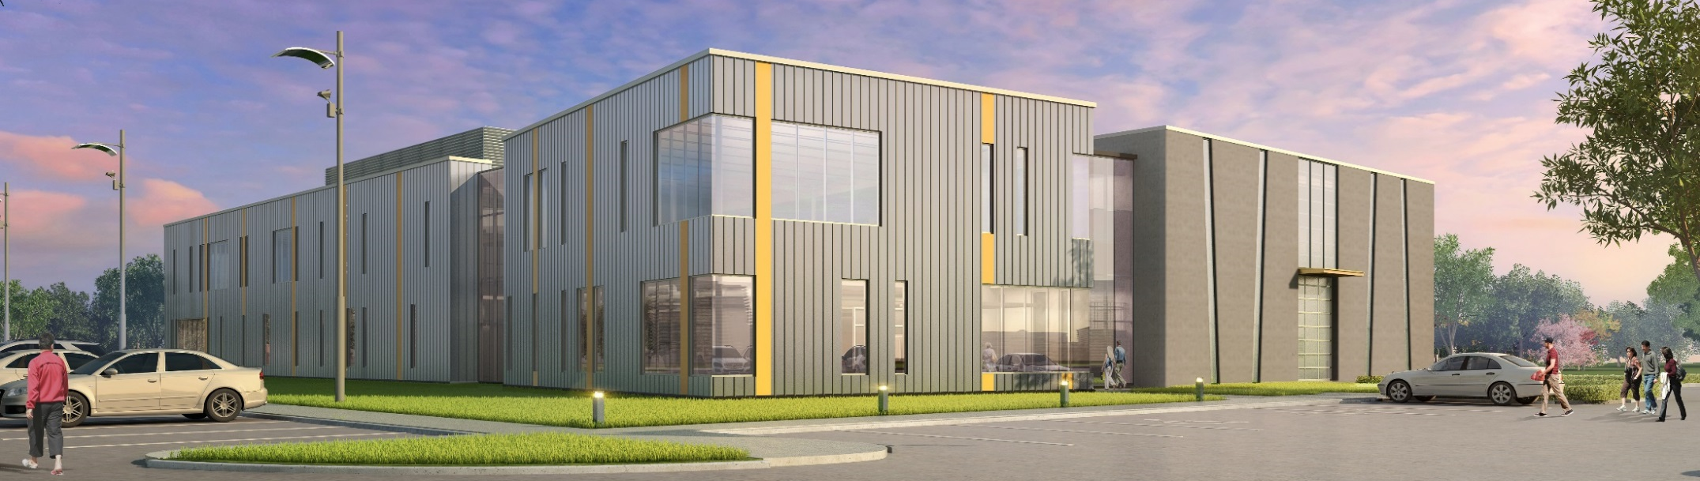
Partnerships for a Diversified Funding Portfolio
Bill Adamowski
President, ISU Startup Factory
Co-PI, ISU I-Corps Site

Slide 2
Personally I feel that University Research & Innovations represent
The Opportunity of Our Lifetime

Slide 3
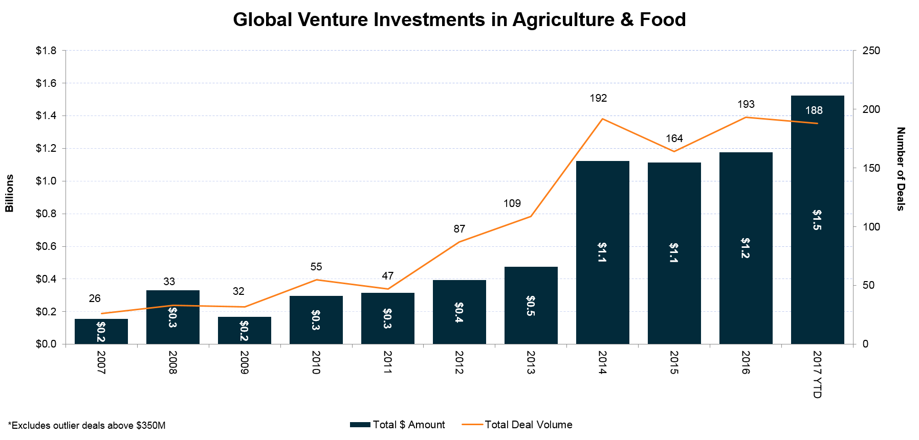
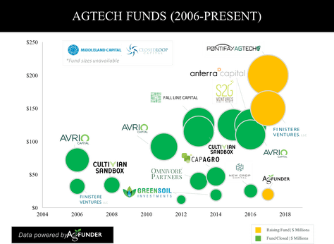
While Government funding is Decreasing
Private Investments in Agriculture & Food are Increasing
Large & significant opportunities in ag & food are driving investment capital. There is money to be made.
Involved in several fund-raising initiatives.

Slide 4
Entrepreneurship as Alternative Funding Source How to take advantage of this trend…
Sources of Funding
Basic
Research
Translational
Research
Proof of Concept
Business Formation
Expand and Scale
IPO/M&A
Government Funded University Research
I-Corps
SBIR STTR
Angel Investment
Venture Capital / Institutional

Slide 5
Entrepreneurship as Alternative Funding Source How to take advantage of this trend…
Sources of Funding
Basic
Research
Translational
Research
Proof of Concept
Business Formation
Expand and Scale
IPO/M&A
Government Funded University Research
I-Corps
SBIR STTR
Angel Investment
What you do in these areas impacts directly the amount of University Research dollars coming in… both Federal and State
Venture Capital / Institutional

Slide 6
I-Corps Program
Great First Step in the Journey of Private Capital
NSF Innovation Corps (I-Corps)
The National Science Foundation (NSF) I-Corps program prepares scientists and engineers to extend their focus beyond the university laboratory, and accelerates the economic and societal benefits of NSF-funded, basic-research projects that are ready to move toward commercialization.
Through I-Corps, NSF grantees learn to identify valuable product opportunities that can emerge from academic research, and gain skills in entrepreneurship through training in customer discovery and guidance from established entrepreneurs.
Sources of Funding
Basic
Research
Translational
Research
Proof of Concept
Business Formation
Expand and Scale
IPO/M&A
Government Funded University Research
I-Corps
SBIR STTR
Angel Investment
Venture Capital / Institutional

Slide 7
Additionally
Awarded NSF I-Corp’s Site
30 Researchers Testing the Entrepreneurial Waters Annually
Goal is to create sustainable pipeline from this activity
Research to Full Company Launch Continuum
Agriculture
5 Startups
National I-Corps
5 Startups
Startup Factory Business Accelerator Program
Startup Factory Individual Development Plan
Engineering
30 Research Oriented Potential Startups
I-Corps Site
20 Startups
Startup Factory I-Corps
15 Startups
20 Startups
CBIRC
Others
4 Week Customer Discovery
8 Week Full Customer Discovery
18 Week Business Accelerator Program
26 Week Individualized Development Plan
Existing Research Establishment
“Current Gap” Research to Commercial Relevance
Startup Factory 52 Week Program

Slide 8
SBIR – STTR
Great funding source from Research to Commercialization
SBIR / STTR
The Small Business Innovation Research (SBIR) program is a highly competitive program that encourages domestic small businesses to engage in Federal Research/Research and Development (R/R&D) that has the potential for commercialization.
Sources of Funding
Basic
Research
Translational
Research
Proof of Concept
Business Formation
Expand and Scale
IPO/M&A
Government Funded University Research
I-Corps
SBIR STTR
Angel Investment
Venture Capital / Institutional

Slide 9
SBIR / STTR
The program’s goals are four-fold:
Stimulate technological innovation.
Meet Federal research and development needs.
Foster and encourage participation in innovation and entrepreneurship by women and socially or economically disadvantaged persons.
Increase private-sector commercialization of innovations derived from Federal research and development funding.
Phase I: $100,000
Phase II: $600,000
Phase I: $225,000
Phase II: $750,000

Slide 10
Angel Investment
Angel Investment
An angel investor (also known as a business angel, informal investor, angel funder, private investor, or seed investor) is an affluent individual who provides capital for a business start-up, usually in exchange for convertible debt or ownership equity.
Sources of Funding
Basic
Research
Translational
Research
Proof of Concept
Business Formation
Expand and Scale
IPO/M&A
Government Funded University Research
I-Corps
SBIR STTR
Angel Investment
Venture Capital / Institutional

Slide 11
Venture Capital
Institutional Investors
Venture Capital / Institutional
Venture capital is financing that investors provide to startup companies and small businesses that are believed to have long-term growth potential. Venture capital generally comes from well-off investors, investment banks and any other financial institutions. However, it does not always take just a monetary form; it can be provided in the form of technical or managerial expertise.
Sources of Funding
Basic
Research
Translational
Research
Proof of Concept
Business Formation
Expand and Scale
IPO/M&A
Government Funded University Research
I-Corps
SBIR STTR
Angel Investment
Venture Capital / Institutional

Slide 12
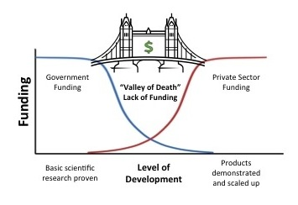
A very intense 52 week program that takes a startup from “out of the lab” to investor ready.
Team in place (Management, Board, Advisors, Mentors, etc)
Business Model Validated
Sales Process Implemented
Initial Customer Signed & Implemented
Initial Product Developed
Investor Pitch Refined
Revenue Break-Even or Capital Raised

Slide 13
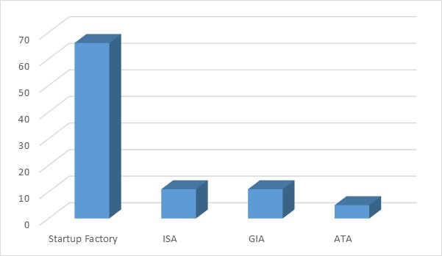
Huge Success in First Two Years
In our First 2 Years:
World-Class Purpose Built Facility
Groundbreaking “Super-Accelerator” Program
Over $20 million in venture financing and growing
#1 – Most Startups in the State
#1 – Most SBIR Phase I Awards
#1 – Most SBIR Phase II Awards
#1 – Most Seed Financings
Winner – Pappajohn Business Plan Competition
Winner – SBIR Pitch Competition
Winner – IdTechEx Materials Development Award
Winner – TAI Women of Innovation Award
Winner – Entrepreneurial Investment Award
Winner – NSF I-Corps Site Award
Winner – EDA i6 Challenge Award
Huge Momentum
SuperTeam of Mentors & Teaching Team
Funding from the University
Funding from the State
Funding from Corporate Sponsorships
Funding from Individual Sponsorships
Two years ago we had:
No Facility
No Acceleration Program
Few Startups
No Momentum
Little to No Venture Financing
No Mentors/Teaching Team
No Funding for Program
#1 in the State

Slide 14
Huge Success in First Two Years
Raised about $20 Million So Far in Venture Funding (remember this is Early Stage – Seed Financing)
Funding and Award Highlights
36 I-Corps Site Teams
5 I-Corps National Teams
10 SBIR Phase I Award Winners
4 SBIR Phase II Award Winners
8 Proof of Commercial Relevance Fund (State)
6 Demonstration Fund (State)
14 Angel Investment Rounds
4 Institutional Investment Rounds
More in the works!
SmartAg $5,000,000 Stine
Gross-Wen $2,000,000 Doerfer
Tractor Zoom $1,000,000 Angels
Structurely $ 800,000 Ames Seed Capital

Slide 15
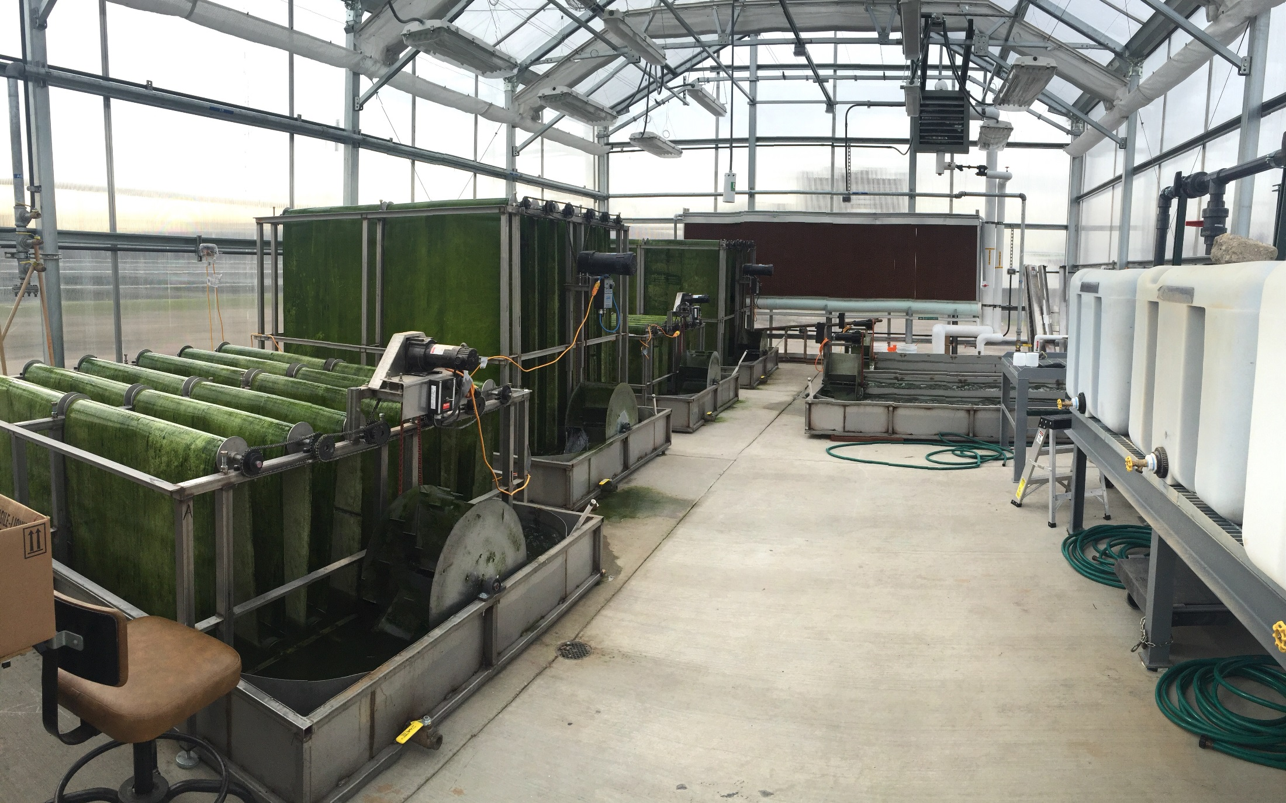
Cross Over

Slide 16
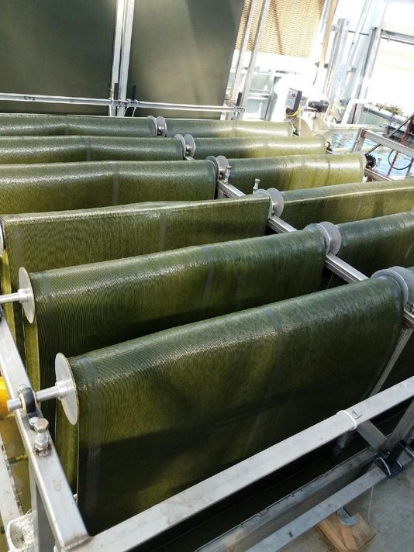
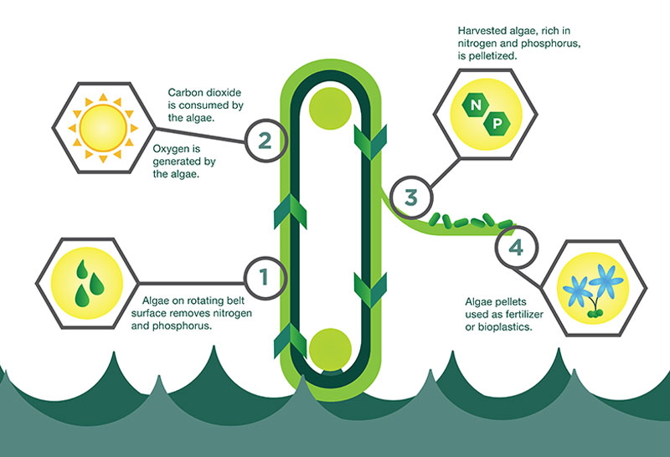
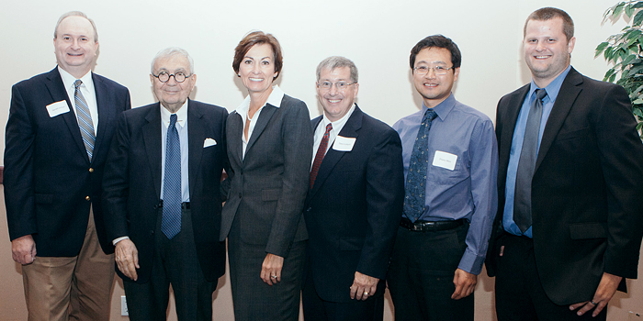
Cross Over
I-Corps Site
Startup Factory Program
SBIR Phase I $100,000
SBIR Phase II $600,000
State (Demo Fund) $100,000
Angel Investment $500,000
SBIR Phase I $100,000
Institutional Investment $2,000,000
Visibility at State level

Slide 17
Providing Automated Systems to Row Crop Farms
I would pay you $50,000 right now if I could run my grain cart without an operator.
Lowell Garret, Adel, IA

Slide 18
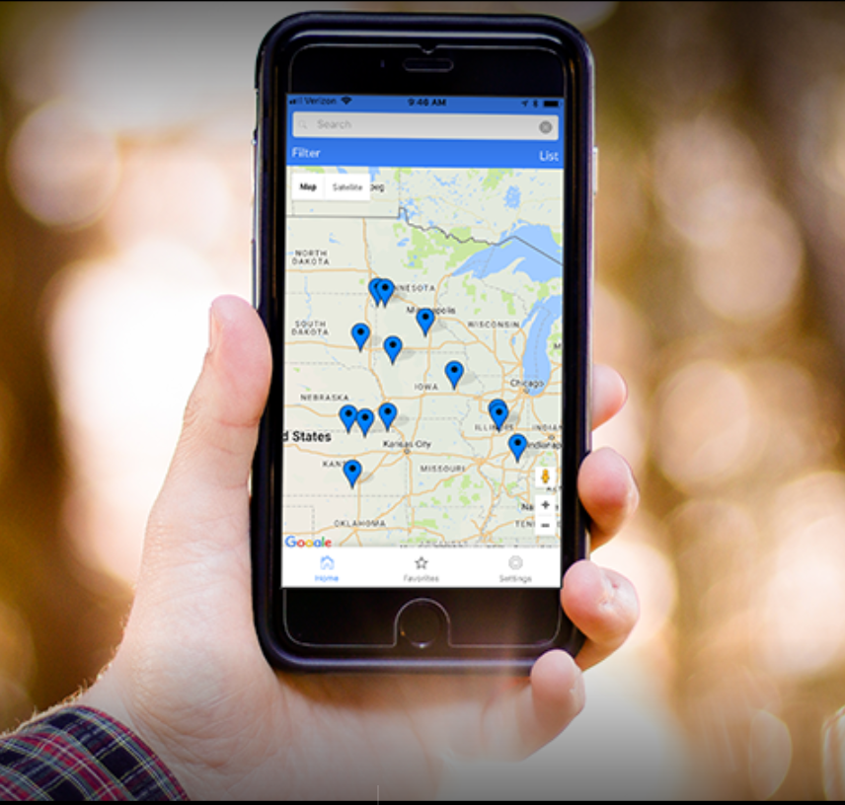
Making local auctions searchable
Real-time information on Equipment Sales and Values
Just closed $1,000,000 Angel Investment Round

Slide 19
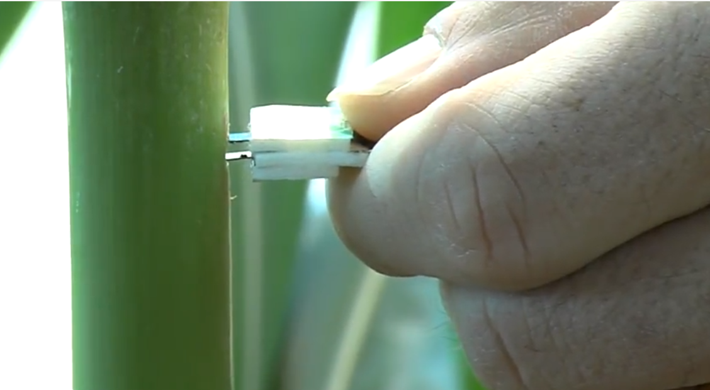
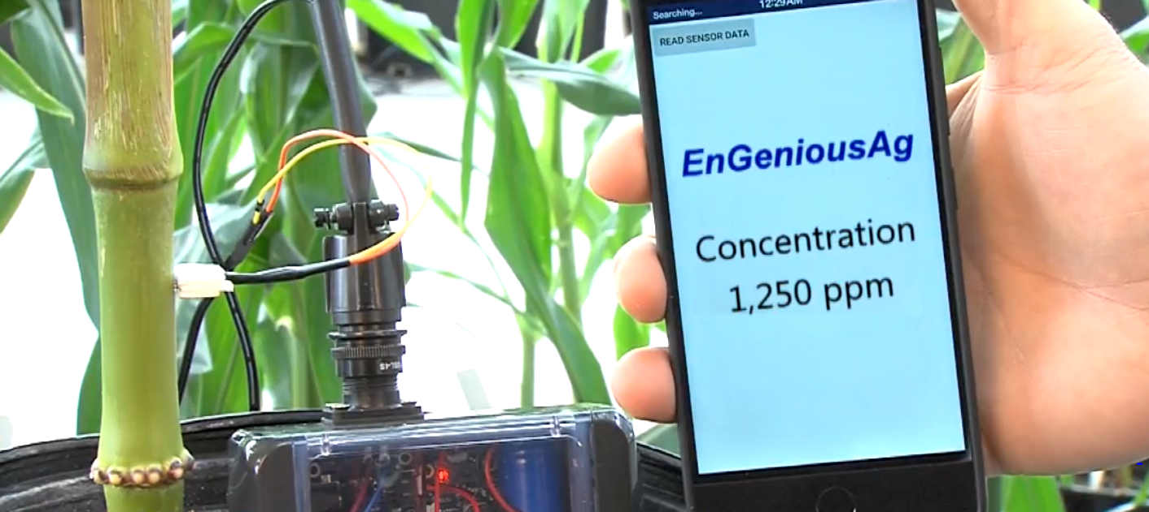

Slide 20
Real-time nitrogen sensing in the soil.
Apply the right amount in real-time.
High Pressure Aeroponics and Artificial Intelligence
Vertical Indoor Farming
Real-time salmonella detection utilizing a graphene based sensor

Slide 21
Other Agricultural Startups
from various “colleges” and the community

Slide 22
Going along with the theme of Pursuing Partnerships
Capital is the easy part. There’s plenty of investment money.
The challenge is in “Connections”
Getting the right Customers
Getting the right Advisors
Getting the right Data (studies / research)
Developing a collaboration between several Universities that want to work together to increase opportunities, increase access to capital and access to programming.
If you are interested please give me your business card or contact me
Bill Adamowski
ski@iastate.edu

