Slide 1
Update May 11. 2023

Slide 2
Why a IPM Survey?
To identify funding and resource gaps at the state level and as a data set to advocate for increased funding
To create a baseline for future analyses
To promote the idea that IPM is infrastructure important to the future of society

Slide 3
How?
Completed by state or territory IPM coordinator
Representative not exhaustive
Standardized by population and NASS commodities
Consulted other data sources NAS, NPDN etc
Smartsheet survey form
Analyses pending

Slide 4
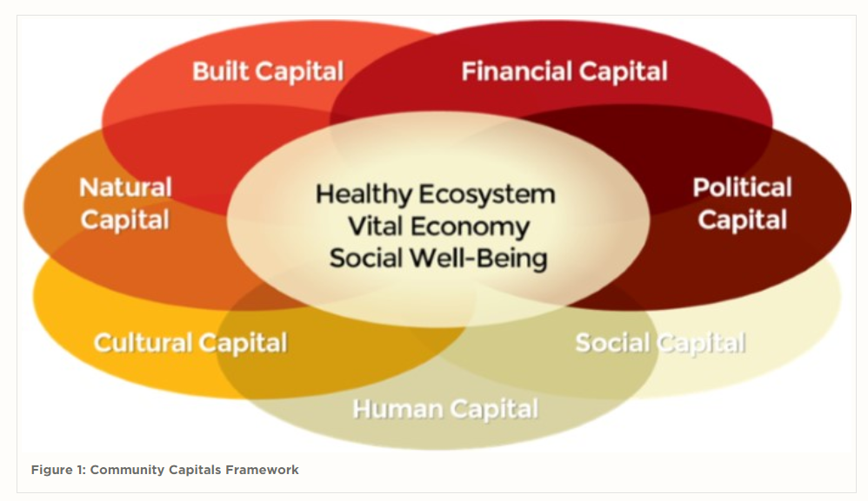

Slide 5
Human
Cultural
IPM
Infrastructure
Physical
Social
Natural
Economic
Stakeholder

Slide 6
Training next generation IPMers
IPM Tools/information
Human
Cultural
Reduced economic, environmental and human health risks
IPM
Infrastructure
Physical
IPM Networks
Social
Natural
Economic
Stakeholder
IPM Awareness
IPM Funding

Slide 7
Human
Cultural
IPM
Infrastructure
Physical
Social
Natural
Economic
Stakeholder

Slide 8
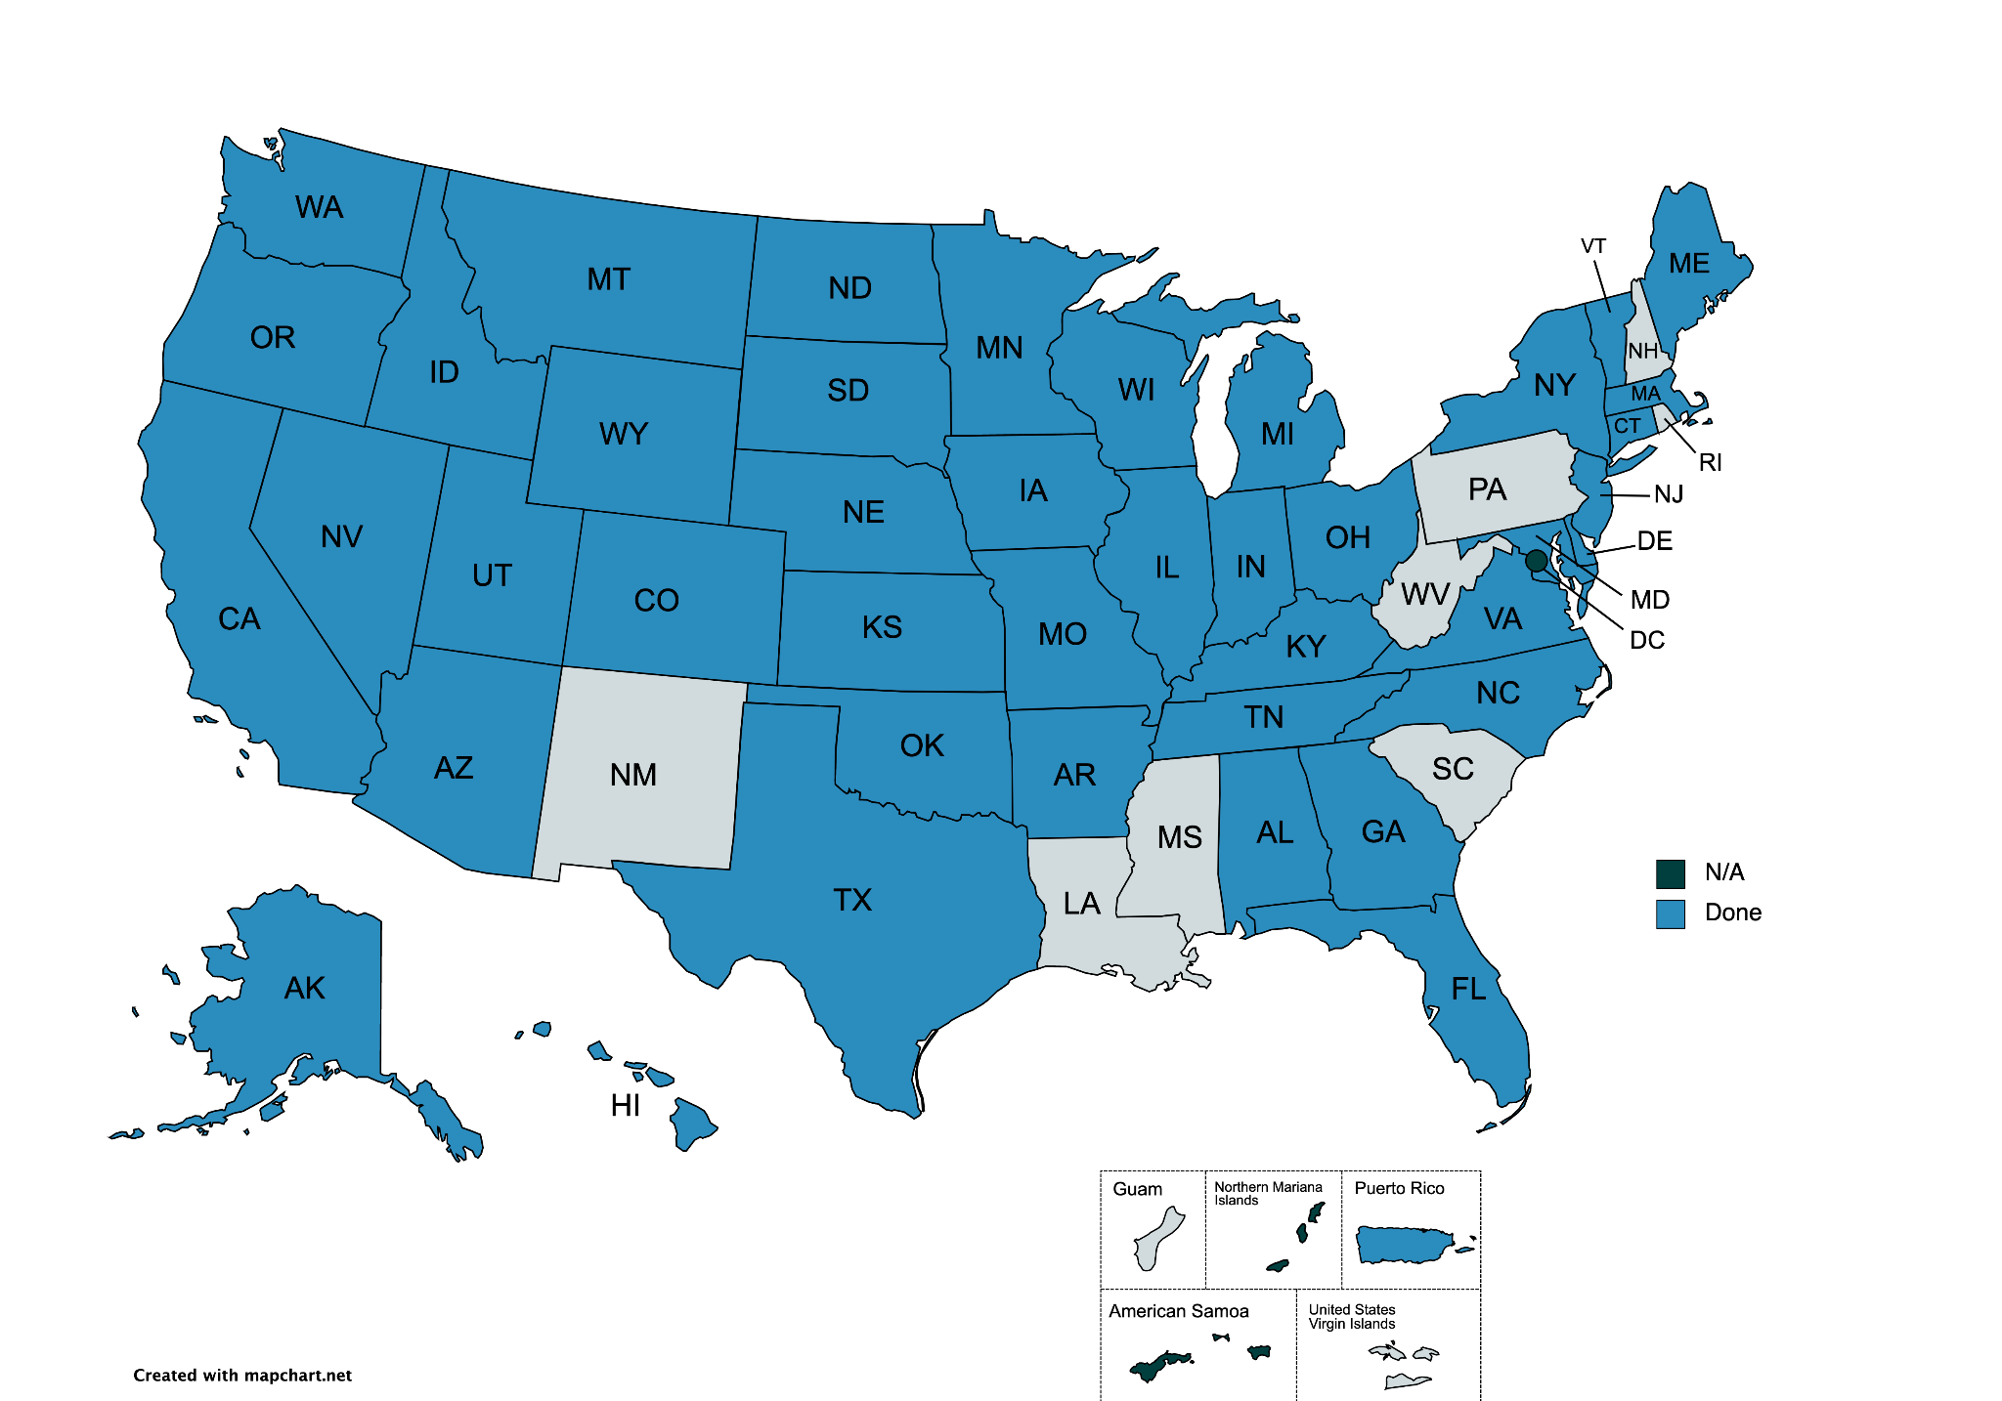
January 31 June 1 Deadline

Slide 9
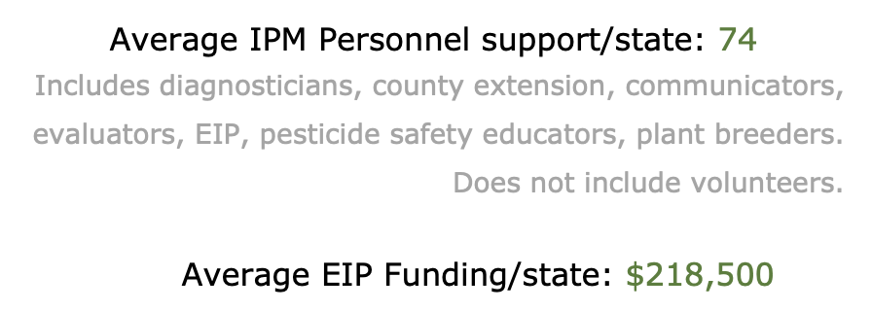

Slide 10
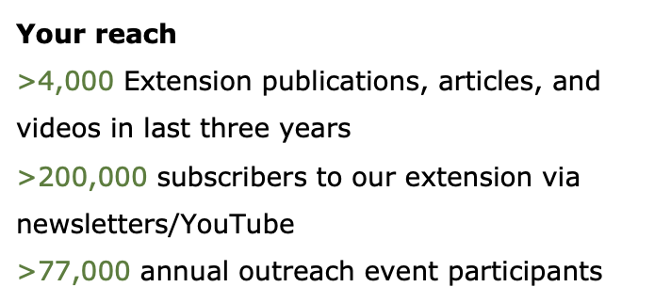

Slide 11
Need feedback from you all!
Let us know what information you would like to see as part of the analysis.

