Slide 2
Eco-efficiency update
Roger Magarey
NIPMCC Virtual Meeting
May 11, 2023

Slide 3
ECO-EFFICIENCY
R&D

Slide 4
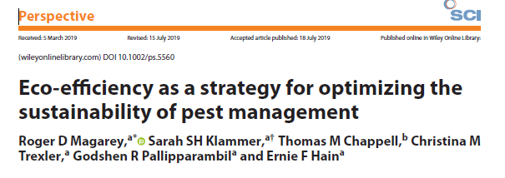

Slide 5
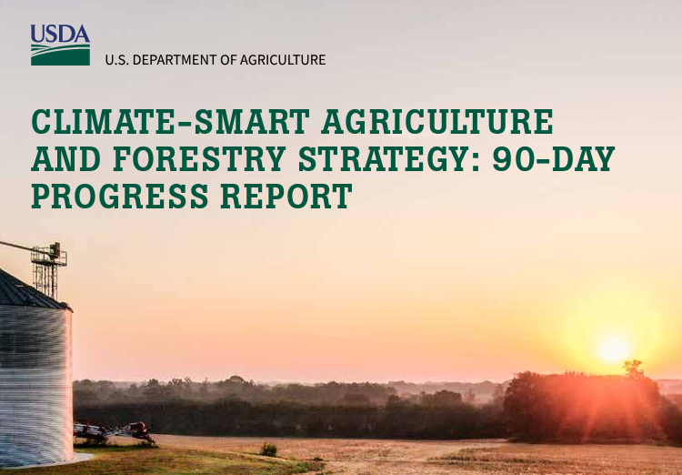

Slide 6
Ecoefficiency
Proposed Special Issue in Frontiers in Insect Science on Eco-efficiency in pest management
Identify promising eco-efficient practices/ and priorities and research, extension and regulation.
Descriptions of tools to assist stakeholders in quantifying impacts and selecting eco-efficient practices.
Studies that track implementation and quantify benefits of eco-efficient practices.
Methods for quantification, monitoring, and verification of eco-efficient practice.
Research, regulatory, extension or policy papers on improving eco-efficiency in pest management.

